Slide 1
French and Indian War! Or Seven Years War 1754 - 1763

Slide 2
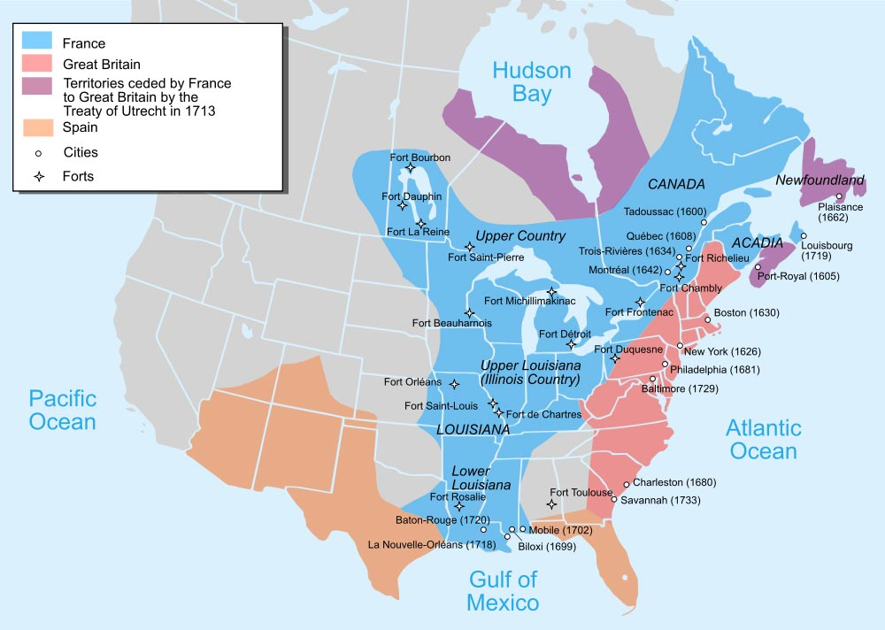

Slide 3
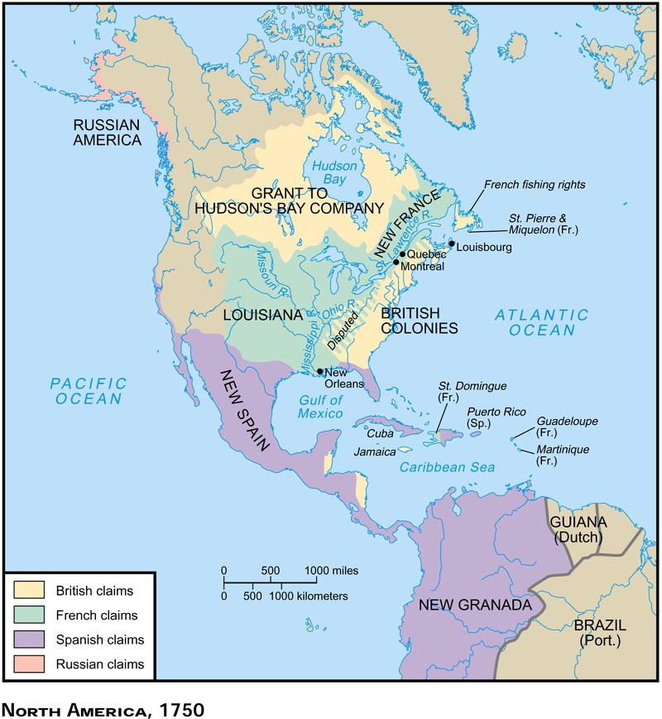
Conflict over which land led to the skirmishes that resulted in the French and Indian War?
France and England - competing claims in North America.
French trapping and trade routes in the Ohio Valley.
English colonies spreading west (tobacco) conflicted with these
Struggle for the important Ohio River Valley and Pittsburg
Virginian land speculators – G. Washington
→ conflict 1754 and defeat of GW

Slide 4
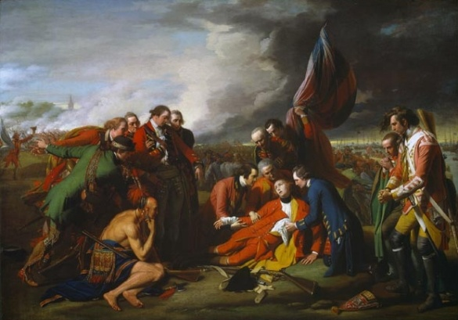
In what way was the French and Indian War or the Seven Years War a world war?
A. fought in Europe, America, the West Indies, Africa, and the Philippines.
“America was conquered in Germany.
The basis of England’s control of India resulted
Iroquois and English/Huron and French
In America the most important fighting = Canada. Quebec under Montcalm fell to Wolfe in 1759. A TREMENDOUSLY IMPORTANT VICTORY. ENSUREDTHAT CANADA WOULD BE GIVEN TO ENGLAND.

Slide 5
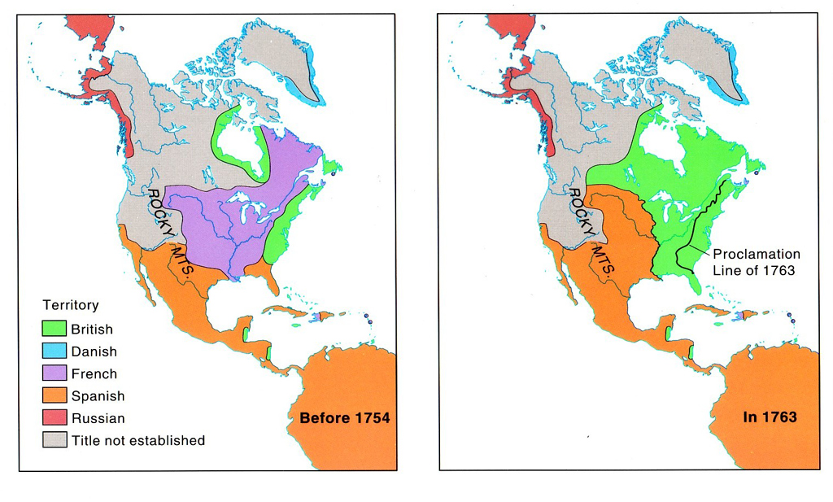
The French and Indian Wars transformed the map of America. How?

Slide 6
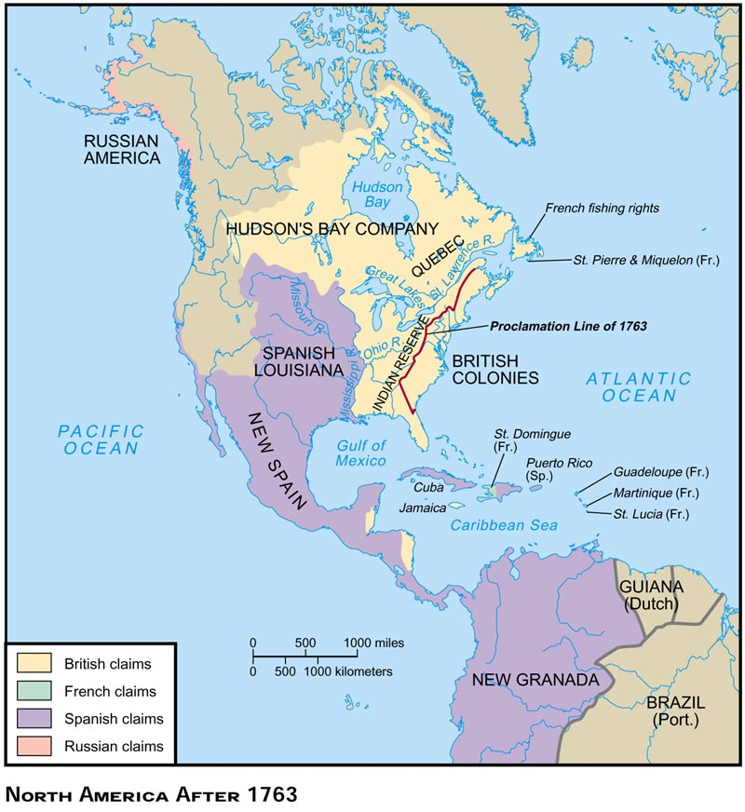
The French and Indian Wars transformed the map of America
France lost its entire new world empire except a couple of sugar islands.
Canada went to England. Louisiana to Spain as payment for its support of France.
Spain ceded Florida in exchange for the return of Cuba.
Native Americans lost a key ally → Pontiac’s Revolt in 1763

Slide 7
To what extent did the Albany Plan demonstrate colonial unity in 1754?
7 colonies attended
approved Franklin’s document promoting a substructure of government below British authority to govern the colonies.
A council of elected representatives
headed by a President-General appointed by the crown.
Rejected by colonial governments
LOCALISM!!!!!
"Join or Die" (1754) published by Franklin is considered the first political cartoon of the colonies.

Slide 8
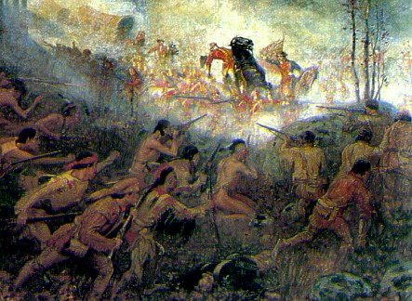
In what way did the French and Indian War transform the relationship between England and its North American colonies?

Slide 9
New Attitudes
American
Increased confidence with the French and Spanish removed
Some new self esteem
Disdain for English troops
Increased concern with rights of Englishmen
Some new nationalism(shared experiences) but no calls for independence!
Desire to move west past Appalachians into native American land
British
The importance of America
Disdain for American forces
Awareness of colonial nonsupport (need for bribes) AND American smuggling
Indebtedness
Colonists should pay for their defense (not the war!)
Desire to prevent future conflicts with native americans

Slide 10
A Changed Relationship
Desire for independence occurred to different individuals at different times or not at all
Due not underestimate role of Great Awakening and Enlightenment ideas
20% or more remained loyalists
Between 1763 and 1776 arguments mostly regarded “rights of Englishmen not independence”
Locke’s notion of natural rights and right to overthrow governments
New sense of constitutionalism
Fear of absolute power; support of republicanism (interestingly motivated loyalists and patriots)
Frontiersmen, and those dependent on trade in cities more interested earlier (problems with Indians, land restrictions, opposition to elites)
Slaves? Inspired by rhetoric but promised freedom by the British
Native Americans feared loss of protection

Slide 11
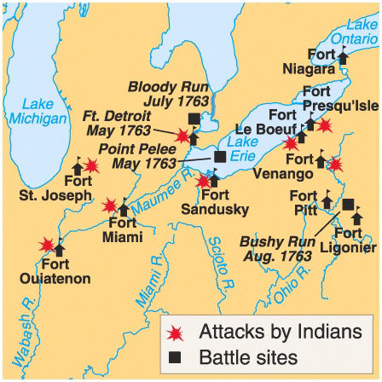
War → Problems on Frontier → New Indian Policy – Proclamation of 1763
The Frontier Attacked! (Why?)
no longer protection of France
Pontiac’s rebellion (1763): Indian confederation but Pontiac sued for peace
Proclamation of 1763: no colonial settlement west of Appalachians
Colonists angered at this appeasement of Indians – loss of territory
Paxton Boys: Indians must be eliminated

Slide 12
New Imperial Trade Policies
Sugar act (1764)→ use of admiralty courts, writs of assistance
Customs officials feared
Otis: Protection of a citizen’s private property (constitutional rights) must be held in higher regard than a parliamentary statute.
He lost – note British idea of constitution and law v. American idea

Slide 13
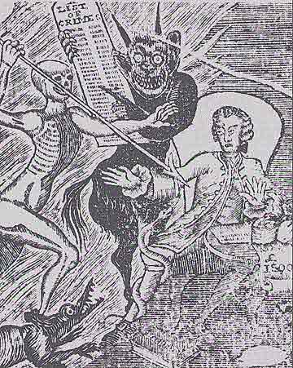

Slide 14
Stamp Act (1765) proposed by Grenville
New taxes violated right to property – “no taxation without representation” rejection of virtual representation favored actual representation
Stamp Act Congress
“it is unquestionably essential to the freedom of a people that no taxes be imposed on them but with their own consent” however legislation not taxes accepted”– stamp act congress (9 colonies)
A new sense of unity
mostly urban protest.
Non-importation – sons and daughters of liberty – nationalist?
ECONOMIC COERCION WORKED!
Outcry → repeal before revenue collected
Declaratory Act (1766) “bind in all cases whatsoever”

Slide 15
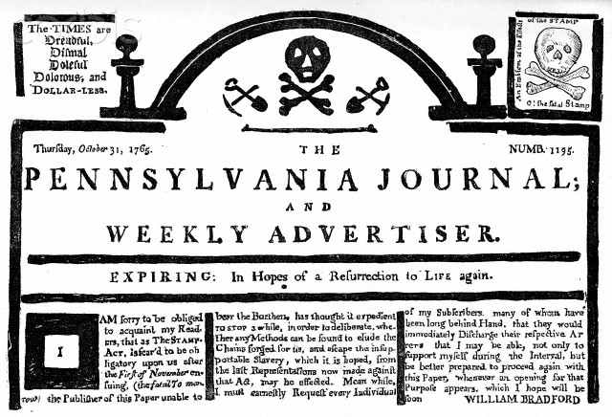

Slide 16
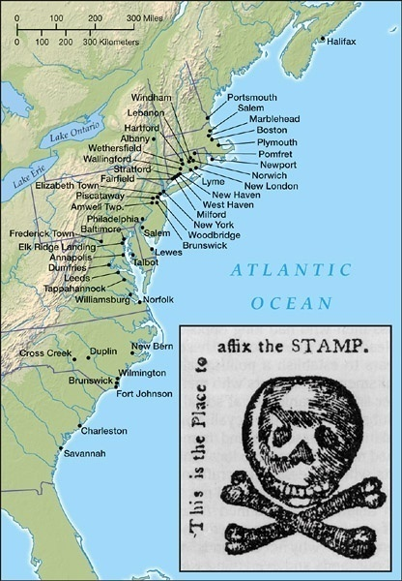
Stamp Act Demonstrations

Slide 17
Quartering Act (1765)
5 colonies forced to pay taxes to support troops on frontier.
Standing army that was eventually moved to cities (1768) (immensely unpopular as they could be used to centralize power AND took jobs as well)
NY refused to raise these revenues → suspension of legislature

Slide 18
Townshend Duties (1767) - lead, glass, tea, paper, paint
Not really a trade restriction but an indirect tax
Raised revenues to pay salaries of governors and judges!
Circular letters from MA to other legislatures
VA letter “oppose policies that “have an immediate tendency to enslave them”
Nonimportation
Role of women who organizd sinning bees and supported nonimportation
troops to Boston and Boston Massacre (1770)
repeal except tax on tea

Slide 19
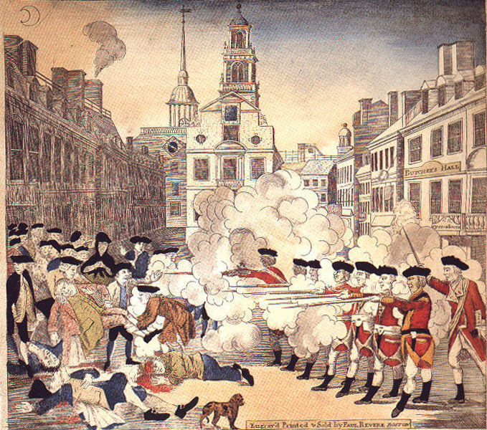
The Boston Massacre (March 5,1770)

Slide 20
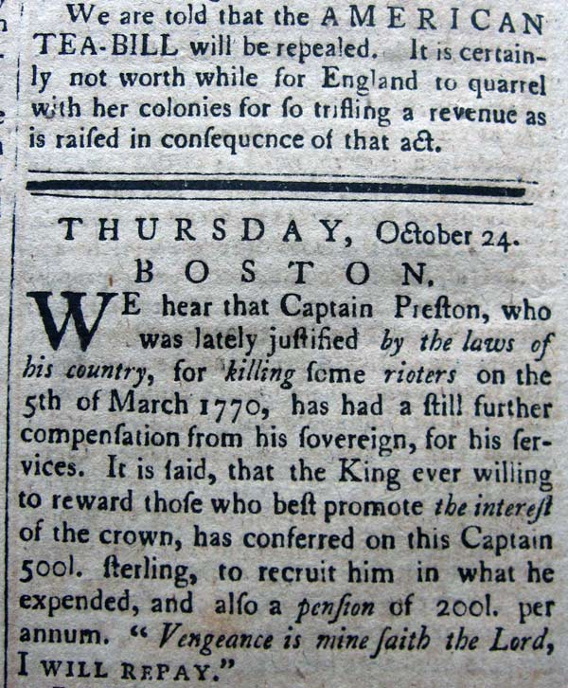

Slide 21
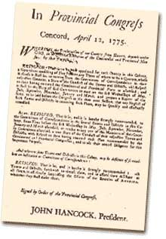
Seeds of Nationalism
Committees of Correspondence (Intra colony – S. Adams) and Circular Letters (intercolonial) – beginnings of unity?

Slide 22
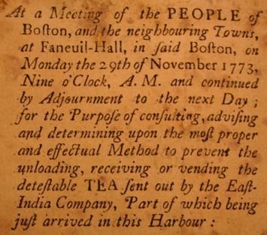
Tea Act (‘73) not a new tax but a policy to favor the East India Tea Company
→ Violence and Tea Parties (12/73)

Slide 23
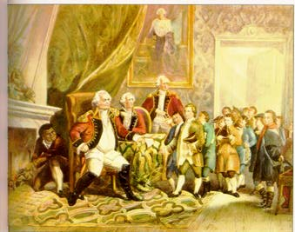
The Coercive or Intolerable Acts (1774)
1. Port Bill
2. Government Act
3. New Quartering Act
Lord North
4. Administration of Justice Act

Slide 24
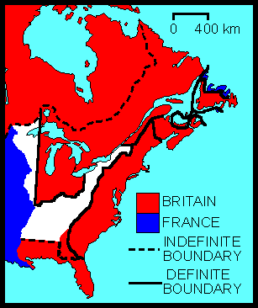
The Quebec Act (1774)

Slide 25
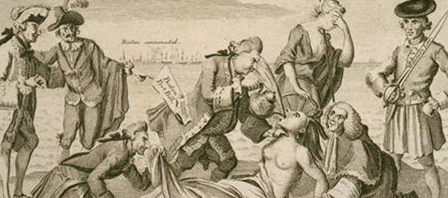

Slide 26
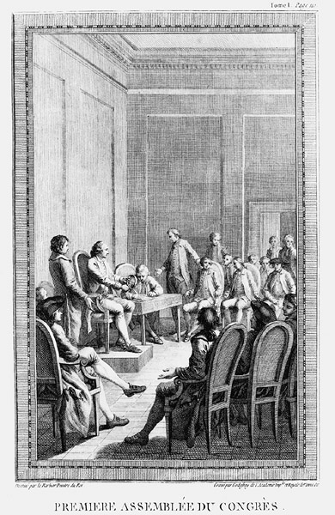
First Continental Congress (9/74)
12 colonies
Moderate Galloway Plan which would share taxation with Parliament rejected
Declaration and Resolves condemned 13 British acts violation of rights
Continental Associations in each “county, town, and city” to enforce boycott
Endorsed Sussex resolves to take up arms to defend liberties
Is this body an American government?

Slide 27
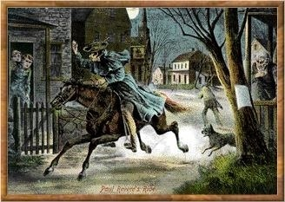
The British Are Coming? . .
Lexington and Concord … a stand to protect gunpowder and weapons against British regulars

Slide 28
As of 1775 colonists were fighting to protect their rights as Englishmen. What changed?
Warfare
Ticonderoga, Bunker Hill, invasion of Quebec, ports in VA and ME burned
Governor Dunmore (VA) promised freedom to all slaves who joined British
The Second Continental Congress was governing as a sovereign body
Chosen by extralegal bodies, few conservatives
All colonies ( sympathy from Nova Scotia and Caribbean but Navy too present)
A continental army - GW commander
Olive Branch Petition (7/75)– begged K George to prevent hostilities → Prohibitory Act “to bring the traitors to justice”

Slide 29
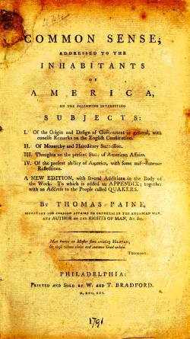
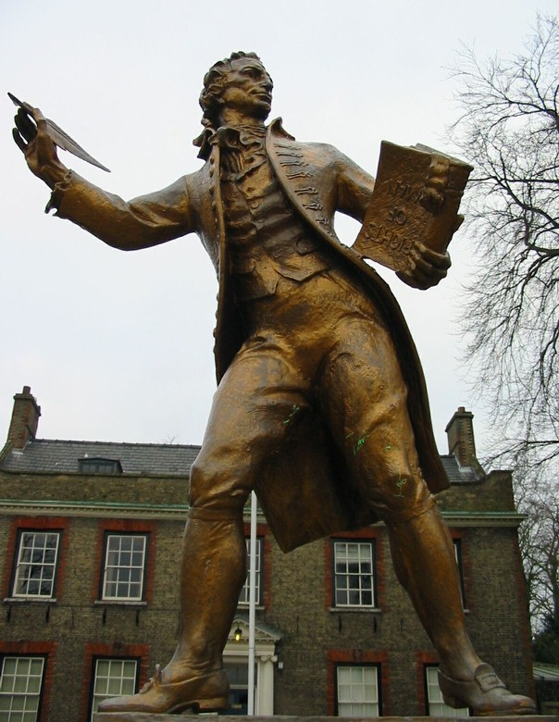
Thomas Paine: Common Sense

Slide 30
Common Sense (Paine)
Folly to be loyal to king
Millennialism “to begin the world over again”
June 7, 1776 resolution of independence, 7/2 vote on independence, 7/4 approval of DI
“statement of rights
“free and independent states”

Slide 31
“He has dissolved representative houses repeatedly for opposing, with manly firmness, his invasions on the rights of the people.”
He has… and sent hither swarms of officers to harass our people and eat our their substance.
“He has kept among us in times of peace, standing armies.”
He has [given] his assent… for
Quartering large bodies af armed troops among us
For protecting them by a mock trial, from punishment for any murders, which they should commit
For cutting off our trade with all parts of the world.
For imposing taxes on us without our consent.
For depriving us , in many cases, of the benefits of trial by jury
For abolishing the free system of English law in a neighboring colony.
For altering fundamentally the forms of our governments
For declairing themselves invested with power to legislate for us in all cases whatsoever
For waging war against us
For transporting large armies of foreign mercnetaries

Slide 32
“He has excited domestic insurrection among us”
Omitted: “he has waged cruel war against human nature itself, violating it's most sacred rights of life and liberty in the persons of a distant people who never offended him, captivating and carrying them into slavery in another hemisphere, or to incur miserable death in their transportation thither. This piratical warfare, the opprobrium of infidel powers, is the warfare of the Christian king of Great Britain determined to keep open a market where MEN should be bought and sold”

Slide 33
The Impossible War
British Advantages/ American Weaknesses
British population – 7.5M v. 2.5M → soldiers, wealth, support
1/3 to 1/5 of Americans loyalists, 20% slaves
Who were the loyalists? Anglicans, people of the south, often more wealthy,
A number of slaves responded to Dunmore but a number fought with Americans
Large professional army
Americans: a smaller continental army and militia (often unreliable)
Largest navy in the world necessary for supplying troops and blockading support
But America had effective privateers
British central government
Continental congress relatively powerless
Could only ask for troops or funds
Localism: Americans were committed to their state not their nation.
British manufacturing.
American dependence on support from Europe

Slide 34
Victory
*** Challenging task of British – force Americans to give up their ideas of independence – the Americans only needed to fight until the British lost interest
Washington’s ability to keep the army together – Trenton, Princeton
The support of the French and to a lesser degree Spain
Support from the outset but alliance after Saratoga (1778)
US could not negotiate without France; treaty in perpetuity.
British lack of commitment
Cost of war to a nation already in debt
Strategic concerns: Gibraltar and Europe
Cost of privateers’ damage
Political splits: Whigs and Tories

Slide 35
Treaty of Paris - 1783
America betrayed its ally and received very generous terms. Britain hoped to force separation between FR. And US.
All lands east of Miss
Florida to Spain with disputed boundaries.
US agreed the states must compensate loyalists; many states refused. Therefore GB remained in the northwest supplying NAs.
Huge problems. The west was American in name only!

Slide 36
The effects of the Revolution
“the war is over, but this is far from being the case with the American Revolution” – Benjamin Rush 1783

Slide 37
Radicals: republican government, limited government, greater role of the people in government, emphasis on freedom and greater equality,
Conservatives: republican government – but only consent of the people, less power to the common people, more centralized power, more power to the government to protect order, stability and the elites, greater emphasis on order and stability,

Slide 38
Greater separation of church and state
Jefferson: VA Resolutions – no man shall be compelled to support a church
Disestablishment of Anglican church
NE – although church not disestablished –individuals could specify the church they wanted to support
Note DI speaks of God; Constitution does not
Discrimination still present

Slide 39
Limitations on Slavery “I tremble when I reflect God is just” - TJ
20% of population; 5000 served in the war
Most states forbade further importation of slaves. GA and SC did not.
First abolitionist society
Many southerners freed their slaves – manumission – 10K in VA; 1/5 of MD
All northern states abolished slavery by 1786 through gradual emancipation. TJ called for emancipation in VA
No slavery in the northwest territory – Northwest Ordinance.
Growing free-African American community → establishment of schools and churches
Banneker and Wheatley

Slide 40
Women
New roles in society
Efforts in revolutionary society
Republican motherhood; in a republican government women must raise virtuous sons
Some increased educational opportunities

Slide 41
Spirit of Egalitarianism
States and constitution forbade citizens from accepting titles
Laws of primogeniture repealed
Society of Cincinnati denounced
Still idea of deference! No real change in leadership – 69 of DI signers held colonial office

Slide 42
Republican limited governments debate between radicals and conservatives
A response to British centralization of power
Constitution making taken from state legislatures. Special conventions ratified by the people. Consent of people demanded. Constitutions = fundamental law!
New state governments had bills of rights
Relaxation of franchise requirements; however only PA and GA eliminated them.
Movement of capitals
In PA a government a unicameral govt without a governor was proposed along with redistribution of property – failed by one vote
Still mostly Adam’s model followed – mixed government – aristocracy and democracy

Slide 43
Impact on Indians
Americans claimed TP was victory over Indians as well; “conquest” → demands for land
In Ft. Stanwix and McIntosh treaties Congress seized lands (after taking hostages)

Slide 44
What did the terms radical and conservative mean in 1776 – 1787?
Explain the government created by the Articles of Confederation.
What was the goal of the authors of the Articles of Confederation?
Explain how the Articles of Confederation was a radical document.

Slide 45
According to Jefferson, what rights do all individuals have?
According to Jefferson, when may a people overthrow their government?
*In 1776, did the colonists have a right to overthrow the government of England and become “free and independent states”?
In what ways was the War for Independence a civil war?
*Why were the Americans able to win the war for independence?
*In what ways did the War for Independence become a revolution?

Slide 46
The Articles of Confederation
A radical government
Notes:
46

Slide 47
Proposed in 1777; ratified in 1781 after settlement of land dispute
Reflected fear of centralized authority!
Each state maintained “its sovereignty, freedom and independence” – no thought of consolidation! – a confederation to provide national defense, protect liberties and cooperation
Funds to be provided by the states.
No executive or judicial branches
A unicameral Congress elected by state legislatures – each state one vote – terms 1 year
No power to tax or regulate trade without unanimity
Notes:
47

Slide 48
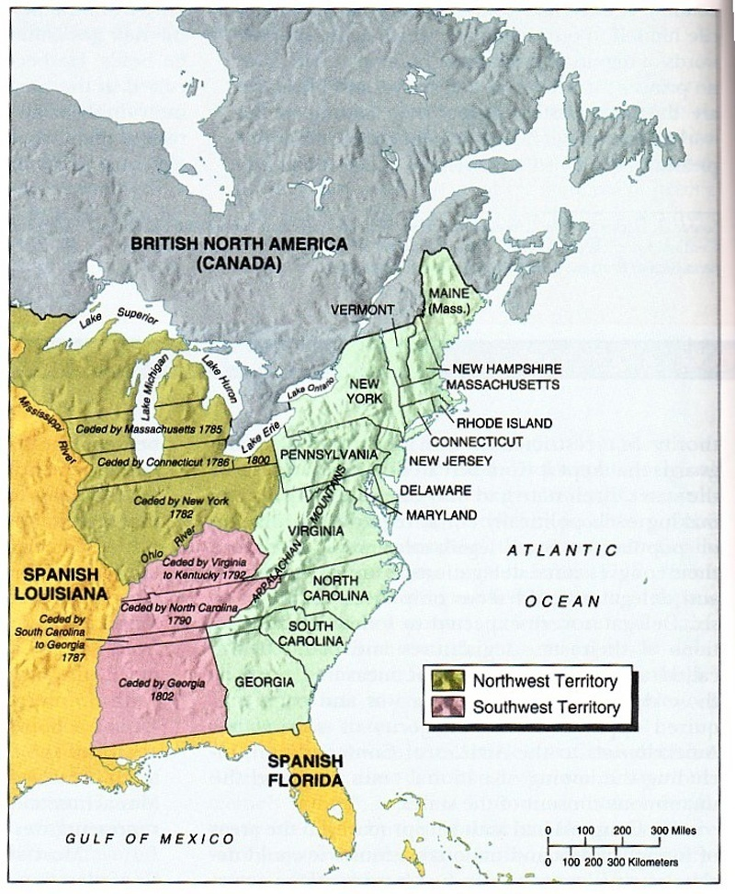

Slide 49
Loss of Faith – by whom?
Shays Rebellion
Economy disrupted by trade restrictions
Heavy taxes
Laws placed that debts could only be paid in specie
Demand for stay laws and paper money defeated
Shays in 1786 led 2000 to shut down western MA courts → rout by MA forces
But debtor legislation and violent action threatened in other states
Responses
Jefferson: rebellion important
Anarchy?
Appeals for foreign despot or restraint of liberties? → desire for a new government to protect limited government from more reactionary desires
Notes:
49

Slide 50
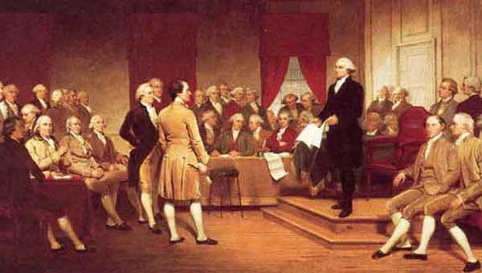
The Coup and the Constitution “the conservatives regain control”

Slide 51
Constitutional Convention
1787: delegates from 12
55 men – 24 were creditors, 15 owned slaves, 40 had government bonds, 14 were land speculators
No Paine, no S. Adams, no Henry, no Jefferson, no RI
Inspired by Hobbes, Montesquieu and Whig Ideology

