Slide 1
Jackson and Democracy
Remember to focus on the extent to which Jackson and his policies reflected the common man and the ways in which Jackson defied the law

Slide 2
Warmup: Prepare to answer the following
What does democracy mean?
What was the opinion of the founding fathers regarding democracy?
How was the voice of the people limited by the Constitution?
Who should vote? According to Hamilton? According to Jefferson?
Note charts in the homework, what is happening in regard to voting?

Slide 3
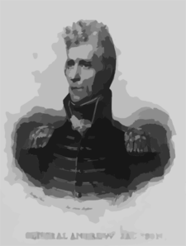
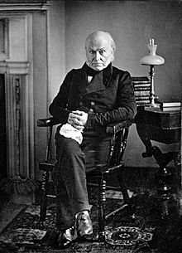
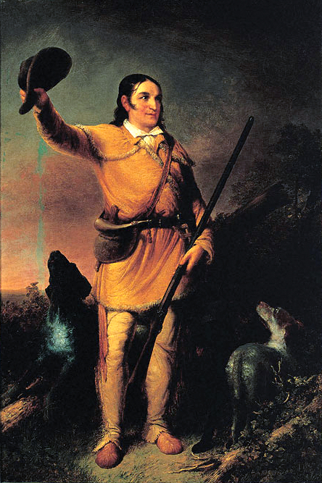
Jacksonian America Jackson as the symbol of the age as well as the engine
→→→

Slide 4
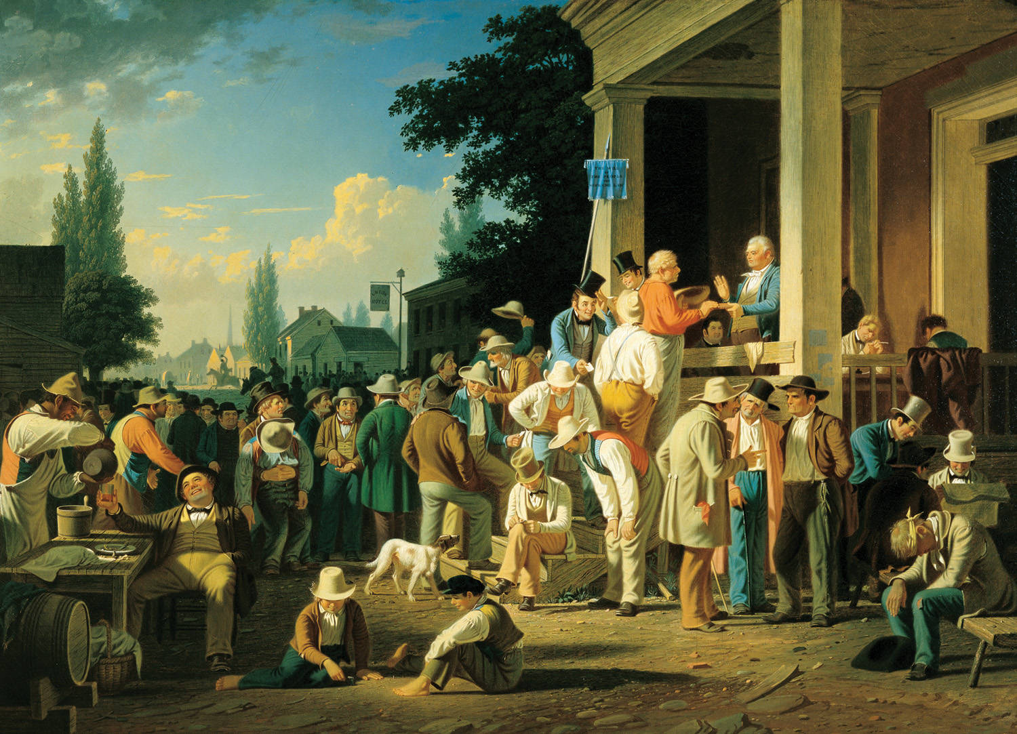
Rise of a Democratic Society
Increasing belief in equality for white males
Universal male suffrage – first in western states where had no religious or property qualifications for voting
In many states poll taxes
Voting participation skyrocketed – 350,000 votes 1824 → 2.4M 1840
Party nominating conventions instead of party congressional leaders (Anti Masonic Party 1830)
Popular election of electors

Slide 5
5. Political Parties
“New” Democrat”: western farmers and eastern “ mechanics” or workingmen. The poor as opposed to the elites
6. Campaigning pitched to the common man – hard cider, beer and barbecue! Log cabins of Harrison ( Webster apologized for not being born in a log cabin)
7. campaign issues : scandal.
Adams characterized as a pimp, condemned for bringing gaming tables into the white house.
Jackson’s wife!

Slide 6
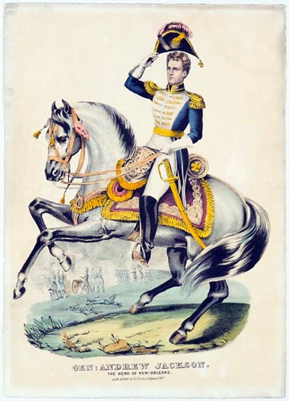
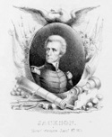
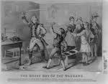
Also….
new breed of political leaders
Important to be common! Log cabins!
Crockett – campaigned on number of bears killed
Jackson – (paraphrase) questionable parentage, impoverished background, hard charging, hard drinking, no formal schooling. an American success story, “Jesus, just another Jackson.” The contradiction: land speculator and owner of the Hermitage and 100 slaves. Adams spoke of him as a barbarian. Jefferson of his dangerous rage.
Contrast with Q. Adams!

Slide 7
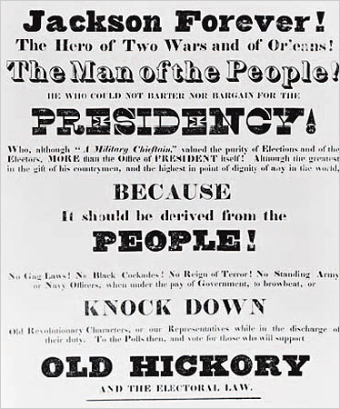
Who is the poster for?
What are the claims?
Hero of two wars?
Orleans?
He who could not barter or bargain for presidency?
No standing army?
No gag laws?
Knock down old revolutionary characters?

Slide 8
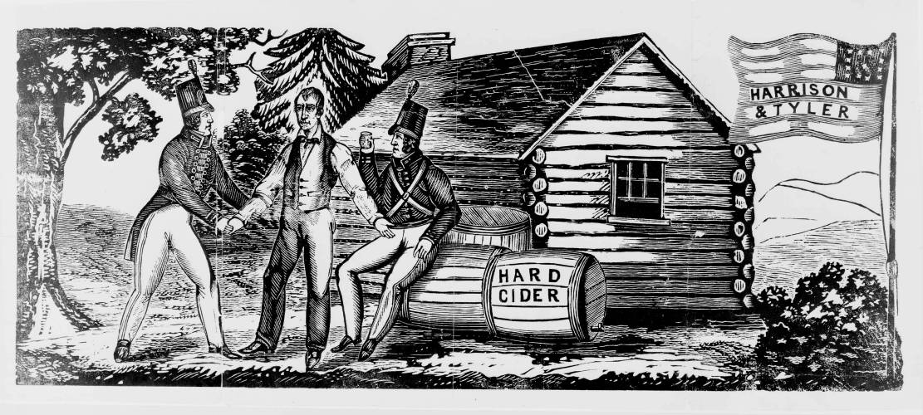
Harrison 1. why hard cider? log cabin? 2. why called Tippecanoe?

Slide 9
The Growing Trend Towards Democracy the result of several factors
meaninglessness of property requirements
Increasing importance of government decisions resulting from market economy
Missouri, Panic of 1819, tariffs
The Corrupt Bargain of 1824. Jackson won the popular and electoral vote but seemed to be cheated by Adams and Clay!

Slide 10
Jackson – the Democratic President or “Mobocracy” and tyranny?
Election in 1828!
Faith in the common man!
Distrust of elites! “equal protection and benefits” for all white males
Spoils system or rotation in office
“democracy is promoted by appointments by newly elected officials”
All should have the opportunity to share in governing
Political corruption “to the victor belongs the spoils”
Use of the veto – 12 times (more than all previous Ps combined. Note bank veto!!)
Belief that he represented the people!

Slide 11
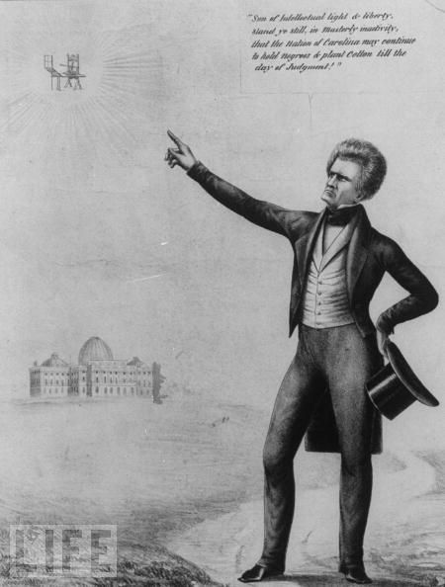
Tariffs, Nationalism and Sectionalism
1828 tariff of abominations blamed for SC’s struggling economy, (effect on prices and exports)
seen as threatening power of the north
→SC Exposition and Protest (Calhoun) - Call for nullification and states rights, not secession.
compact theory: States created the fed govt and therefore judged it.

Slide 12
The issue provoked statements of nationalism and sectionalism
Webster: Liberty and Union, now and forever, one and inseparable. “rope of sand” (Webster Hayne Debate)
Jackson: Our Federal Union—it must be preserved.
Calhoun: The Union, next to our liberty, most dear. It can only be preserved by respecting the rights of states.” (driven from Vice presidency)

Slide 13
Crisis of 1832!
1832: a lower tariff was passed but only from 45% to 35% - not enough.
SC Convention nullified tariff, no other state followed.
Jackson: “the laws of the United States must be executed.”→ Force Bill
Privately he spoke of hangings
An attack on SC would have split the nation
Clay’s Compromise. Reduced tariff 10% over the next 8 years.
On what previous occasion had Clay proposed an important compromise?
The south won? It seems threats led to concessions.

Slide 14
The Crisis of the BUS
Rechartered in 1816 for 20 years
Biddle’s bank: sound currency, promoted business expansion and it did not allow inflation favored by debtors by keeping state banks in check.
regarded as a threat by the west
Jackson saw it as un-American, undemocratic and a hydra of corruption.
Clay forced the recharter issue in 32 to embarrass Jackson, but Jackson vetoed it as unconstitutional and a threat to the people. → Electoral victory(3/4 of vote)!
Jackson then set out to “destroy the monster”

Slide 15
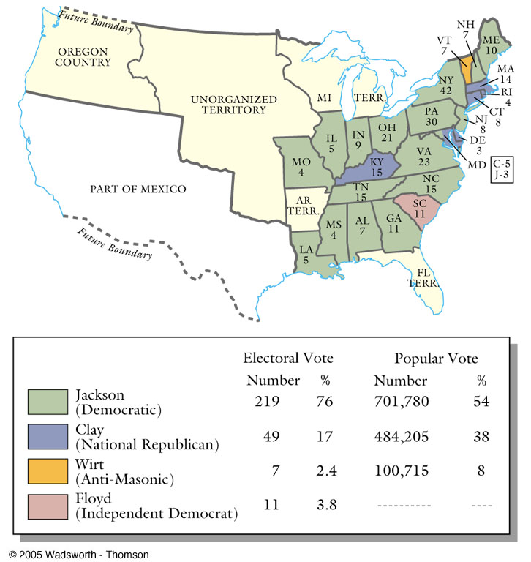
1832 Election Results

Slide 16
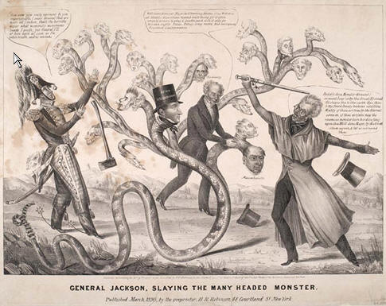

Slide 17
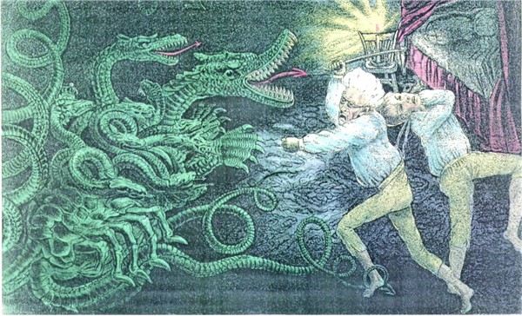

Slide 18
Jackson and Taney: 1833, remove all federal funds from BUS - all money put in state or pet banks.
Wild speculation and inflation!
Jackson -Specie Circular - 1836. only metallic money could be used to buy public lands →panic of 1839!
Whig Response: higher tariffs, investment in internal improvements but Van Buren won
Independent Treasury Act of Democrats – lock the surplus in a vault to keep it safe.

Slide 19
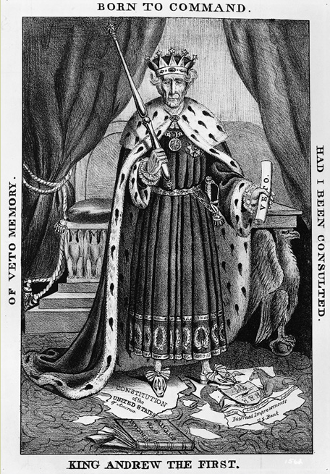
“King Andrew”?
Birth of Whigs – opponents of Jackson!

Slide 20
The Second Party System a response to King Andrew
Parties became a source of personal identity.
Whigs – a positive liberal state – government had a right and duty to contribute to general prosperity and economic growth.
Probusiness industrialists who wanted tariffs, merchants who favored internal improvements, farmers engaged in the market economy
Evangelical Protestants and old stock protestants who desired to enforce their morality
Temperance and bibles in schools
Democrats – a negative liberal state - government should keep its hands off the economy and follow laissez faire policies.
Catholics, immigrants, backwoodsmen

Slide 21
Jackson and the Indians
Jefferson Letter – 1791 – Indians have a right to their land!
“Government should firmly maintain this ground, that the Indians have a right to the occupation of their lands independent of the States within whose chartered lines they happen to be; until they cede them by treaty, or other transaction equivalent to treaty, no act of a State can give a right to such lands… The government is determined to exert all its energy for the patronage and protection of the rights of Indians.”
Andrew Jackson disagreed. 1817
I have long viewed treaties with the Indians as an absurdity not to be reconciled to the principles of our Government. The Indians are the subjects of the United States, inhabiting its territory and acknowledging its sovereignty, then is it not absurd for the sovereign to negotiate by treaty with the subject…”

Slide 22
Jackson and the Indians
Jackson: removal to the plains west of the Mississippi regarded as the Great American Desert.
Land for the common man?
Protection of the Indians?
(check his speech)
1830 → Indian Removal Act pursued in spite of Marshall’s defense of Indians

Slide 23
The Cherokee
Worcester v. GA (1832)
Marshall: Georgia law had not force in Chreokee lands
→
Jackson: “John Marshall has made his decision, now let him enforce it! “
***** What?!
Trail of Tears 1838

Slide 24
Indian Removal Act
1831 – Choctaw: first tribe, on “Trail of Tears”.
1836 - Creek: 3,500 of 15,000 died along trek.
1838 Cherokee: 4,000 of the 15,000 Cherokee died along the trail to Indian Territory in what is now Oklahoma after a fraudulent treaty signed.
Cholera, exposure, lack of promised supplies,
Notes:
During the winter of 1831, the Choctaw became the first tribe to walk the “Trail of Tears” westward.
Promised government assistance failed to arrive, and malnutrition, exposure, and a cholera epidemic killed many members of the nation.
Then, in 1836, the Creek suffered the hardships of removal. About 3,500 of the tribe’s 15,000 members died along the westward trek. Those who resisted removal were bound in chains and marched in double file.
Emboldened by the Supreme Court decisions declaring that Georgia law had no force on Indian Territory, the Cherokees resisted removal. Fifteen thousand Cherokee joined in a protest against Jackson’s policy.
Cherokees held out until 1838, when the army evicted them from their land. All told, 4,000 of the 15,000 Cherokee died along the trail to Indian Territory in what is now Oklahoma.
Why were such morally indefensible policies adopted? Because many white Americans regarded Indian control of land and other natural resources as a serious obstacle to their desire for expansion and as a potential threat to the nation’s security. Even had the federal government wanted to, it probably lacked the resources and military means necessary to protect the eastern Indians from encroaching white farmers, squatters, traders, and speculators.

Slide 25
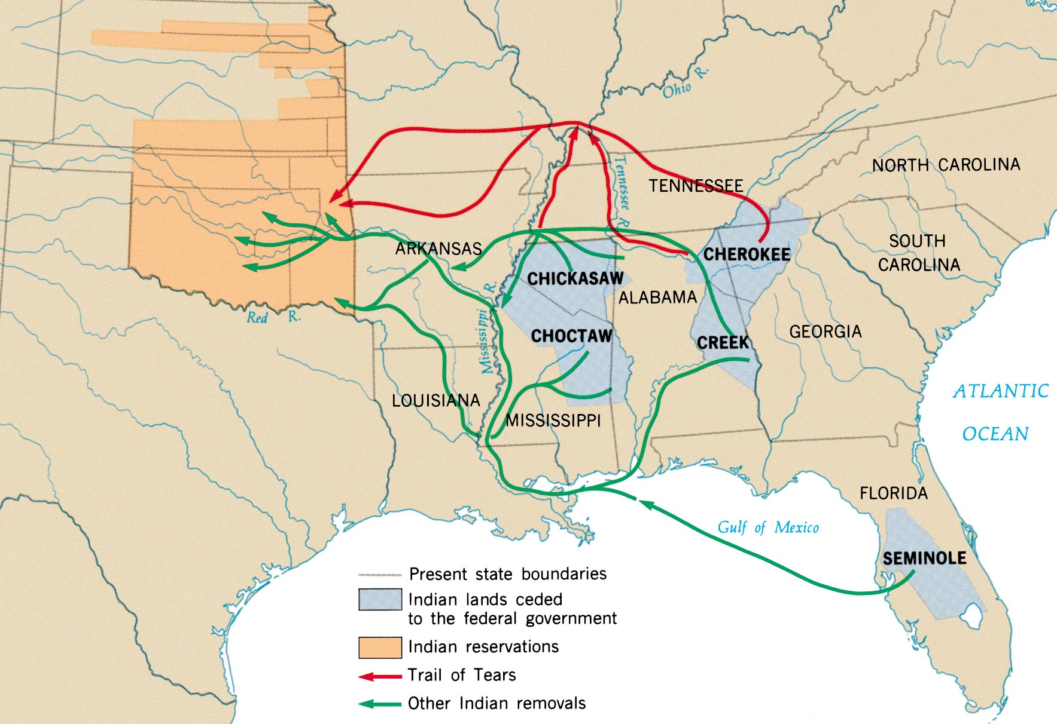
The Removal

Slide 26
Claim of Akhelohguyyah a lawsuit filed by a Cherokee for the following property that he was forced to leave behind (don’t copy)
“3 plows, 1 set of chains, collars and harnesses, weeding hoes, 2 large dishes, 10 small bowls, 2 sets of dishes, 2 sets of knives and forks, 1 water pail, 3 pitchers,… 1 milk strainer, 17 cane baskets, 1 spinning wheel, 1 weaver’s wheel, 1 wall loom, …. 2 rifled guns, 2 bee hives, 60 chickens, 1 feather bed, 1 sheet, 6 cattle, 3 horses, 2 wagons” (many items left off list)

