Slide 1
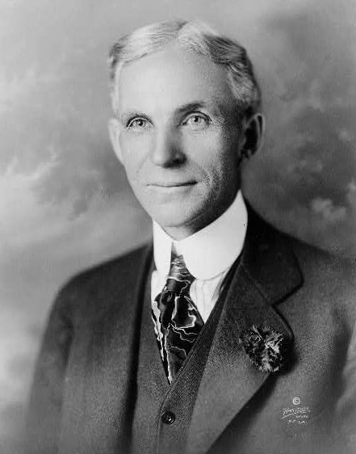
End of progressivism!
“Americans still have a mission to the world but we shall have to save ourselves before we can hope to save anyone else.” Henry Ford

Slide 2
Warmup: Answer the following using the handout.
The 1920s are often perceived as a period of great wealth. What evidence does the author present that America during the 1920s was increasingly prosperous?
What new products were available during the 1920s?
In what ways did electricity transform American households?
What changes occurring during the 1920s in America frightened many Americans? What did these Americans long for?
In what way was the 1920s economy unhealthy? In what way did this lead to an economic disaster?

Slide 3
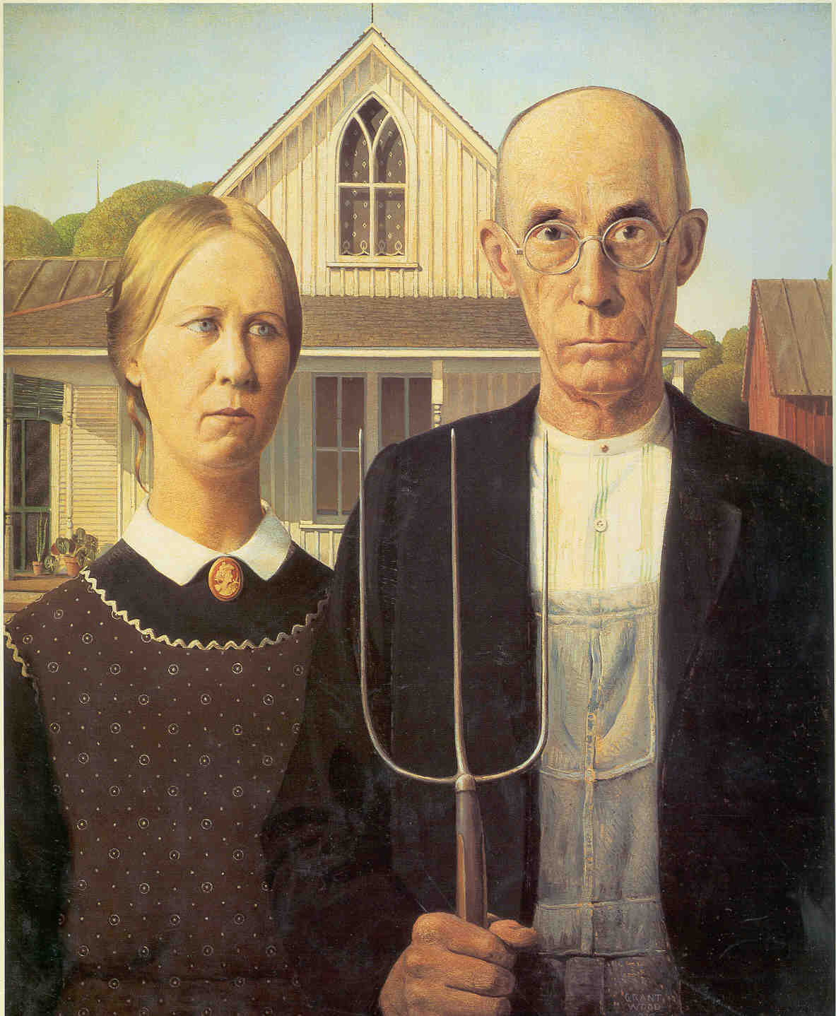
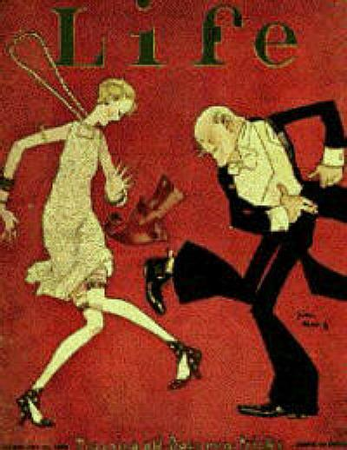
1920s
Change and Backlash

Slide 4
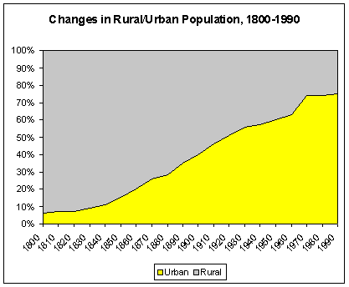
1920s – A New and Threatening America
Cultural diversity
Urbanism
Radios, Magazines, Movies were shocking (NYC and LA)!
Shifting Base of political and cultural power
Traditional America – rural and southern America – rocked → backlash

Slide 5
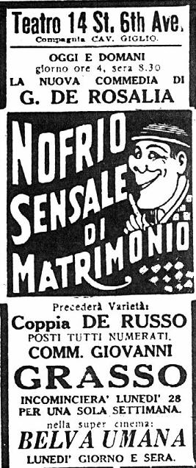
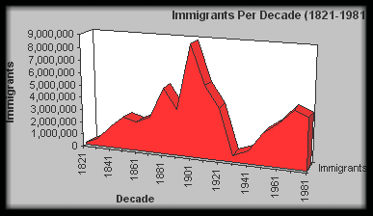
Cities and Immigrants
Immigration soaring. 430K in 1920, 800K in 1921. rates never before seen
New immigrants dominant
Urbanism: for the first time a majority (54 of 106M lived in cities. ¼ lived in cities over 100,000.
Urban values shaped radio, magazines, advertising
“it is a garbage can!... When the hordes of aliens walk to the ballot box and their votes outnumber yours, then that alien horde has got you by the throat.” – a member of the KKK
“rural Americans are real Americans… You can’t always be sure with other Americans. Not all of them are real.” – D. Quayle -1988

Slide 6
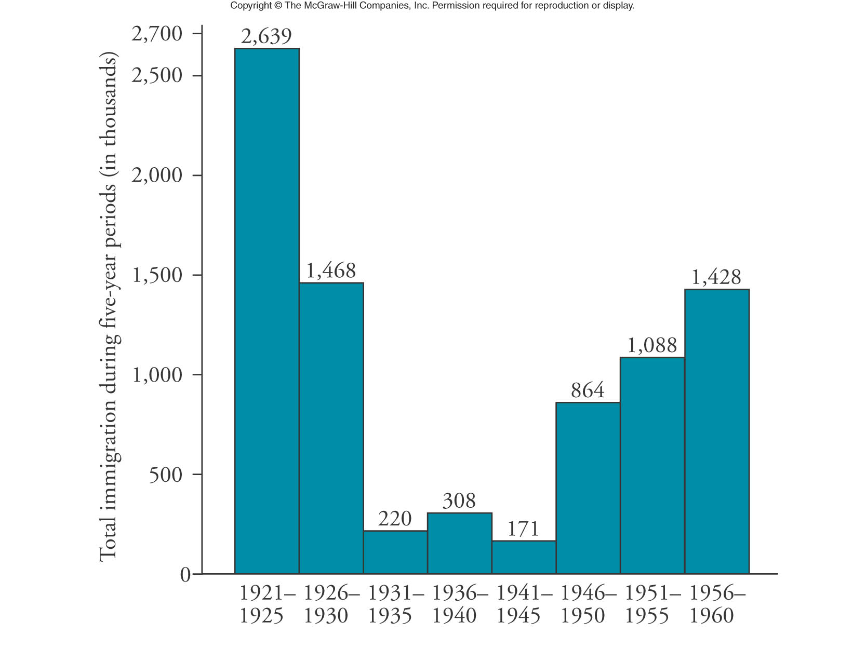
Immigration, 1921-1960
Notes:
Brinkley 11e

Slide 7
Notes:
Nash

Slide 8
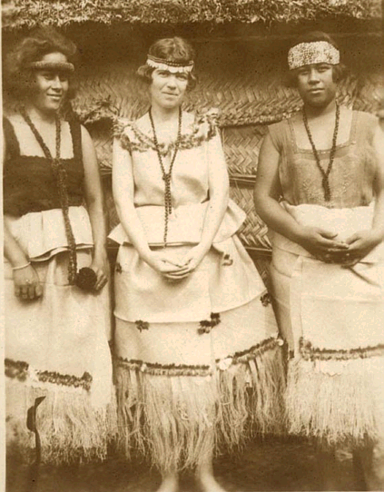
Science and Ideas
Relativism: absolutes questioned – is anything as it seems?
Darwin + Evolution: the Bible might not be the whole truth
Freud
Margaret Mead – societies define their own culture and that of the west might not be the best – Coming of Age in Samoa (later discovered to be a hoax)
Einstein/Heisenberg- relativity and uncertainty theory– even time might not be absolute

Slide 9
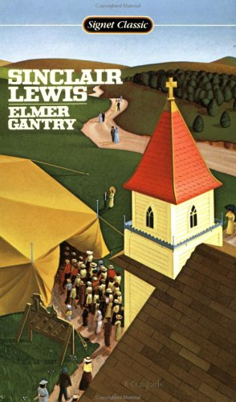
Literature and Arts
Sinclair Lewis - Main Street and Babbitt – questioned conformity in America
F. Scott Fitzgerald
HL Mencken – Baltimore columnist “booboisie”
Jazz – freer in form, improvised, African American roots, a “syncopated embrace”

Slide 10
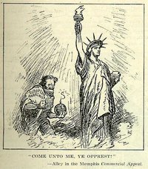
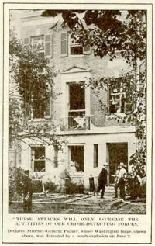
The News
Leopold and Loeb; 2 Jewish boys, influenced by Nietzsche killed another because they were “supermen” life sentences not death (Darrow - Chicago lawyer)argued that they were too influenced by teaching.)
Black Sox Scandal – 1919
1919 – 3600 Strikes –police in Boston, general strike Seattle, series of letter bombs

Slide 11
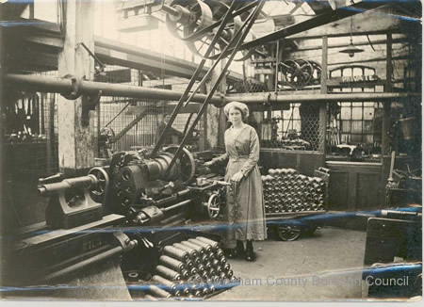
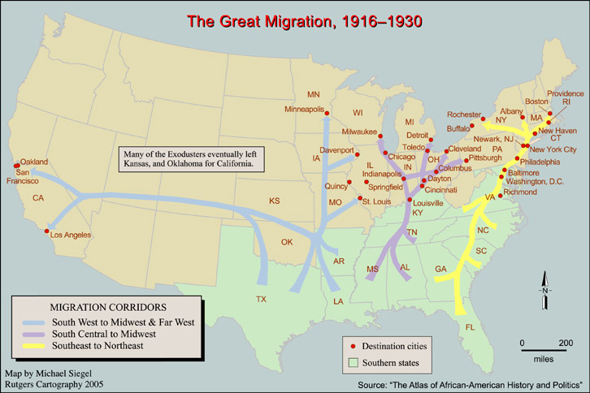
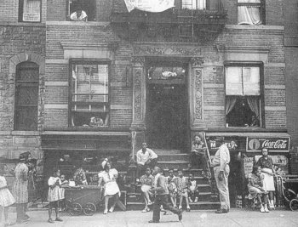
Great Migration → Black ghettoes, i.e. Harlem
a distinct Black culture flourished

Slide 12
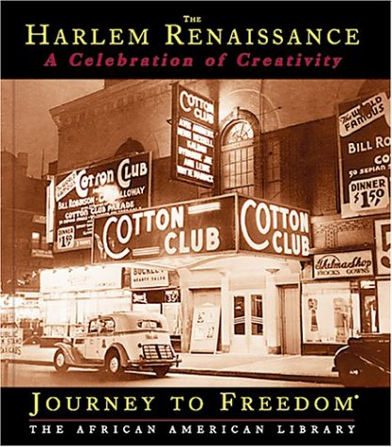
The Harlem Renaissance, “Negro Nationalism”
Harlem Renaissance – celebration of a different culture

Slide 13
Note the attitudes – would B. Washington have stated such ideas?
If we must die, let it not be like hogs
Hunted and penned in an inglorious spot…
Like men we’ll face the murderous cowardly pack,
Pressed to the wall, dying, but fighting back. – Claude McKay
I, too, sing America
I am the darker bother.
They send me to eat in the kitchen when company comes,
But I laugh and eat well, and grow strong.
Tomorrow, I’ll be at the table when company comes
Nobody’ll dare say to me “Eat in the kitchen,” then.
Besides, They’ll’’ see how beautiful I am and be ashamed – I, too, am American – Lanston Hughes

Slide 14
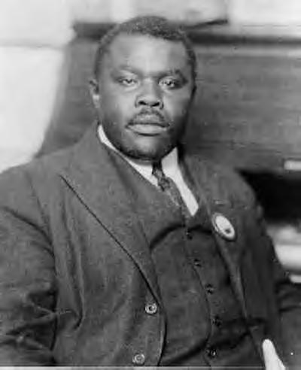
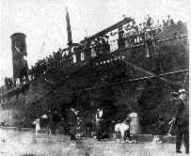
Marcus Garvey and the Universal Negro Improvement Association
believed in Black pride
advocated Black Nationalism, economic self-determinism and even a return to Africa

Slide 15
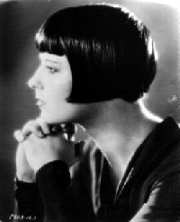
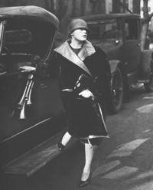
ROLE OF WOMEN – the “flapper” – do not overgeneralize – which women were flappers?
–

Slide 16
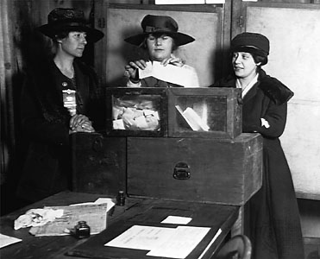
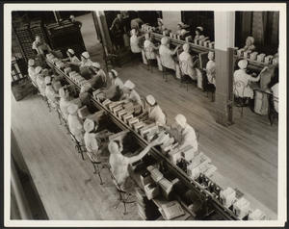
1920 - 19th Amendment
more women worked outside the home
more women went to college and clamoured to join the professions
More in 20s than any decade till 70s
women didn't want to sacrifice wartime gains - amounted to a social revolt
characterized by the FLAPPER/ "new woman"
(bobbed hair, short dresses, smoked in public...)

Slide 17
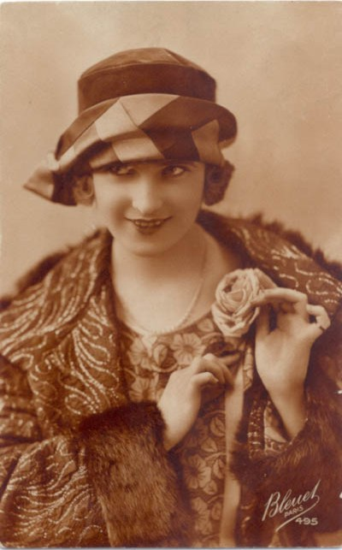
Perception of sexual revolution – flappers, literature, movies, magazines
“none of the Victorian mothers had any idea how causally their daughters were accustomed to be kissed” – 47% claimed sex before marriage (3/4 with future husbands)

Slide 18
Warmup: Have you been reading? Have you been reviewing your work? Answer the “quiz” questions in your notebook. Do not mark on sheet.
Part D on page 284 – 285 and Part F on page 286

Slide 19
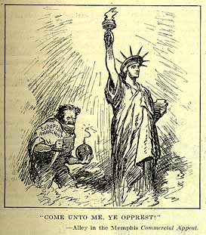
Backlash (reaction to change and progressivism) – The Guardians
The Red Scare (continuation of prejudice of WWI)
Prompted by:
Bolshevik revolution IWW, steel strike, police strike in Boston,
1919 strikes -
Nearly 40 bombs intercepted by Post Office – one addressed to the AG
→State Laws passed that made the mere advocacy of violence to secure change unlawful
→Anti- union activities
→Palmer Raids.
5000 suspects rounded up without warrants/homes offices ransacked.
600 aliens deported. Without benefit of hearing.

Slide 20
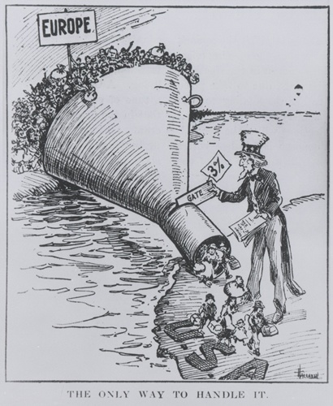
Nativism
Emergency Act of 1921; immigrants = 3% of that nationality living in US in 1910
Quota Act of 1924 immigrants = 2% of those here in 1890
85% from Northern and Western Europe. , only 600 from Itlay

Slide 21
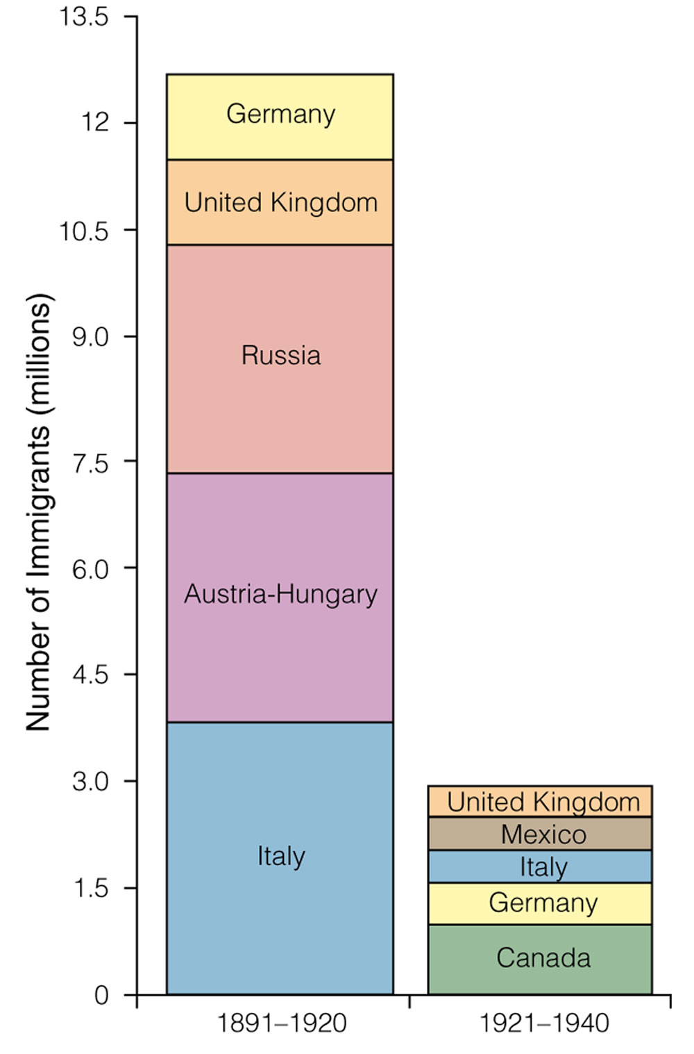
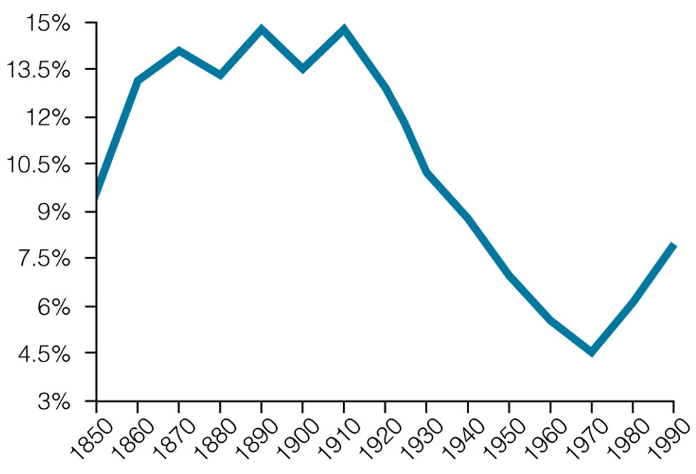
National Origin Act of 1924
Number of Immigrants and Countries of Origin, 1891-1920 and 1921-1940
Percentage of Population Foreign Born, 1850-1990
Notes:
Jones, Created Equal (both)

Slide 22
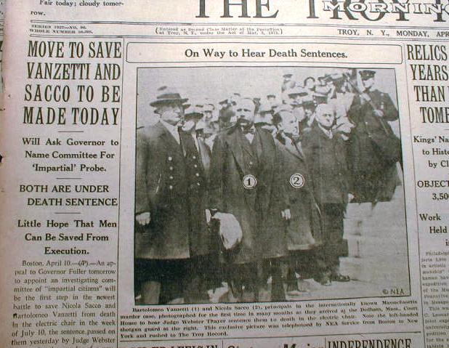
Persecution and Execution of Sacco and Vanzetti

Slide 23
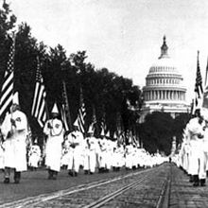
The New Klan
Opposed Jews, Blacks and Catholics – a social agenda to “bring clean motion pictures, literature and break up roadside parking.”
Nearly 5 million members in 1924 - social organization
40,000 marched in DC openly in 1928
Lost creditability when the grand dragon Stephenson forced whiskey on a secretary and raped her.

Slide 24
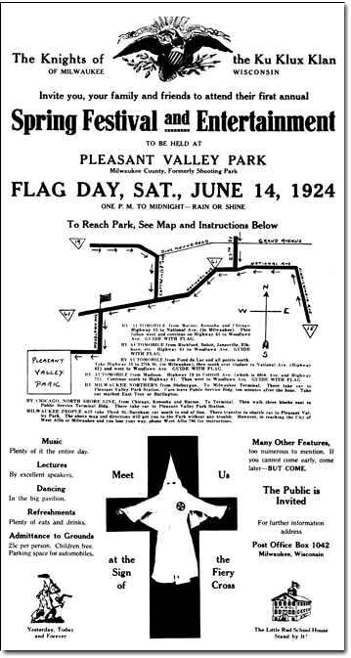
Ku Klux Klan
(mid-1920s)
(Private Collection)
Copyright 1997 State Historical Society of Wisconsin
Notes:
Ku Klux Klan pamphlet: "America for Americans" - Pageant 13e
Poster for the Milwaukee KKK inviting citizens to a summer 1924 rally - http://us.history.wisc.edu/hist102/photos/html/sindex.html

Slide 25
We are a movement of plain people, very weak in the matter of culture, intellectual support, and trained leadership. We are demanding, and we expect to win, a return of power into the hands of everyday, not highly cultured, not overly intellectualized, but entirely unspoiled and not de-Americanized, average citizen of the old stock. The Klan therefore has not come to speak for the great mass of Americans of old pioneer stock… as distinguished from the intellectually mongrelized “liberals.”

Slide 26
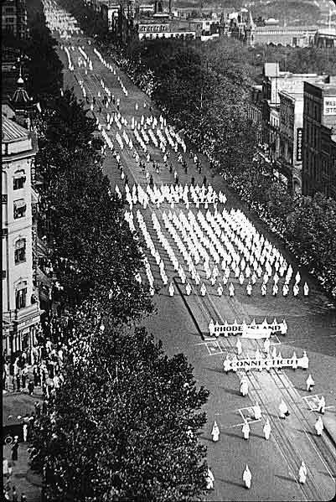
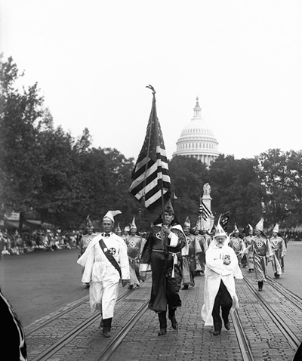
Ku Klux Klan
Ku Klux Klan parade in Washington, D.C., Sept. 13, 1926
Notes:
Klan Parade (leaders) - Pageant 13e; Klan Parade (wide view) - http://www.wadsworth.com/history_d/special_features/image_bank_US/1920_1930.html

Slide 27
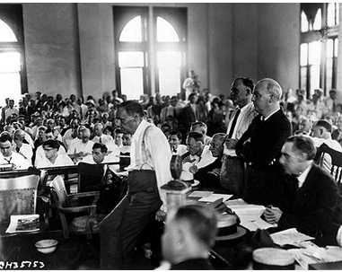
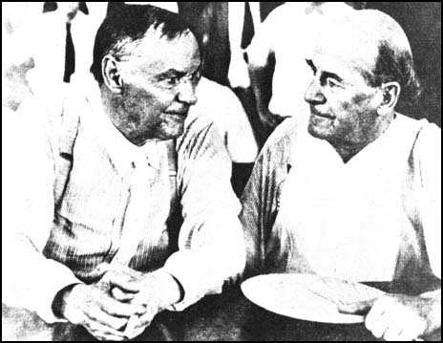
Religion
“modernists”
“fundamentalism” stressed absolute truth of Bible
20 states banned teaching of evolution
“I am a Christian mother and I am not going to let that rot go into Texas textbooks.” – TX gov Ferguson
Scopes Trial
American Civil Liberties Union
Clarence Darrow
William Jennings Bryan
Notes:
American Journey Online

Slide 28
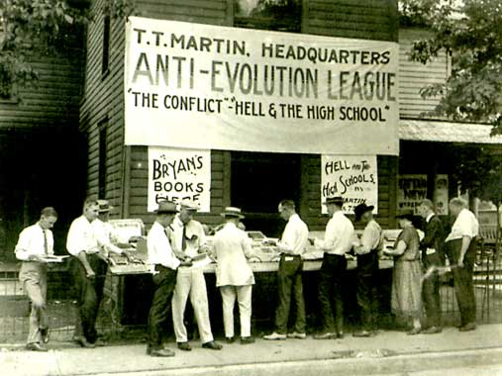

Slide 29
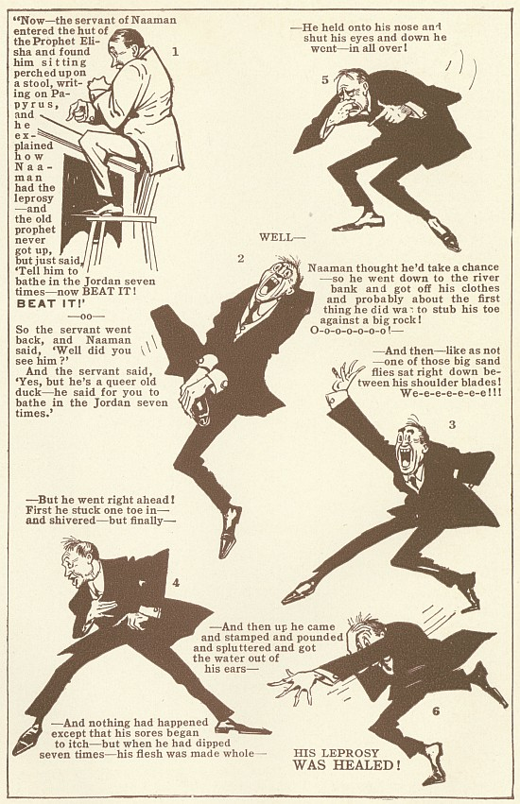
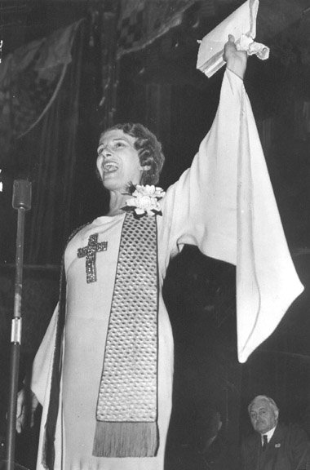
Synthesis?
Full gospel movement
Aimee McPherson on the radio
600 branches – megachurch of 5500 in LA
“heaven a cross between Pasadena and DC”
Billy Sunday and muscular Christianity

Slide 30
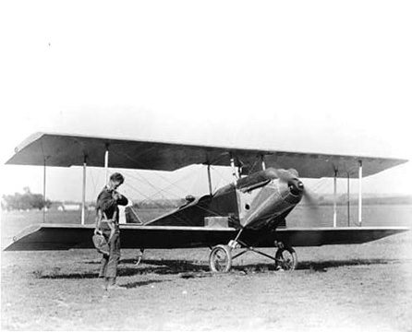
New Heroes for “America”
Lindberg – 1927, solo effort, Christian from the heartland,
What traditional Americans could do?
Later an isolationist

Slide 31
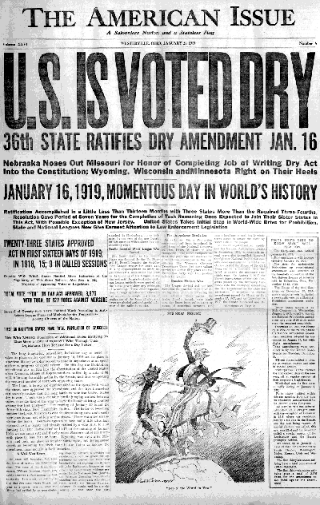
Prohibition – last gasp of progressives but urban population turned against it
1/20 Volstead Act to enforce 18th A. Progressive victory!
Billy Sunday “The reign of tears is over. The slums will soon be only a memory. We will turn our prisons into factories… men will walk upright now. Women will smile and children will”

Slide 32
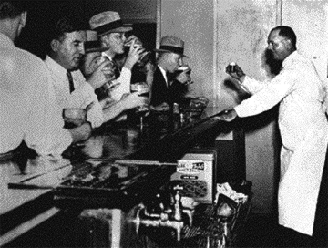
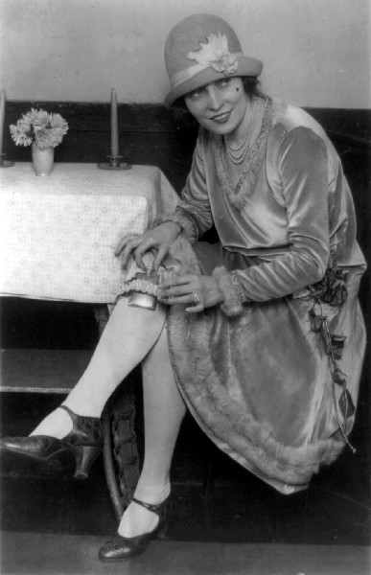
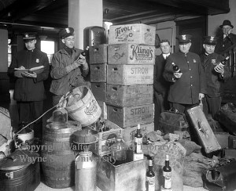

Slide 33
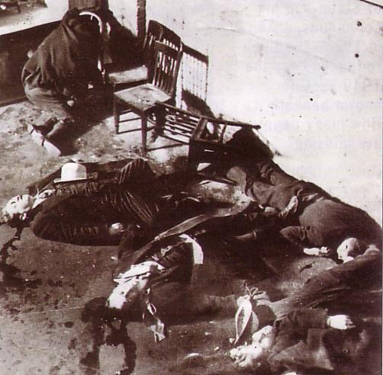
What went wrong? Problems of enforcement
Wets: liberals, immigrants, educated v. Drys: native born protestants
NY repealed enforcement bureau in 1923
Speakeasies
Organized crime – Al Capone
1928 – Hoover (dry) v. Smith (Wet)
Repealed in 1933. – consumption went down to 1/3 prewar level

Slide 34
Republican Resurgence – The End of Progressivism
No more crusading
Wilson it is only once a generation that a people can be lifted above materialism
Control of Presidency returned to GOP – although rural areas and south remained democratic
Harding
Coolidge
Hoover

Slide 35
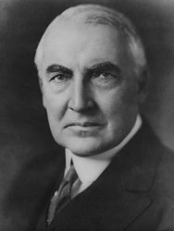
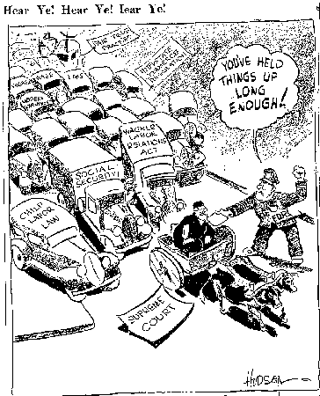
déjà vu all over again
Harding – the Old Guard
“America’s present need is not heroics, but healing … normalcy”
Appointed 4 justices opposed to progressivism
Sec of Treasury Mellon – trickle down: drastic lowering of tax rates, reduced inheritance tax and tax on corporate profits – why a problem?
Raised tariffs Fordney McCumber Tariff (38%)
Business consolidation –anti trust laws relaxed
Use of injunctions
Corruption: Teapot Dome (Albert Fall) , Veteran’s Administration

Slide 36
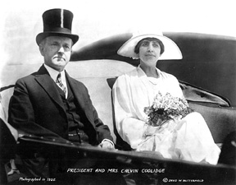
Calvin Coolidge (1923 – 29) – “the chief business of the American people is business”
Decreased taxes and debt
Slept 12 hours a day!

Slide 37
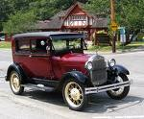
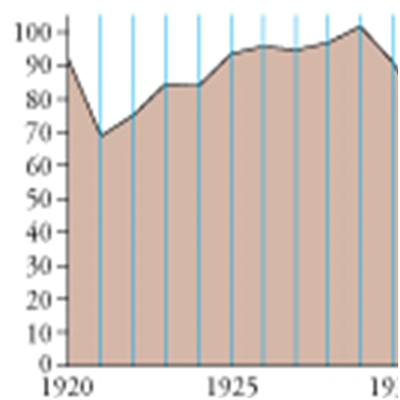
New Economic Order
Brief recession after ww1/demobilization
GNP soared from $70B in 1922 - $100B in 1929
New Economy - based on consumer goods – cars, appliances, radios
60% of homes electrified
23M cars by 1930 (9% of the economy)
Radios and networks

Slide 38
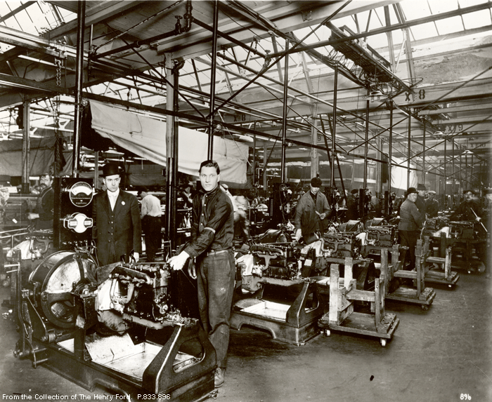
Business Practices Promoted Industrial Expansion!!!
Taylorism/Fordism
Assembly lines
Anti Union Activity and management violence but better wages
Mergers (again) ½ business activity by 100 companies
Republican caretakers “We care not what Democrats pass, if we can administer them”
Probusiness men to advisory boards

Slide 39
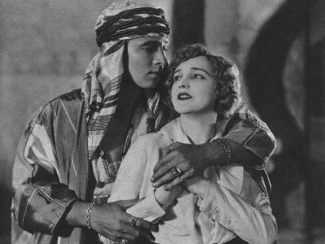
Cars, Radios, Movies
Radios – first commercial broadcast 1920; first networks 1926 → mass culture
Movies weekly attendance 80M!
Cars dominated economy by 1927 -27M (more than tubs)
Freedom from oversight
True suburbs
Decreased isolation of rural areas

Slide 40
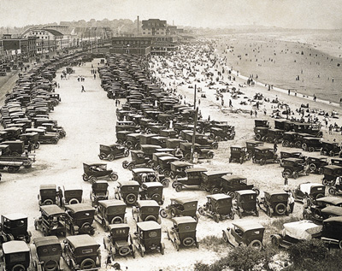
July 4, Nantasket Beach, Massachusetts, early 1920s
Notes:
Wadsworth.com

Slide 41
Auto Manufacturing
Notes:
Roark, American Promise 3e from http://www.bedfordstmartins.com/mapcentral

Slide 42
Consumer Economy

Slide 43
CONSUMERISM – anti puritanism
advertising (image vs. utility)
buying on credit
chain stores
Consumer Debt, 1920–1931
General Electric ad (Picture Research Consultants & Archives)
Notes:
Faragher, Out of Many, 3rd Ed.; http://wps.prenhall.com/hss_faragher_outofmany_ap/; Brinkley 11e IR
General Electric ad; Electric appliances became commonplace in the 1920s and advanced the consumer economy. Note here the obvious link between a daughter and her mother, whose domestic tasks appear to be made easier and more appealing by an electric range, a vacuum cleaner, and an iron. (Picture Research Consultants & Archives)
Pageant 13e

Slide 44
Advertising!

Slide 47
Credit
Dodge advertisement photo, 1933
< Ford ad: “Every family -- with even the most modest income, can now afford a car of their own."
“Every family should have their own car. . .You live but once and the years roll by quickly. Why wait for tomorrow for things that you rightfully should enjoy today?"
(Library of Congress)
Copyright © Houghton Mifflin Company. All rights reserved
Notes:
Ford ad- Henry Ford constantly worked to reduce car prices on his cars. He also promoted installment buying, promising in this ad that "with even the most modest income, [every family] can now afford a car of their own." This ad also encouraged impulse buying: "You live but once and the years roll by quickly. Why wait for tomorrow for things that you rightfully should enjoy today?" (Library of Congress) [Pageant 13e]
DODGE PHOTO: Nickolas Muray. Dodge, 1933.; PBS American Photography

Slide 48
Retreat from foreign affairs
Observers sent to LN
Washington Naval Conference – 5:5:3 – to cut spending
US would not fortify Philippines
Japan slighted
9 Power Treaty to keep China open
Kellogg Briand Pact: member nations agreed to not fight

Slide 49
Explain how each of the following contributed to the economic depression of 1929
The Fordney and McCumber Tariffs
The desire of Harding and Coolidge to lower taxes and cut government spending.
The decline in farm income
The fact that 16 million families earned less than $2000 a year
Value of building permits issued fell over 25% between 1925 and 1928.
The stock market crash of October 1929
1300 banks failed in 1930; 3700 failed in 1931 – 1932.

