Slide 1
Warm Up
Objective: Examine the events leading up to WWII
Review: Name 4 methods of enforcement of totalitarianism
Using the cartoon: Who are the ”America first” people at the time?
What is the cartoon trying to say?
Do you recognize the cartoon artist?

Slide 2
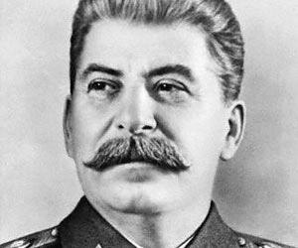
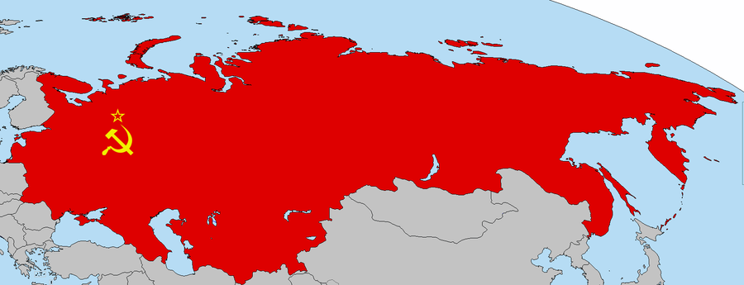
World War Looms
 | Nation | Political Movement & Beliefs
Joseph Stalin | Soviet Union (USSR) | Spread communism by worker’s revolution throughout the world; state ownership of property; eventual rule by the working class
 |  | Aggressive actions taken in the 1920s and 1930s
 |  | Massive campaigns to collectivize agriculture and to industrialize the nation (five-year plans); the Great Purge (“removed” anyone who threatened his rule)

Slide 3
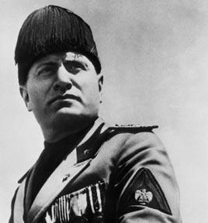
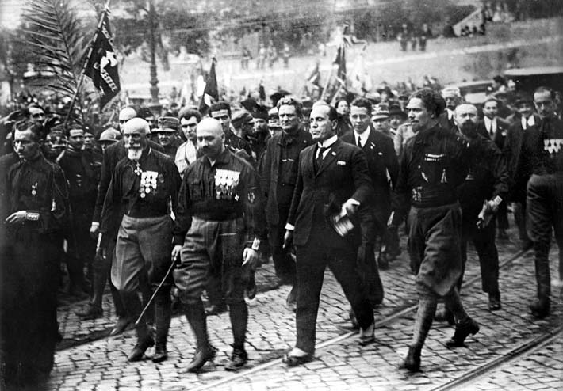
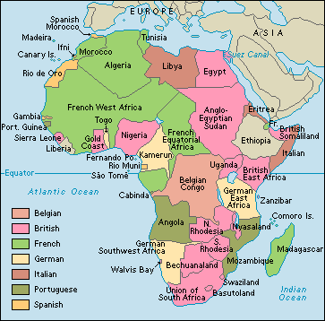
World War Looms
 | Nation | Political Movement & Beliefs
Benito Mussolini | Italy | Fascism and extreme nationalism; militaristic expansionism; strong centralized government; anti-communism
 |  | Aggressive actions taken in the 1920s and 1930s
 |  | The “march on Rome”; the invasion of Ethiopia

Slide 4
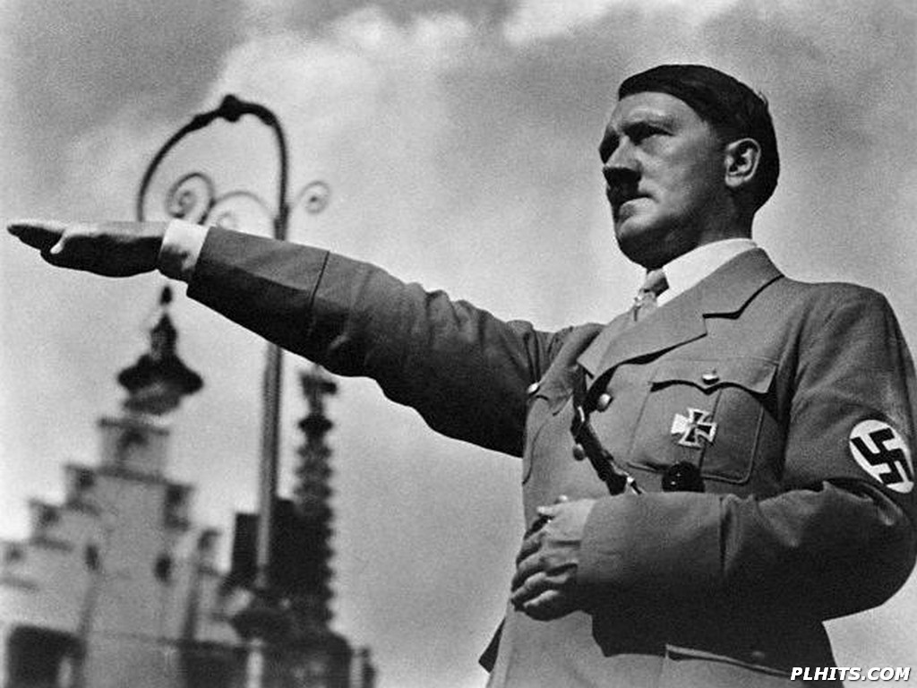
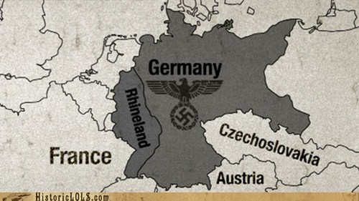
World War Looms
 | Nation | Political Movement & Beliefs
Adolf Hitler | Germany | Nazism; militaristic expansionism; strong government; anti-communism
 |  | Aggressive actions taken in the 1920s and 1930s
 |  | Established the Third Reich; pulled out of the League of Nations; built up military

Slide 5
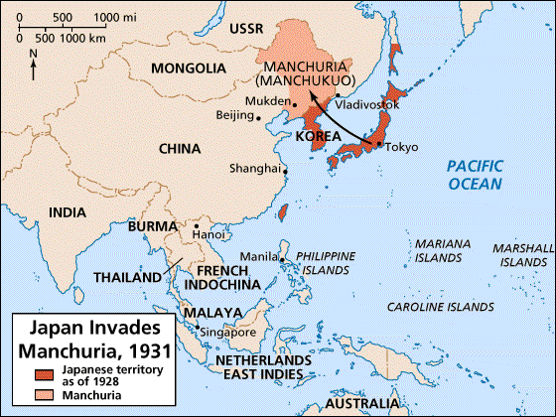
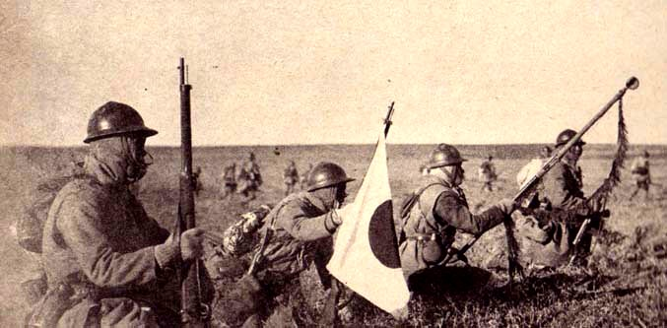
World War Looms
 | Nation | Political Movement & Beliefs
Japanese Militarists | Japan | Nationalism; militaristic expansionism (fueled by industrialization)
 |  | Aggressive actions taken in the 1920s and 1930s
 |  | The invasion of Manchuria; pulled out of the League of Nations

Slide 6
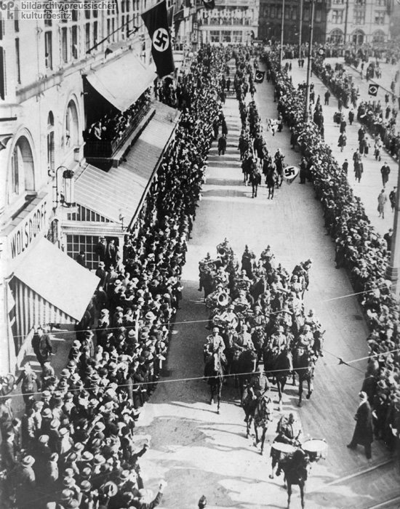
Germany Violates the Treaty of Versailles
Nazi Germany rebuilds military
1936-German Wermacht (army) reoccupied the demilitarized zone along the Rhine River
France & Britain took no action to stop them

Slide 7
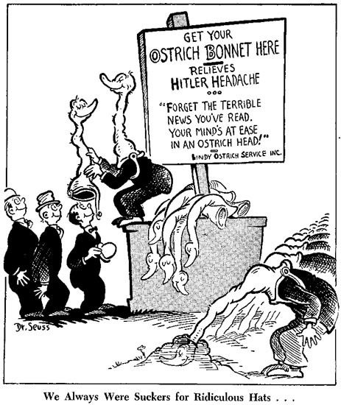
Why No Action?
France was politically unstable to face Germany alone
France & Britain both believed that Stalin was a greater threat than Hitler

Slide 8
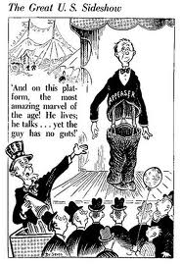
Why No Action?
Britain wanted to avoid a war at all costs
American isolationism led Britain to doubt that they would get US support

Slide 9
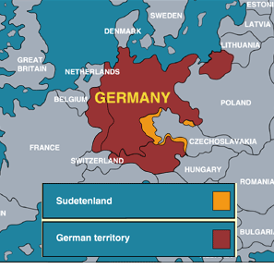
Czechoslovakia
1938-Hitler demanded that Czechoslovakia surrender the Sudetenland
Czechs refused; asked Britain and France for help

Slide 10
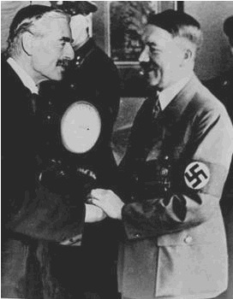
The Munich Conference
Britain and France decide on a policy of appeasement, agreed to support Germany’s claim
Hitler promises to not make further demands/threats

Slide 11
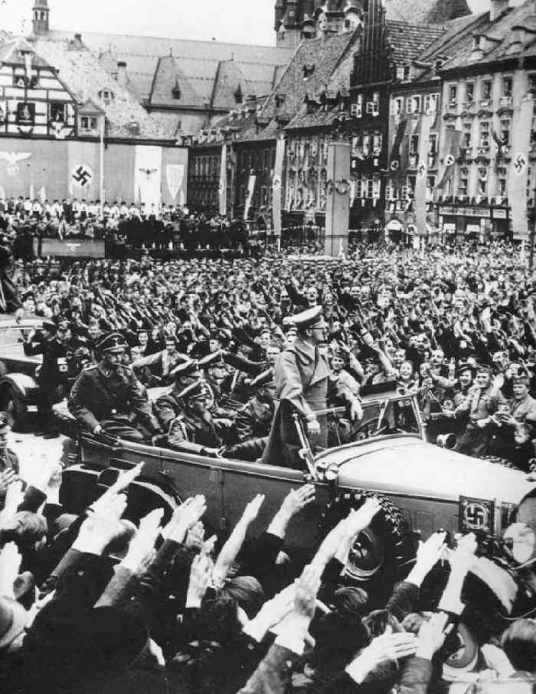
Appeasement Fails
In March 1939, Hitler invaded Czechoslovakia
Poland panicked, sought guarantees of protection from England and France

Slide 12
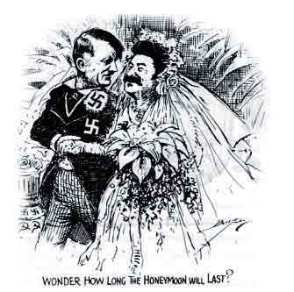
The Nazi-Soviet Pact
August 1939-Germany and the Soviet Union announced they signed a non-aggression pact
Not alliance, just agreement not to fight each other
Notes:
This removed the Soviet Union as a potential ally for Britain and France if a war with Germany broke out

Slide 13
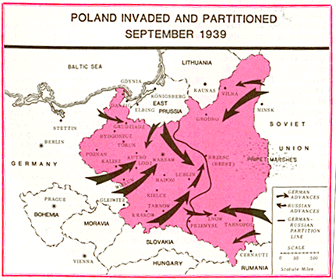
The Invasion of Poland
September 1, 1939
German forces invaded from the west, Soviets from the east
By the end of September, Poland had fallen
Britain and France declared war against Germany
Notes:
At the same time, the Soviets also moved against Finland and the Baltic States (Latvia, Lithuania, and Estonia)

Slide 14
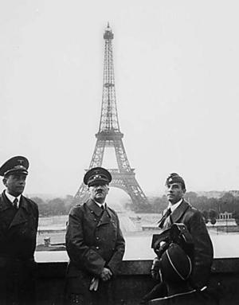
Germany’s Next Moves
By late spring of 1940, Germany had invaded Denmark, Norway, Belgium, Luxembourg, the Netherlands, France
France formally surrenders on June 22nd, 1940- 6 weeks after German invasion of France

Slide 15
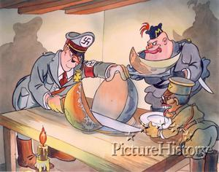
Tripartite Pact
September 1940
Formally joined Italy, Germany, Japan in a military alliance
Divided up spheres of influence
  Germany-Europe
  Italy -Mediterranean and Africa
  Japan-East Asia and the Pacific
Notes:
15

Slide 16
Recap
Germany commits numerous violations of the Treaty of Versailles
Wanting to avoid future conflict, France and Britain attempt to “appease” Germany
Appeasement ultimately fails; German victories Czechoslovakia, Poland, Western Europe occur in short time

Slide 17
Warm Up

Slide 18
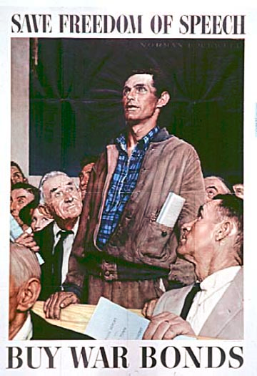
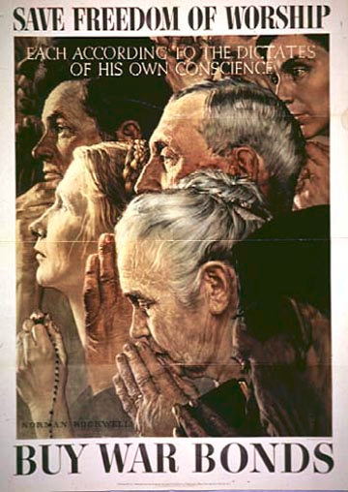
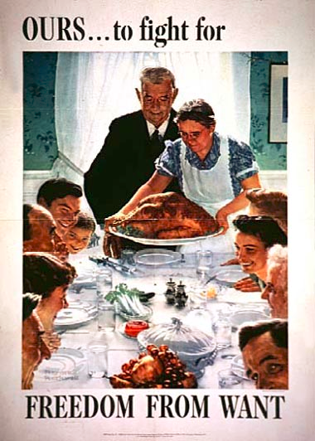
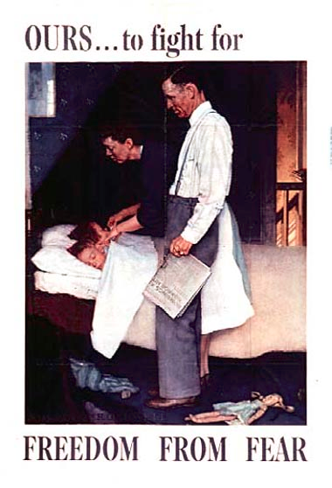
Warm Up
Objective: Explore US Entry into WWII
What aspects of the images stand out to you?
What ideas or messages are being communicated in these images?
Why do you think these ideas are being portrayed?
How do these sources portray freedoms in the U.S.?

Slide 19
Review
Appeasement fails; Germany conquered France, Poland, others quickly.
Germany-Soviet Union sign non-aggression pact.
U.S.A.- Not involved, remaining “isolated”

Slide 20
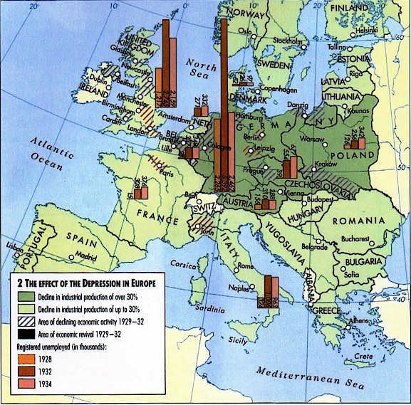
What led to support for Isolationism?
Idea of entangling alliances (League of Nations)
By 1934, Europe was broke; could not repay what they owed to U.S.

Slide 21
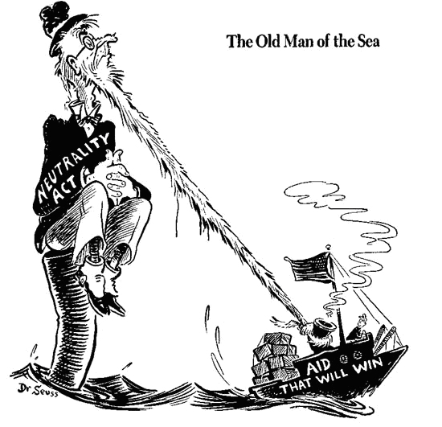
Neutrality Acts
Made it illegal for US to sell weapons to nations at war
1937- non-military supplies sold to nations at war paid for via cash and carry
1939- allow arms sales to Britain (cash and carry)

Slide 22
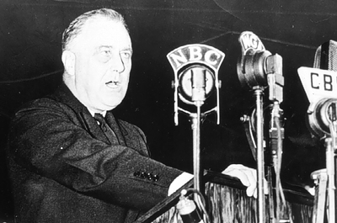
The Quarantine Speech
FDR called for a “quarantine” against any “aggressor” nations
Speech angered many American isolationists

Slide 23
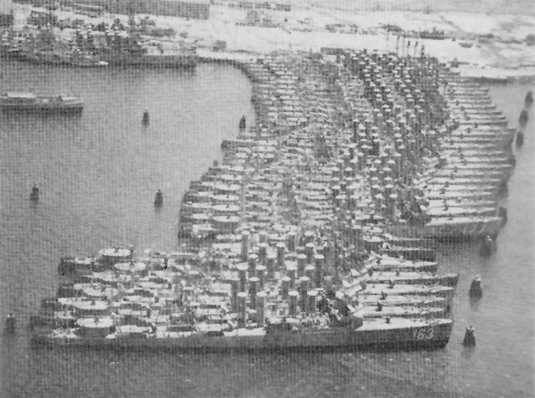
Destroyers for Bases Deal
Spring 1940: FDR agreed to trade 50 Navy destroyers to Britain in exchange for building US naval bases in British territories

Slide 24
Isolationism Debate
Some wanted US to take an active role
Some wanted the US to increase aid to the Allies but not fight
Some opposed ANY involvement

Slide 25
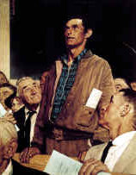
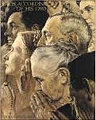
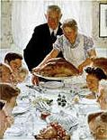
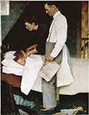
FDR’s “Four Freedoms” Speech
January 1941
Roosevelt proposed four fundamental freedoms that "everyone in the world" ought to enjoy:
  Freedom of speech
  Freedom of worship
  Freedom from want
  Freedom from fear

Slide 26
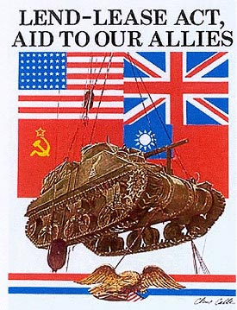
Lend-Lease Act
March 1941
US declared that it would lend or lease weapons to nations considered “vital to the defense of the US”
$40 billion in weapons sent to the Allies in WWII

Slide 27
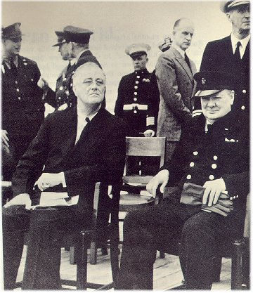
The Atlantic Charter
August 1941
FDR met with British Prime Minister Winston Churchill to lay out a post-war plan for prosperity
A group of 26 nations pledged their support for this declaration

Slide 28
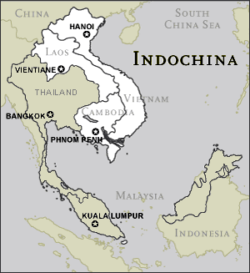
Japan Takes Advantage
1940-41: Japan occupied French Indochina (Vietnam, Laos, & Cambodia)
Threatens British/US colonies

Slide 29
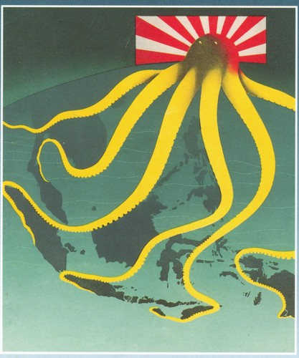
US Embargo
In response, US cut off Japan’s access to critical war materials such as steel and oil
Both supplies Japan bought almost entirely from US
Japan considered this an act of war

Slide 30
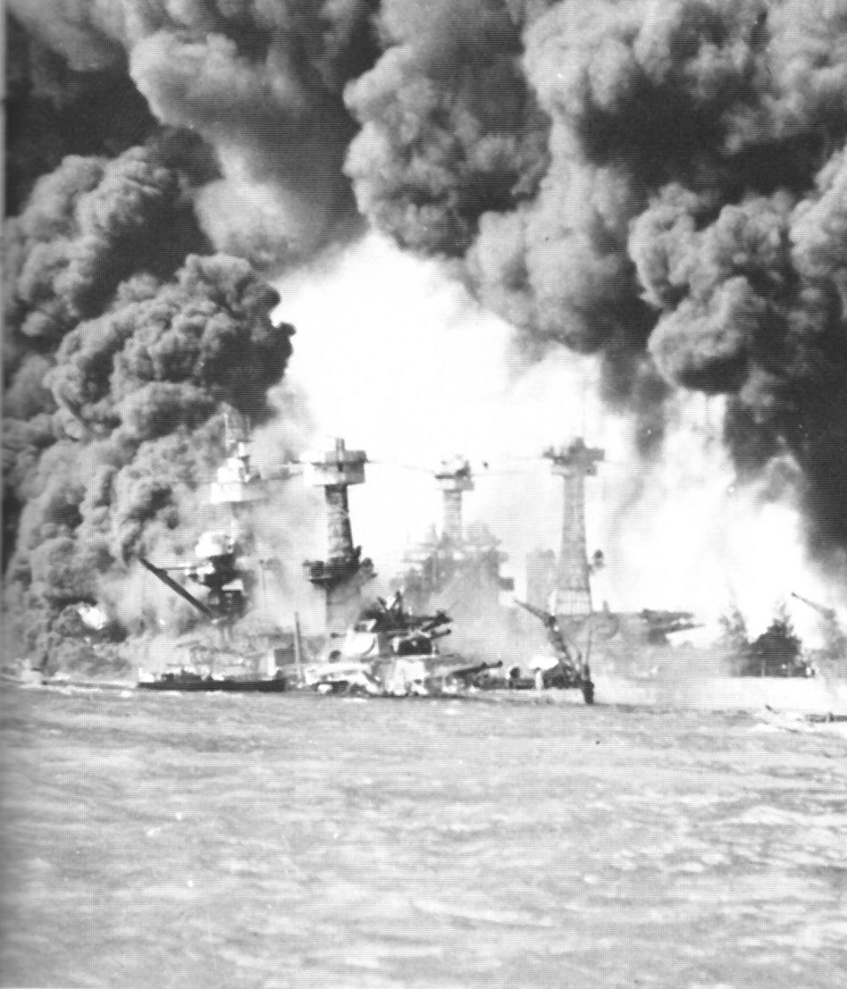
Pearl Harbor
December 7, 1941
Japan launched a surprise attack against US naval base in Hawaii
4 battleships destroyed
2403 Americans killed
Dec. 8, 1941: US and Britain declared war against Japan

