Slide 1
Warm up
Matching: Terms will be on study guide/test. Record answers in your journal
Members of the film industry publicly shamed for alleged communist influence
Soviet accomplishment caused panic in the American public/govt
Organization dedicated to investigate acts of “Un-American” activity
Trying to achieve an advantageous outcome by pushing dangerous events to the edge of conflict
Provided funding to U.S. education institutions at all levels, especially in science and math
Term for competition between USA-USSR for spaceflight supremacy
Collective defense treaty among the USSR and Soviet satellite states in Central and Eastern Europe
U.S. citizens who were executed for conspiracy to commit espionage for the USSR.
Widespread fear of a potential rise of communism
Soviet leader from 1953-1964, the height of the Cold War
Brinksmanship
Nikita Khrushchev
NDEA
Hollywood Ten
Red Scare
The Rosenbergs
HUAC
Sputnik
Warsaw Pact
Space Race

Slide 2
Answers
Members of the film industry publicly shamed for alleged communist influence
Soviet accomplishment caused panic in the American public/govt
Organization dedicated to investigate acts of “Un-American” activity
Trying to achieve an advantageous outcome by pushing dangerous events to the edge of conflict
Provided funding to U.S. education institutions at all levels, especially in science and math
Term for competition between USA-USSR for spaceflight supremacy
Collective defense treaty among the USSR and Soviet satellite states in Central and Eastern Europe
U.S. citizens who were executed for conspiracy to commit espionage for the USSR.
Widespread fear of a potential rise of communism
Soviet leader from 1953-1964, the height of the Cold War
Brinksmanship
Nikita Khrushchev
NDEA
Hollywood Ten
Red Scare
The Rosenbergs
HUAC
Sputnik
Warsaw Pact
Space Race

Slide 3
Review
Eisenhower becomes President in 1953.
U.S. foreign policy of brinksmanship; foreign tensions remain high with new Soviet leader Nikita Khrushchev
Example of tension?
Cold War extends to other nations, arms race continues
Example of foreign engagement?
Space tech and education are now battlefields

Slide 4
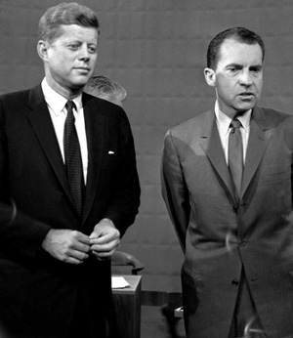
Election of 1960
Republican-Richard Nixon
Democrat-John F. Kennedy
Election featured the first televised presidential debates
First time TV used as a serious campaign tool

Slide 5
The Debate
On the radio
Nixon sounded more experienced with issues (He won)
On the TV
Nixon lost, looked sweaty, uncomfortable, awkward
JFK won, looked relaxed, poised, charismatic

Slide 6
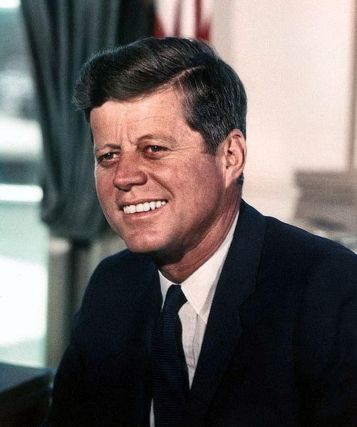
John F. Kennedy
35th President (1961 – 63)
WWII veteran
Former Senator from Massachusetts
First Catholic president
Youngest President at age 43

Slide 7
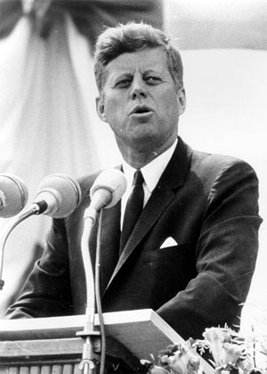
What was the New Frontier?
JFK’s legislative program that promoted idea that govt should work for people
Called “New Frontier” after he used the term in his acceptance speech

Slide 8
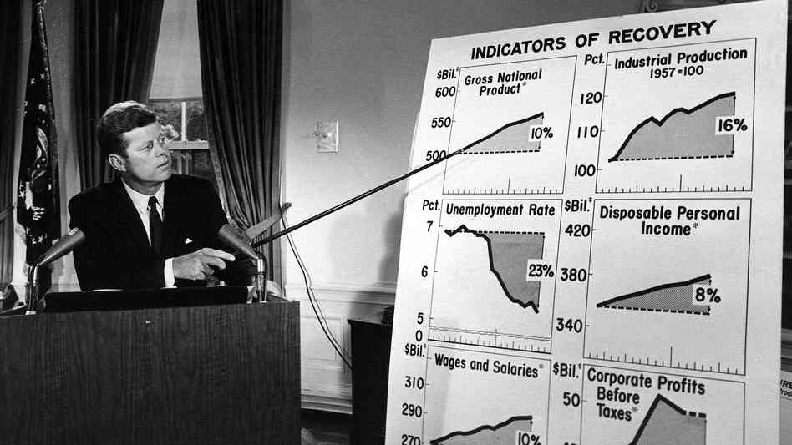
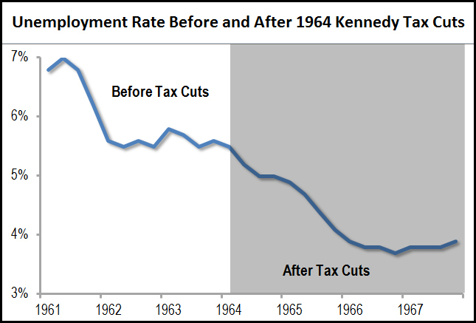
Economic Recession
Problem | Solution | Programs, laws, and accomplishments
Economic recession | Increased spending; deficit spending Lower taxes | Congress increased defense spending Increased the minimum wage Extended unemployment insurance

Slide 9
Poverty Abroad
Problem | Solution | Programs, laws, and accomplishments
Poverty Abroad | Offer assistance to developing nations | The Peace Corps- volunteer aid to Asia, Africa, Latin America The Alliance for Progress- technical assistance to Latin America

Slide 10
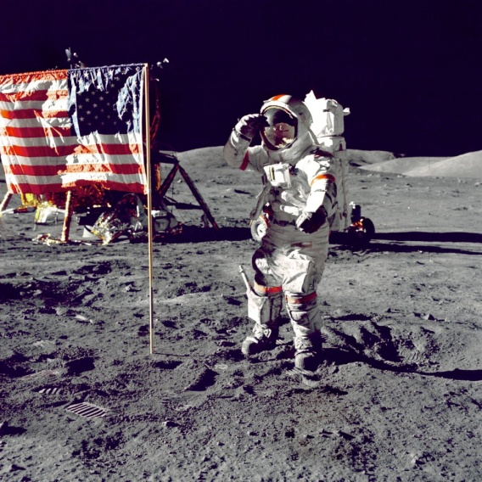
Soviets in Space
Problems | Solution | Programs, laws, and accomplishments
Soviet Successes in Space | Set the goal of landing on the moon before the end of the 1960s | U.S. astronauts orbited the Earth (John Glenn and Mercury Program) Landed on the moon in 1969 (Apollo Program and Neil Armstrong) Science programs expanded New technological developments

Slide 11
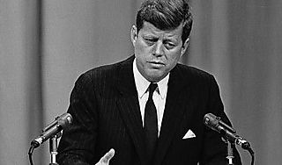
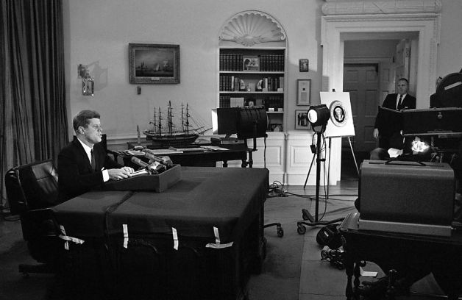
Rejected Proposals
Reform proposals did Kennedy make that were rejected by a conservative Congress: Medical care for the elderly Rebuilding of blighted urban areas Federal aid for education Kennedy lacked a popular mandate-clear indication that voters approved of his plans

Slide 12
Later Proposals
Proposals that Kennedy made but never had the chance to get through: A “national assault on poverty” An investigation of racial injustice in the South A national civil rights bill

Slide 13
Summary
Election of 1960- TV plays large role in JFK getting elected
New Frontier plan- Kennedy’s vision of progress in multiple areas
Although JFK faces some opposition in Congress, accomplishments are made
Economic, Poverty abroad, Space

Slide 14
In-Class; Kennedy’s Inaugural Address
What do you believe JFK means when he says, “If a free society cannot help the many who are poor, it cannot save the few who are rich”?
Explain the following: “Let us never negotiate out of fear. But let us never fear to negotiate.”
What sorts of things does Kennedy believe science can do?
What are the “common enemies of man”?
Why do you believe that Kennedy said “ask not what your country can do for you- ask what you can do for your country”?

