Slide 1
Warm up
After the horrible experience of WWI, what factors do you think led to another World War?
What do you think could have been done after World War I to prevent World War II?
What do you think are some post-war feelings in the U.S. at this time?

Slide 2
Post War Changes in America

Slide 3
Postwar Trends
Nativism- prejudice against foreign born people, swept the nation
Isolationism- policy of pulling away from involvement in world affairs
Post-war Inflation
As regular factory production resumed, pent-up demand for goods drove up prices
Inflation in 1919 alone was over 15%
Rising cost-of-living led to increased wage demands by labor

Slide 4
Strikes
Seattle General Strike (1919)
Shipbuilders in Seattle went on strike for better wages
60,000 workers went on strike, but gained little
Boston Police Strike (1919)
75% of Boston's police force went on strike for higher pay
Massachusetts Gov. Calvin Coolidge sent in the National Guard to restore order
The Steel Strike
350,000 steel workers went on strike for better pay
US Steel blamed the strike on foreign immigrants
US Steel hired African-Americans and Mexican replacement workers to keep the steel mills runnings

Slide 5
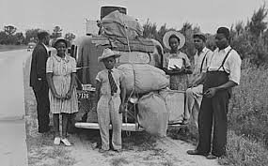
Population Shifts
European immigration stopped during the war, creating employment opportunities for minorities
Many AAs left the south for the north -The Great Migration
AAs were drawn to better pay, higher standard of living, and improved political rights in North.
Many Mexicans also entered the US to fill the labor shortage

Slide 6
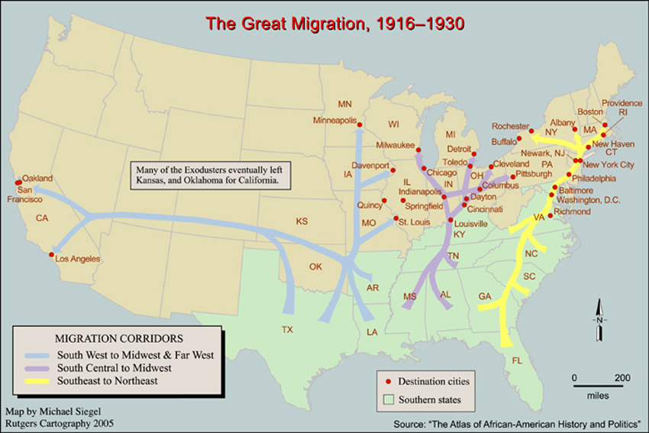

Slide 7
Isolationism
President Harding urged America not to get involved in foreign alliances
America would still trade with other nations
No League of Nations membership

Slide 8
Fear of Communism
In the U.S., there’s been a long history of fear of communism and suppression of socialist ideas.
Communism-all the people/workers will own all the ways of making money—all the land, machines, stores (No private business, no way for one person to become rich).
Labor strikes led to fear that Communists were trying to create a revolt in the US similar to the one that had occurred in Russia in 1917
Why does communism look attractive?

Slide 9
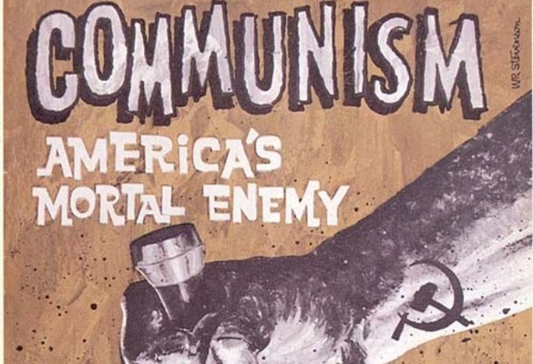
The Red Scare
In April 1919, dozens of bombs were sent through the US Mail to important government officials and business leaders, furthering the belief that communists were plotting against the US
Made people believe that that communists were plotting against the US
Lead to Red Scare- A growing climate of xenophobia, anti-radicalism, and nativism during WWI and into the 1920’s.

Slide 10
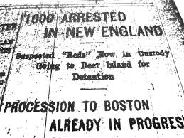
The Palmer Raids
US Attorney General A. Mitchell Palmer, sent federal agents to raid the headquarters of various radical organizations, trying to find the bombers/communists
Agents entered homes without search warrants, jailed individuals without charges, and refused them access to lawyers-all violations of basic civil rights
No evidence was ever found, but hundreds of immigrants deported as communists

Slide 11
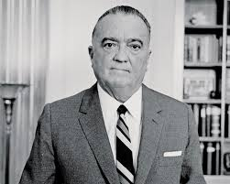
J. Edgar Hoover/FBI
Palmer also organized a new branch of the Justice Department – the General Intelligence Unit (GIU)
Later renamed the Federal Bureau of Investigation (FBI)
To investigate “radical” organizations
Palmer chose J. Edgar Hoover to head the GIU/FBI in 1924
Hoover remained in charge until his death in 1972

Slide 12
“Keep America for Americans”
Anti-immigrant attitudes grew after WWI
Congress decided to limit immigration from certain countries- Southern and Eastern Europe
Quota System- maximum number of people who could enter from a foreign country
Goal- cut European immigration to the US
Notes:
Quotas discriminated against people from Southern and Eastern Europe
2% of number of people living in US in 1890

Slide 13
Rise of the KKK
The KKK was reborn in 1915 as a much more formally structured organization
The Klan preached on the purification of America, practiced racism, anti-Catholicism, anti-communism, nativism and anti-Semitism
Strong membership in mid-western cities like Detroit and Chicago
In the 1920s, membership was as high as 15 million

Slide 14
Sacco & Vanzetti Trial
Ferdinando Sacco and Bartolomeo Vanzetti were Italian immigrants who were convicted in 1920 with armed robbery and murder
Highly controversial trial, there was almost no evidence against them
Many believed the two men were blamed simply due to the fact that they were immigrants and associated with anarchist organizations
Both were executed in 1927

Slide 15
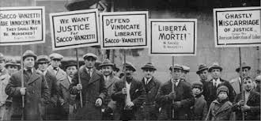
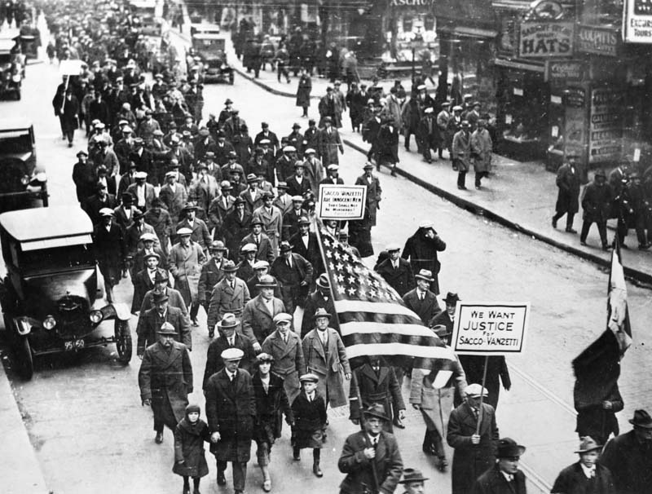
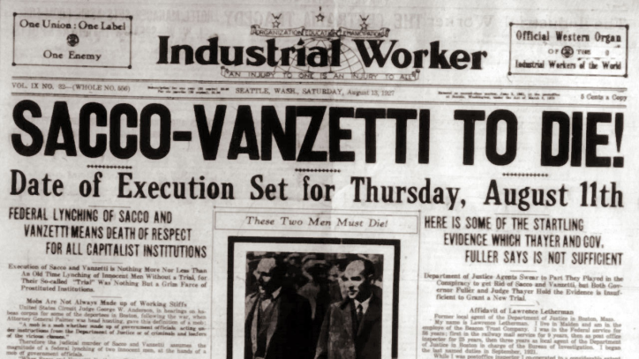

Slide 16
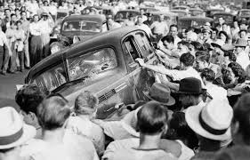
Urban Race Riots
Violent race riots erupted in Northern cities as WWI veterans returned to work only to find themselves competing with AAs and Mexican immigrants for jobs
Worst riot was in Chicago where a two-week long riot killed 38 and injured thousands

