Slide 1
Sectionalism to Nationalism

Slide 2
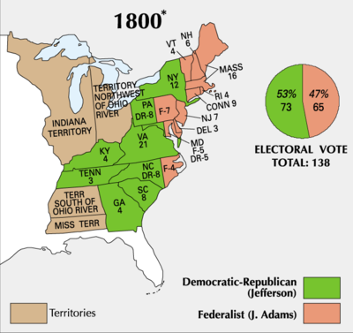
1800 – A Divided Nation!!! The first contest between two organized parties – first time congressional caucuses chose candidates before selection of electors

Slide 3
Federalists argued, a vote for Republicans was “for the tempestuous sea of anarchy and misrule”
Jefferson seen incorrectly as an atheist
Democratic Republicans argued, the vote was for “peace or war, happiness or misery”

Slide 4
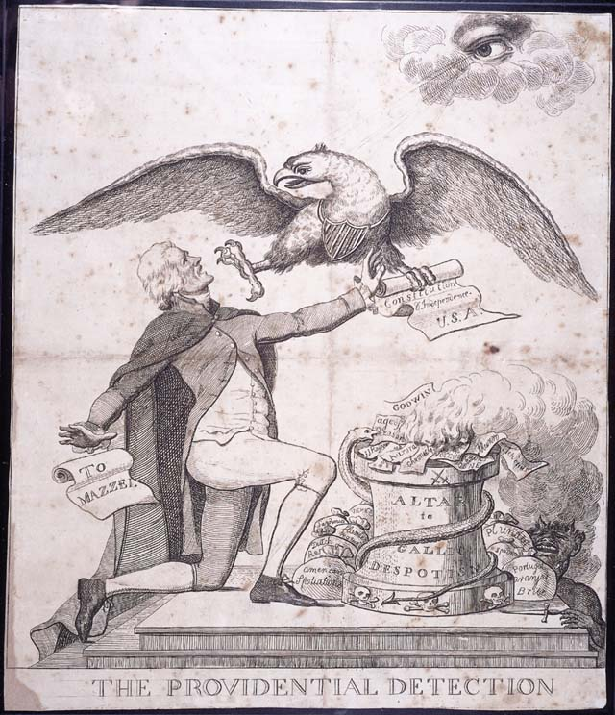

Slide 5
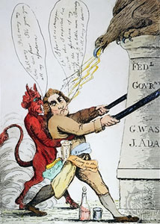

Slide 6
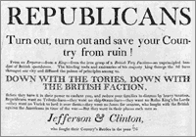

Slide 7
Election Results
A tie between Burr and Jefferson (the two republican candidates) → 12th Amendment
Adams would have won if Burr had not enabled Jefferson to carry NY
The beginning of the Virginia Dynasty
Revolutionary!
Not in terms of policy but a peaceful change of leadership – never before seen
Importance of inaugural address – promotion of unity in a divided nation!
“ let us unite with one heart and one mind… we are all Republicans, we are all Federalists.”

Slide 8
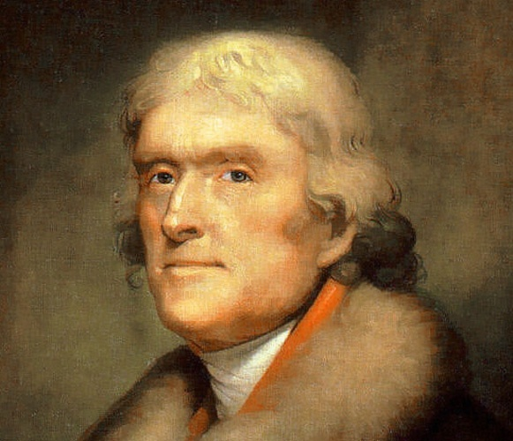
Jefferson’s republicanism only partly shaped the nation.
Continued many policies: tariff, national bank, debt payments, did not restaff government “few die, none resign”
BUT: “encouraged frugality,” abolished internal taxes, allowed sedition act to expire, changed residency requirement back to five years, cut the size of the government, shrunk the army, built a mosquito fleet for coastal defense not protection of trade, decreased formality of office, growing stress on social equality

Slide 9
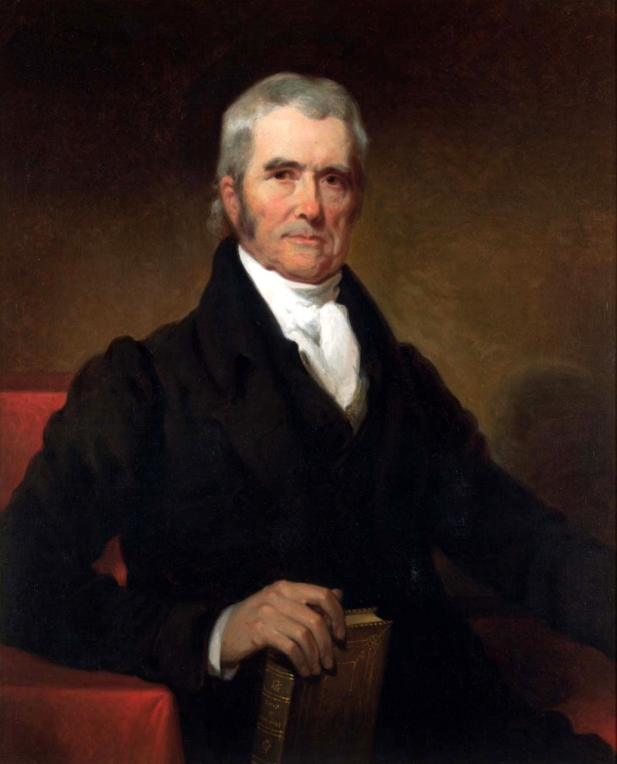
War on the Courts
Favored positive law, not the common law. Judges should reflect the mood of the people.
Worked to impeach federalist judges.
Repealed judiciary act of 1801 which had created new courts and ensured positions for losing Federalists.
Denied Marbury his commission. Marbury sued Madison to get his position→

Slide 10
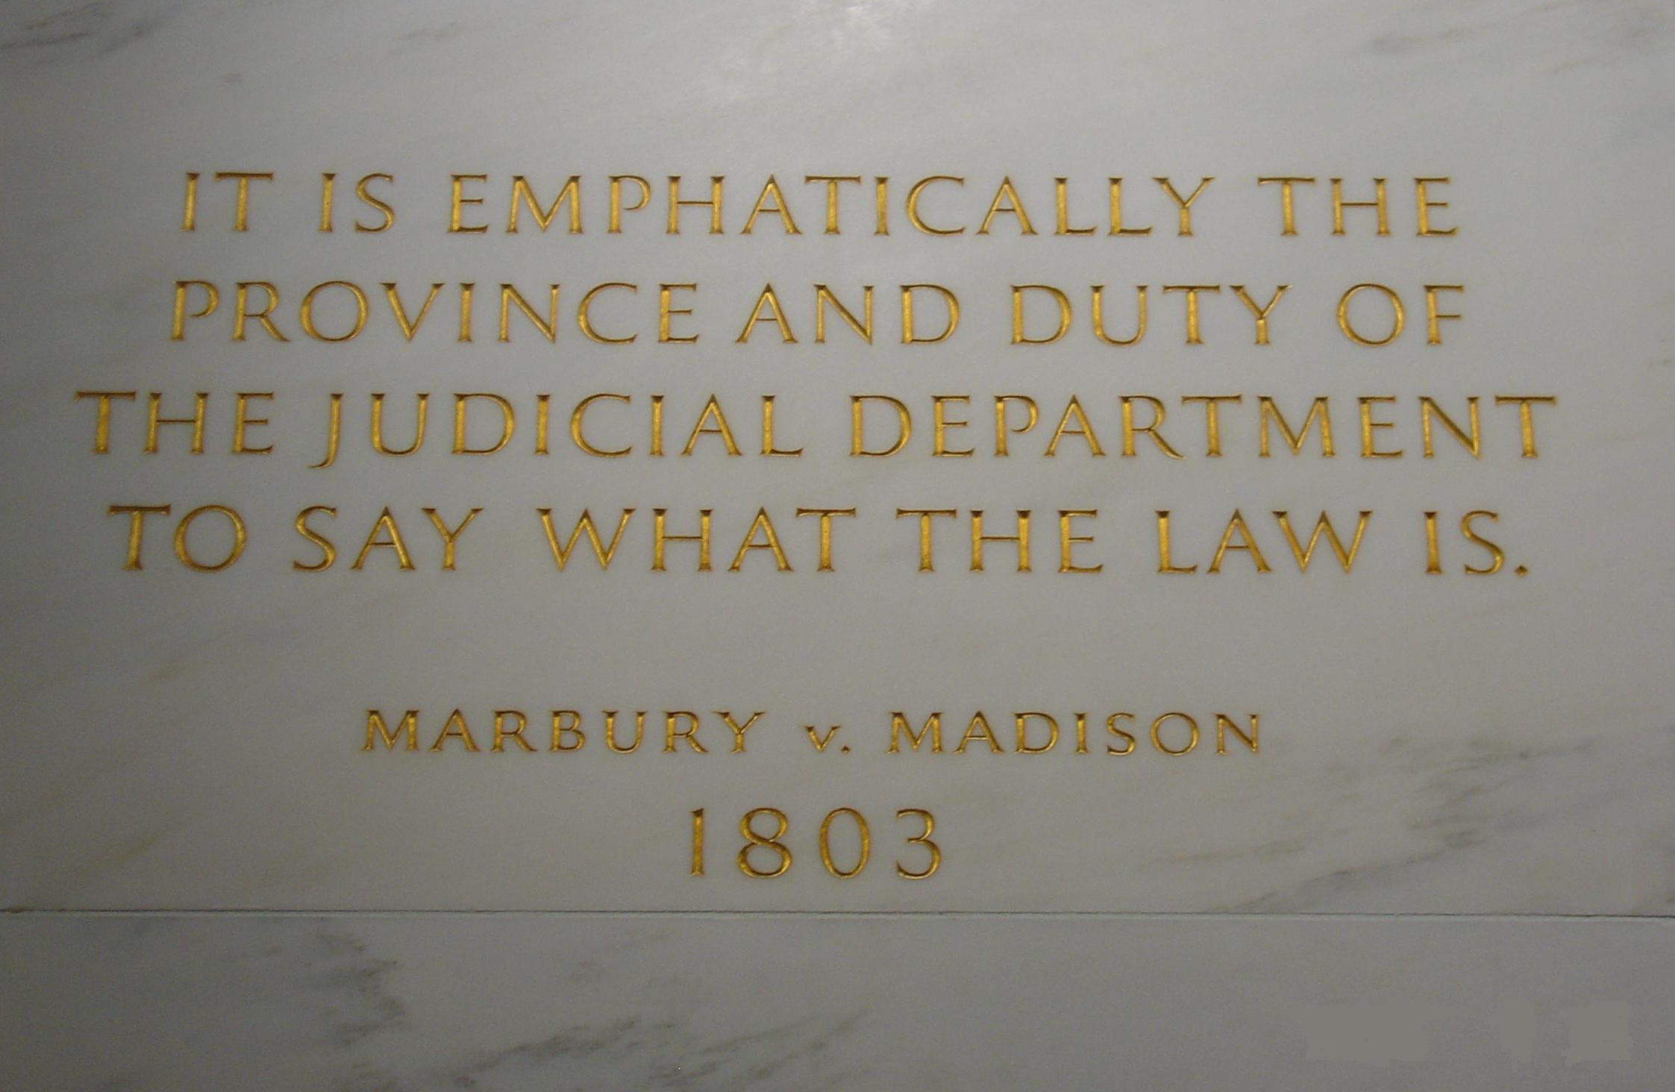
Marbury v. Madison
Marbury sued for a writ of mandamus
Marshall: Marbury owed the position , but could not have writ because the provision of JA of 1789 that gave the court this jurisdiction was unconstitutional
the right of judicial review established – a nondemocratic idea.
J had favored giving the states this right.
But since J won there was nothing for him to challenge

Slide 11
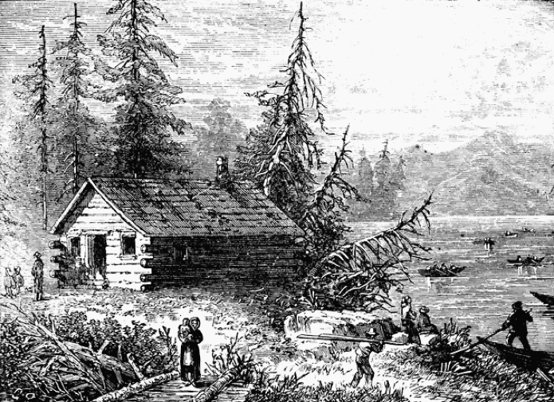
The West
great interest in the west
New land policy to promote “an empire of liberty” – cut amount of land required for purchase from 640 to 320 acres and allowed payment on time.
Prevent landlessness, and the development of urban “sores” with inequality

Slide 12
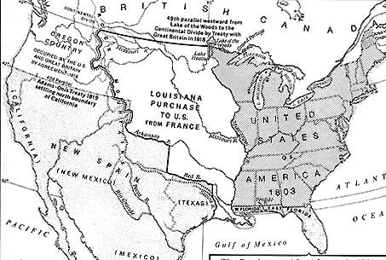
Importance of New Orleans – threat of French control
Mission: New Orleans or treaty with England
Napoleon – need for cash, Haiti Rebellion
$15M
What were the ideas of Federalists and Dem-Reps regarding constitutionality of the purchase?
What was the significance of the purchase?
PROMOTION OF AGRARIANISM
SECURED CONTROL OF MISSISSIPPI

Slide 13
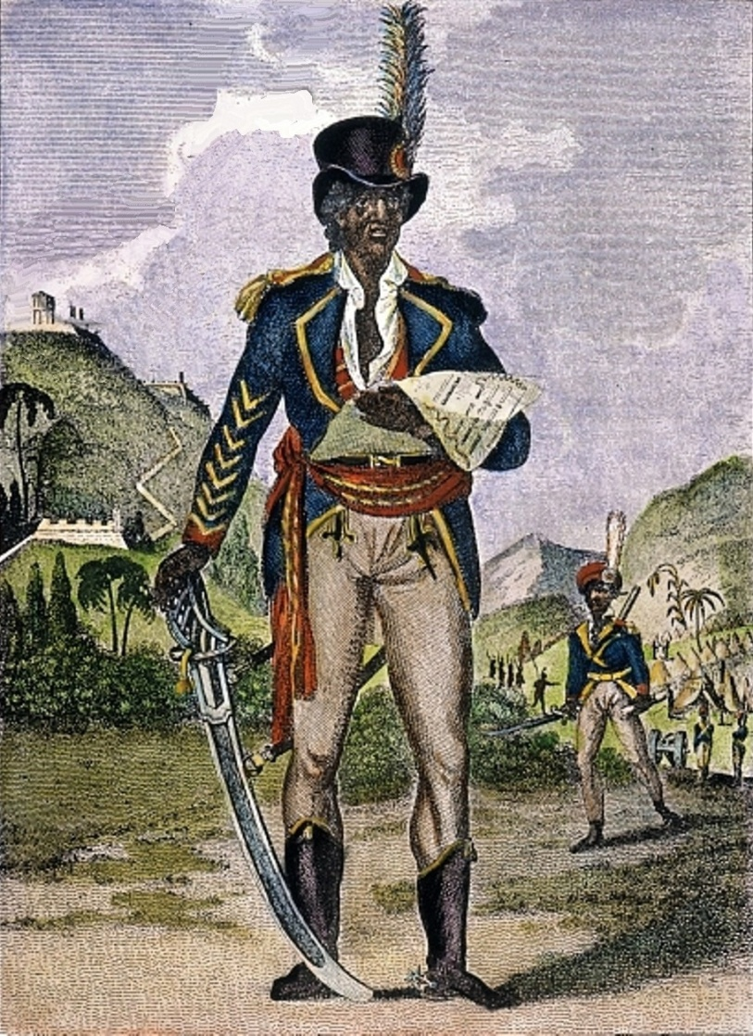
Haiti’s Rebellion
A black Haitian, a former slave-owner, led rebellion (1798 – 1803)
Slave-owners feared uprising would spread to US
Aid to rebels from US cut off by Jefferson (Adams, supported slaves – enemies of France)

Slide 14
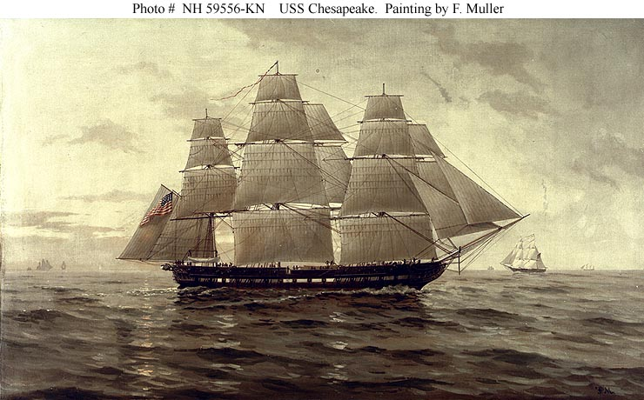
And then there were the problems of neutrality…
“entangling relations with none” – 1801
But: near constant conflict with England since 1775 and their allies the Native Americans
Jefferson’s attempts to promote assimilation failed in northwest. Tecumseh and The Prophet (Shawnee)s supported tradition.
In the southeast many including Cherokee assimilated
British seizures of ships and impressments of seamen (6000)
1807 Chesapeake Incident
“the country has never been in such a state of excitement since the battle of Lexington.” (Jefferson)

Slide 15
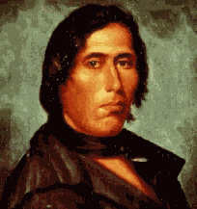
Tecumseh and the Prophet
Very familiar Native American arguments –
land issues
rejection of assimilation
Need of confederation
“Sell a country! Why not sell the air, the great sea, as well as the earth? Did not the Great Spirit make them all for the use of his children?”
“Where are the Pequot, Narragansett, the Mohican, the , and other powerful tribes of our people? They have vanished before the avarice and oppression of the white man, as snow before the summer sun.”

Slide 16
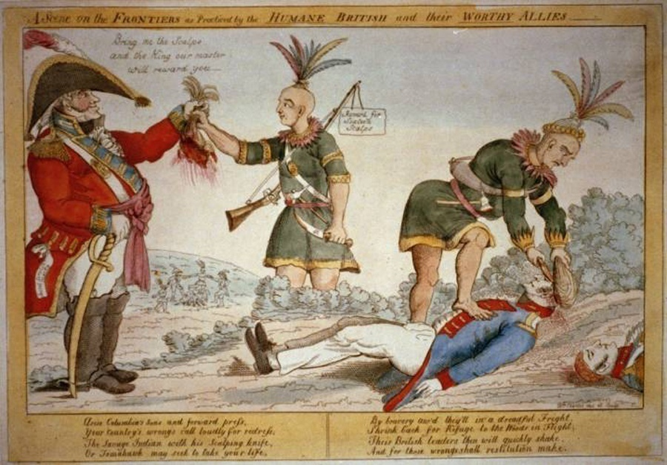
Battle of Tippecanoe - 1811
General W. H. Harrison
“ no doubt of the influence of British agents”
Tecumseh later led all out war against Americans

Slide 17
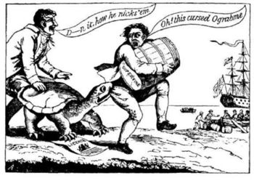
Jefferson and Madison tried to avoid war!!!
1806 – non importation failed
1807 – Embargo Act
An unpopular disaster causing economic depression
MA and CT refused to obey law
England had full warehouses
Madison: Non- Intercourse (1809)
Macon’s Bill Number 2 (1810)
No resolution

Slide 18
The War Debate
Not a presidential war! Popular pressure.
War Hawks. NATIONALISTS !Young representatives from south and west – expansionists, anti-British, nationalists, pressed Madison for war
Henry Clay and John Calhoun
Saw impressment differently from Federalists
Problems with Native Americans. Desire for Canada and Florida to weaken Native Americans
“On to Canada”

Slide 19
But was it the shipping rights of neutrals that led to the Declaration of War in 1812?

Slide 20
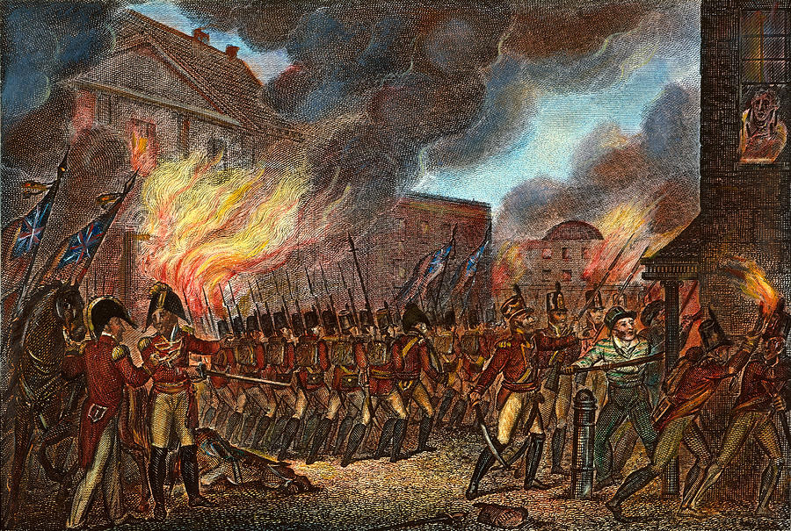
The Results of the War
For the most part the war did not go well.
Little enthusiasm for the war – few volunteer troops. Lack of support in NE
A nation unprepared – no bank, limited tax revenues, fleet building halted
The capital was burned and only a stirring defense of Baltimore saved the city
Jackson did defeat Creek and Cherokee at Horseshoe Bend
Treaty of Ghent (1815) – “status quo ante- bellum” no land transfers, no mention of impressments
Britain still fearful of France on the continent wanted to conserve rsources

Slide 21
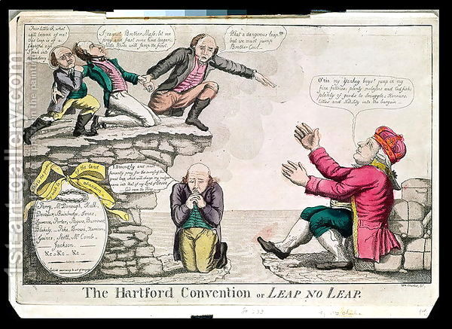
Hartford Convention (January, 1915) – sectionalism!
Meeting of federalists to propose constitutional amendments
2/3 vote in Congress necessary for war, admission of new states, embargoes
No two successive presidents from the same state

Slide 22
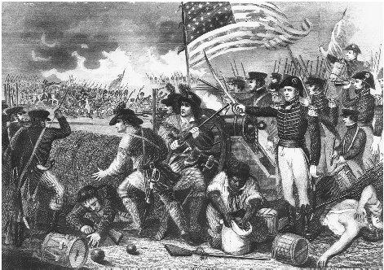
Understand!!!! – nationalism and democracy reinforced.
Battle of New Orleans (post Ghent) Jackson, with militia, pirates, volunteers, defeated English (2000 casualties to 20)
American exceptionalism – democracracy overcame Old Europe!
Jackson – a NEW HERO!

Slide 25
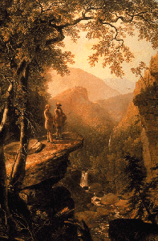
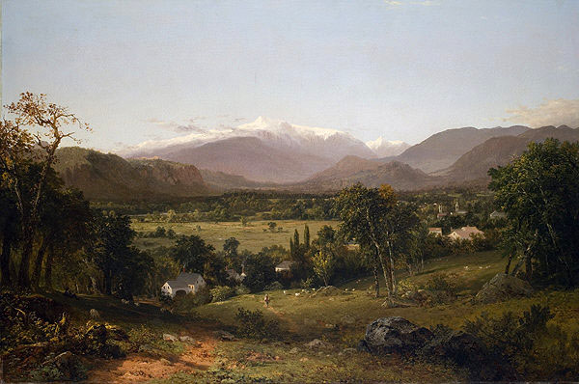
Warm up: copy this slide Cultural Nationalism
Literature:
James Fenimore Cooper – Last of the Mohicans
American themes and Heroes
Art – Hudson River School
Durant
Church

Slide 26
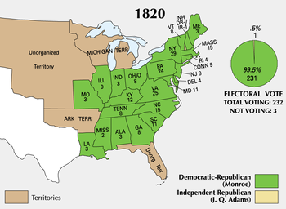
A new sense of nationalism (feeling of national identity and unity) replaced sectionalism and party loyalties
Federalist party, discredited, disappeared→ Era of Good Feelings
Intra party strife (quids =radical republicans)

Slide 27
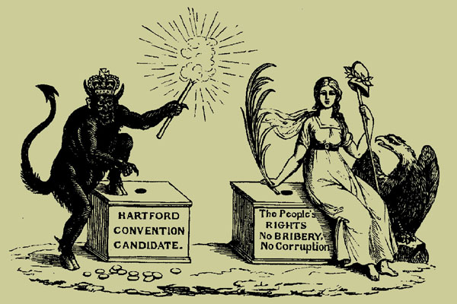

Slide 28
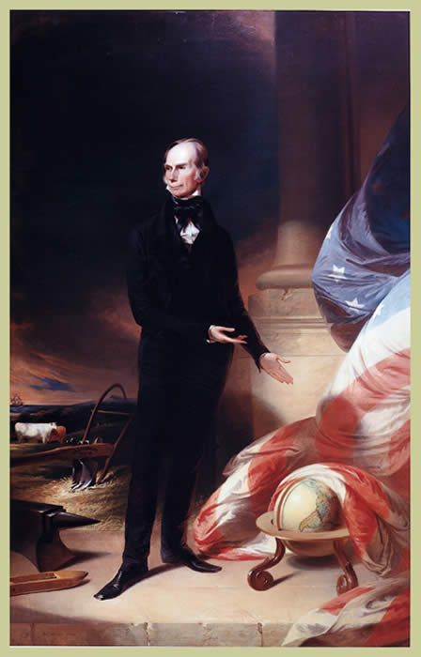
Federalist ideas reborn in Republican Party (republicans become nationalists!)
Madison in 1815 called for expansion of navy and army, a protective tariff, a new national bank and internal improvements
Clay called his plan for national bank, tariffs and internal improvements the American System – government support for economic growth
Elements of plan support each other
Reflected and promoted market economy
Promote national unity
Role for each region:

Slide 29
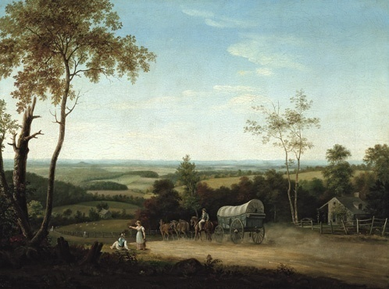
American Plan mostly passed
Tariff supported in all regions
A new national bank passed in 1816 , again chartered for 20 years
The national road was extended but Madison vetoed roadbuilding in states. States became builders of roads and canals
JQ Adams (P in 1824) even called for a national university

Slide 30
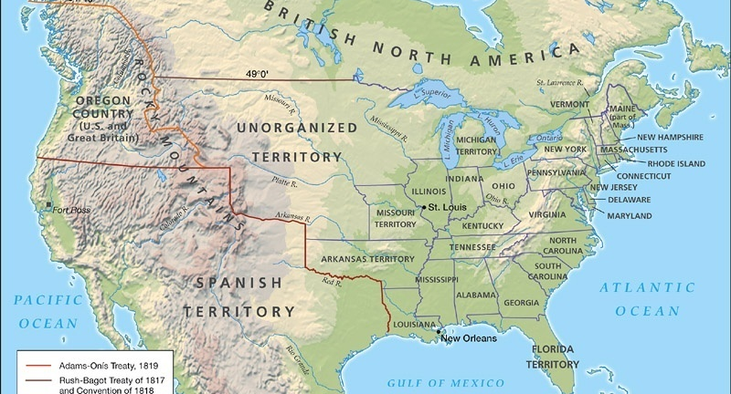
Foreign Policy of Monroe (strong assist by JQ Adams) – proactive, nationalistic
Treaty of 1818: shared control of Oregon for 10 years, northern border of LA Purchase
Seizure of Florida. Adams Onis or Florida Acquisition Treaty (1819)
Jackson sent to FL to retake slaves and push back Seminoles. Jackson seized Spanish forts and threatened to hang governor.
Adams; FL derelict therefore it may be seized. Spain agreed – in return US gave up claims to Mexico

Slide 31
Monroe Doctrine (1823) – not a law!
US did not pass joint resolution with Britain, but knew Britain would support US
No new colonies or interventions in the Americas
The US would protect its interests
US would not intervene in Europe

Slide 32
Chief Justice Marshall Nationalism in the Courts
McCulloch v. Maryland (1819)
Supported idea of loose interpretation
Struck down state law.
The threat of a powerful central government
“the States have no power, by taxation or otherwise, to retard, impede, burden, or in any manner control, the operations of the constitutional laws enacted by Congress”

Slide 33
Cohens v. VA (1821)
The right of the SC to review decisions of state courts
Gibbons v. Ogden (1824)
Only federal government can regulate interstate trade

Slide 34
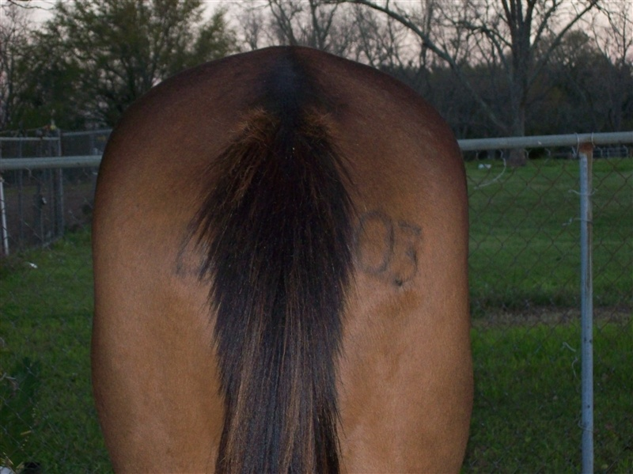

Slide 35
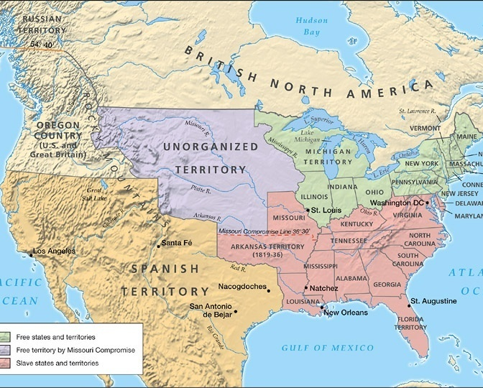
The issues
First territory in LA:
Significance of Balance:
Precedents:
Petition for Statehood:
Tallmadge (1819):
The Responses:
The Compromise:

Slide 36
John Q. Adams…“I take it for granted that the present question is a mere preamble – a title page to a great tragic volume.”
T Jefferson … “All I fear, do not see the speck on the horizon which is to burst on us as a tornado… the dispute was like a firebell in the night… It filled me with terror”

Slide 37
… ought they [opponents of slavery], to risk, in the remotest degree, the consequences which this measure may produce? These may be the division of this Union and a civil war. Knowing that whatever is said here must get into the public prints, I am unwilling, for obvious reasons, to go into the description of the horrors which such a war must produce, and ardently pray that none of us may ever live to witness such an event. - Pinckney

Slide 38
Jefferson, April 22, 1820 … The cession of that kind of property, for so it is misnamed, is a bagatelle which would not cost me a second thought, if, in that way, a general emancipation and expatriation could be effected; and gradually, and with due sacrifices, I think it might be. But as it is, we have the wolf by the ears, and we can neither hold him, nor safely let him go. Justice is in one scale, and self-preservation in the other. Of one thing I am certain, that as the passage of slaves from one state to another would not make a slave of a single human being who would not be so without it, so their diffusion over a greater surface would make them individually happier, and proportionally facilitate the accomplishment of their emancipation, by dividing the burden on a greater number of coadjutors. An abstinence too, from this act of power, would remove the jealousy excited by the undertaking of congress to regulate the condition of the different descriptions of men composing a state. This certainly is the exclusive right of every state, which nothing in the Constitution has taken from them and given to the general government. Could Congress, for example, say that the non-freemen of Connecticut shall be freemen, or that they shall not emigrate into any other state.

Slide 39
Tallmadge, 1819… “If a dissolution of the Union must take place, let it be so! If civil war, which, gentlemen, is so much threatened, must come, I can only say, let it come… If blood is necessary to extinguish any fire which I have assisted to kindle, I can assure gentlemen, while I regret the necessity; I shall not forbear to contribute my might. Sir, the violence to which gentlemen have resorted on this subject will not move my purpose, nor drive me from my place. … Sir, on this subject the eyes of Europe are turned upon you. You boast of the freedom of your constitution and your laws… the enemies of your government and the legitimates of Europe, point to your inconsistencies.

Slide 40
Arthur Livermore, 1820…An opportunity is now presented, if not to diminish at least to prevent, the growth of a sin which sits heavy on the souls of every one of us. By embracing this opportunity, we may retrieve the national character, and, in some degree our own. But if we suffer it to pass unimproved, let us at least be consistent, and declare that our Constitution was made to impose slavery, and not to establish liberty. Let us no longer tell idle tales about the gradual abolition of slavery; away with colonization societies, if their design is only to rid us of free blacks and turbulent slaves; have done also with bible societies, whose views are extended to Africa and East Indies, while they overlook the deplorable condition of their sable brethren within our own borders; make no more laws to prohibit the importation of slaves, for the world must see that the object of such laws is alone to prevent the glutting of a prodigious market for the flesh and blood of man, which we are about to establish in the west, and to enhance

Slide 41
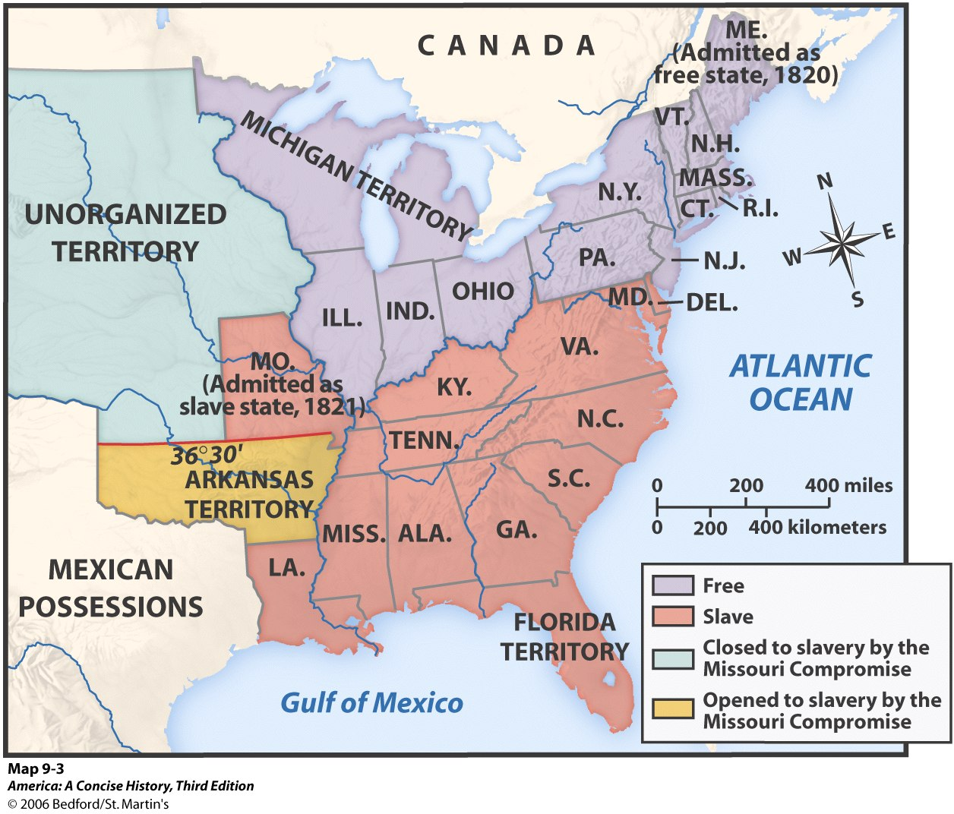

Slide 42
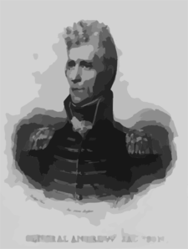
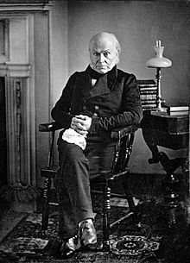
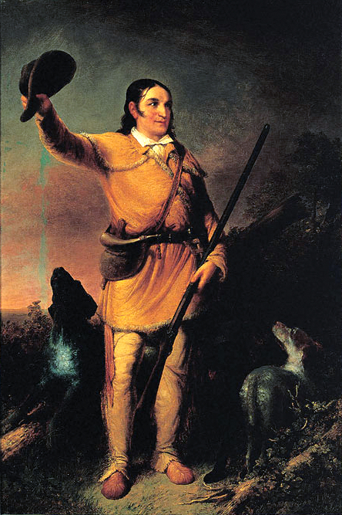
Jacksonian America Jackson as the symbol of the age as well as the engine
→→→

Slide 43
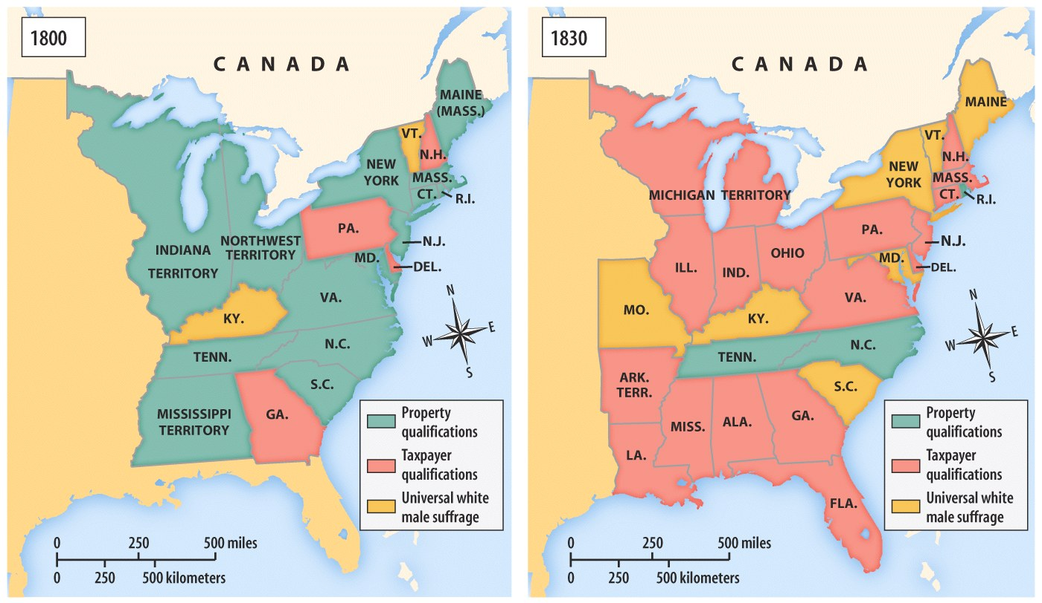
Changes in the franchise precede Jackson! – decreased use of poll taxes and property requirements – not universally popular!

Slide 44
Political Parties
“New” Democrat”: western farmers and eastern “ mechanics” or workingmen. The poor as opposed to the elites
A second party system: democrats v. whigs!
Campaigning pitched to the common man – hard cider, beer and barbecue!
campaign issues : sensation and log cabins.
Adams characterized as a pimp, condemned for bringing gaming tables into the white house.
Jackson’s wife!
Log cabins of Harrison ( Webster apologized for not being born in a log cabin)

Slide 45
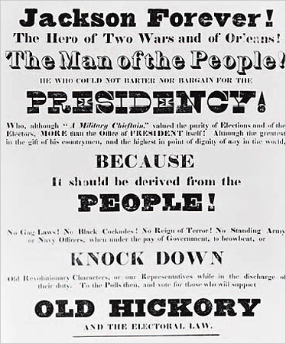
Jackson and Corrupt Bargain (1824)
Clay v. Jackson v. Crawford v. Adams
Jackson won popular and electoral vote
HR elected Adams
CORRUPT BARGAIN; CLAY TRADED SUPPORT FOR SECRETARY OF STATE

Slide 46
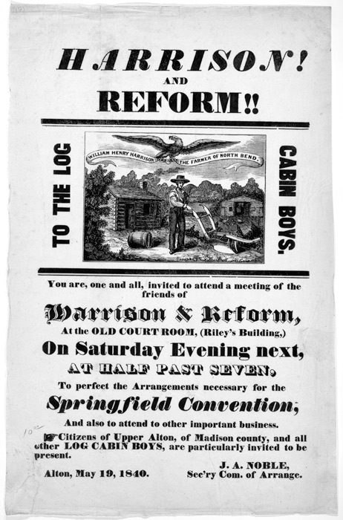

Slide 47
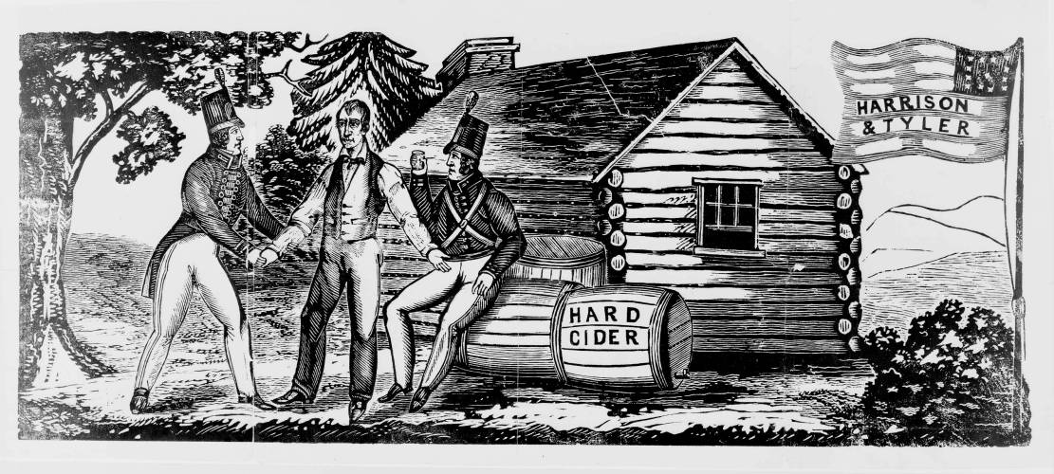

Slide 48
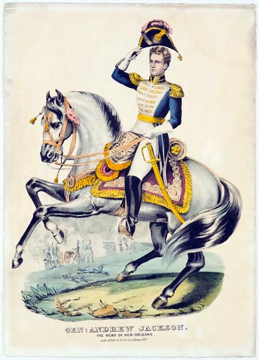
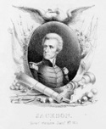
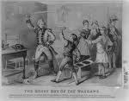
Also….
new breed of political leaders
Important to be common! Log cabins! (Harrison must pretend)
Crockett – campaigned on number of bears killed
Jackson – questionable parentage, impoverished background, hard charging, hard drinking, no formal schooling. an American success story, “Jesus, just another Jackson.” The contradiction: land speculator and owner of the Hermitage and 100 slaves. Adams spoke of him as a barbarian. Jefferson of his dangerous rage.
Contrast with Q. Adams!

Slide 49
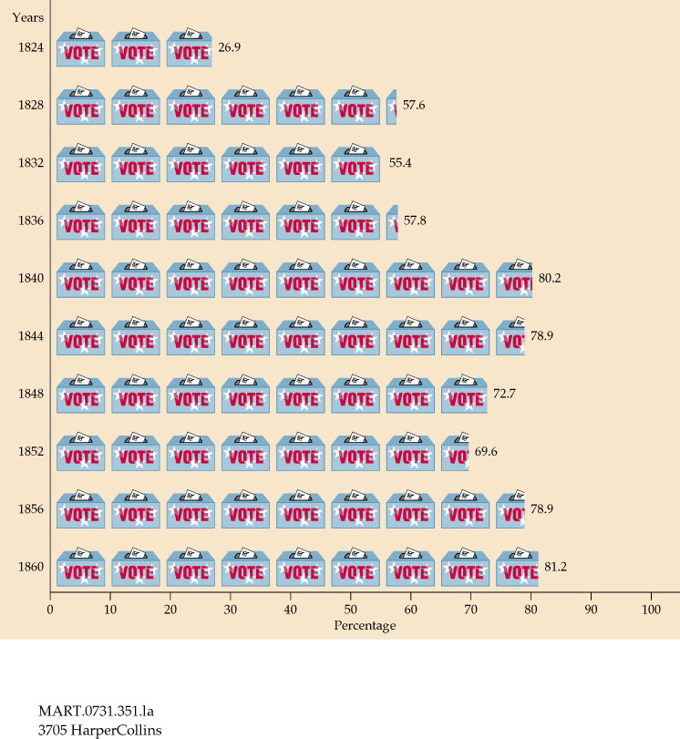
Increasing voter turnout – percentage of qualified voters voting

Slide 50
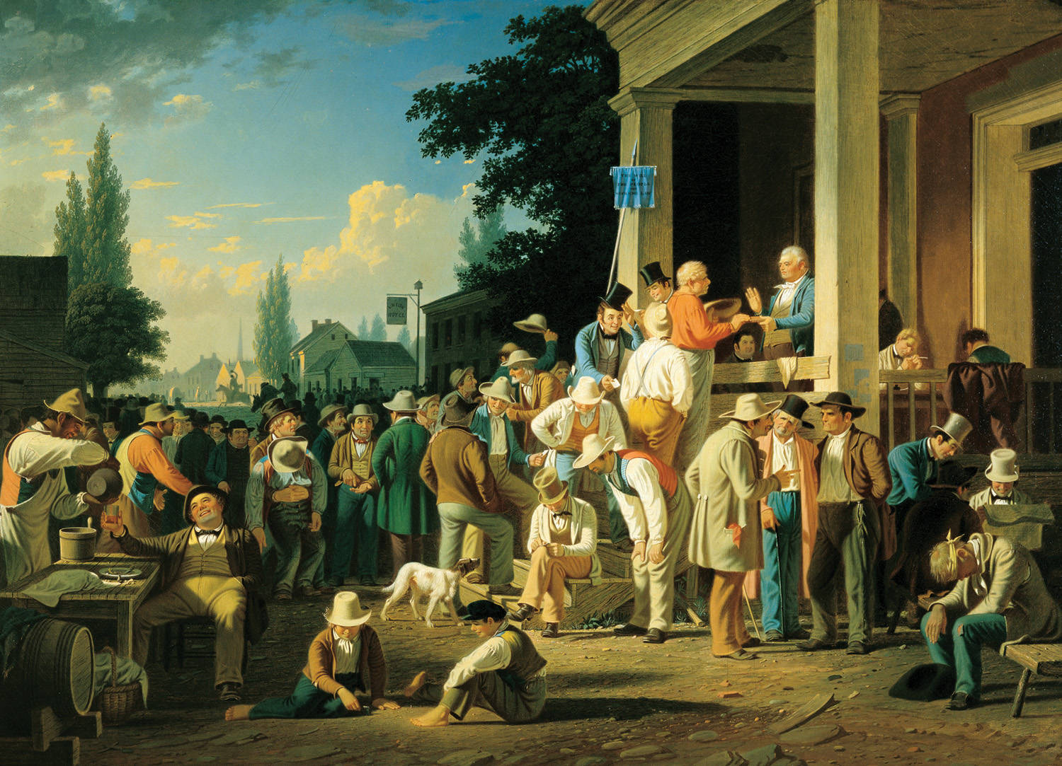
What is the common theme?

Slide 51
The Growing Trend Towards Democracy the result of several factors
Celebration of common man following 1812
meaninglessness of property requirements
market economy increased stake of Americans.
Issues: Missouri, Panic of 1819, tariffs
Second Great Awakening
The Corrupt Bargain of 1824. Jackson won the popular and electoral vote but seemed to be cheated by Adams and Clay!

