Slide 1
Warm-Up
“Every empire seeks as its imperialistic mission not to plunder and control but to educate and liberate.”
“The truth is that imperialism was never idealistic. It has always been driven by economic or strategic interests”
Which of these passages do you find to be the most true? Why?

Slide 2
Imperialism
Policy by which strong nations extend their political, military, and economic control over weaker territories
US time period 1865-1914

Slide 3
CAUSES FOR IMPERIALISM
Business/economic interests
Military/strategic interests
“White Man’s Burden”- spread of Democracy and Christianity; related to Manifest Destiny, Social Darwinism
New territories = more opportunity (Remember Frederick Jackson Turner?)

Slide 4
Business/Economic Interest
Colonies can provide raw materials and natural resources
Rubber, sugar, tea, iron, petroleum, timber
Foreign trade-new markets

Slide 5
Types of Imperialism
Sphere of Influence– area which an outside power claimed exclusive investment/economic interest or trading rights.
Protectorate—area where local rulers were left in place but were expected to follow the advice of the dominated outside powers
Colony—An area ruled directly by a dominate outside power.

Slide 6
ALFRED T. MAHAN
Military historian/U.S. Navy officer
Called “the most important American strategist of the 19th century”
The Influence of Sea Power Upon History- emphasized the need for a strong navy, acquire Hawaii, an isthmian canal and other Pacific Islands

Slide 7
The Influence of Sea Power
Foreign bases in Cuba, Hawaii, the Philippines
U.S. expanded and updated Navy
U.S. Navy—3rd largest navy in the world by 1900

Slide 8
Josiah Strong
Minister that advocated white man’s burden idea- U.S. role was to right the wrongs.
Educate and Christianize
U.S. is the “parent”, supervising lesser developed countries

Slide 9
“Seward’s Folly”/“Seward’s Ice Box”:1867
U.S. purchase of Alaska from Russia for $7.2 million
Named after U.S. Secretary of State William Seward
Turned out to be profitable; gold discovered in 1898, rich in oil

Slide 10
Hawaii
Hawaii becomes a U.S. Protectorate in 1849.
Why was Hawaii important?
Economically – link between U.S. and the Pacific
*Also big exporter of sugar
Military – Great natural harbor for the navy

Slide 11
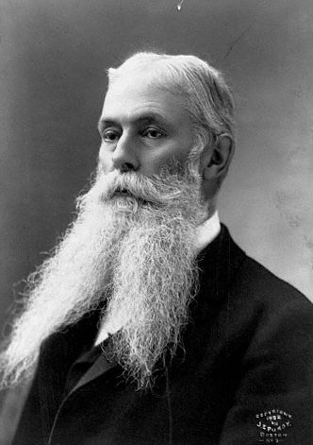
U. S. Interests In Hawaii
1893–Americans backed an uprising against Queen Liliuokalani.
Rebellion successful
Sanford Ballard Dole proclaims the Republic of Hawaii in 1894.
Annexed by U.S. in 1898

Slide 12
Activity
Analyze the two speeches that have been provided to you; Answer the following questions in complete sentences.
What territories are the topic of conversation regarding U.S. Imperialism?
According to Beveridge, what else was going on in the U.S and the rest of the world that made expansion a good idea?.
Why does Bryan believe that taking control of foreign lands is wrong?
After reading both arguments, what side are you on? Explain why you are pro or anti-imperialism.
(Honors) Beveridge and Bryan both have views on destiny. Draw quotes from the readings to illustrate how each man sees American destiny.
(Honors)

