Slide 1
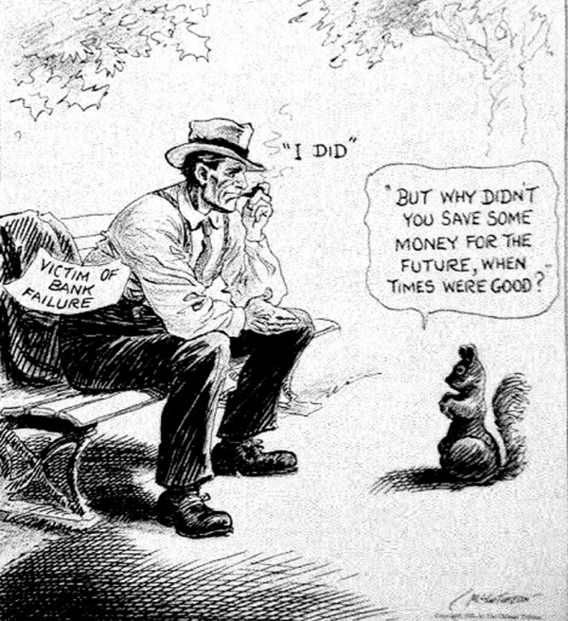
Warm up
Journal: Use the cartoon “A Wise Economist Asks a Question” to respond to the following:
Who does the man on the bench represent?
What does the man's location add to the cartoon?
How is the American citizen depicted?
Why is the squirrel a "wise economist?"

Slide 2
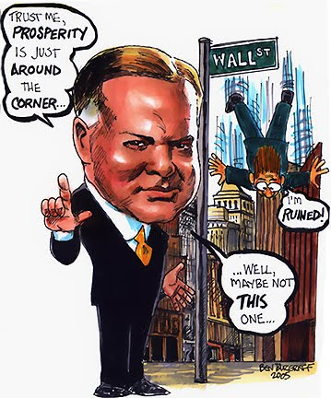
From 1929 to 1932, President Hoover was criticized for not doing more to end the depression
Thousands of businesses failed Unemployment rose to 25%
The American banking system collapsed
Hoover initially relied on rugged individualism, then offered govt relief/job programs… but it was too little, too late

Slide 3
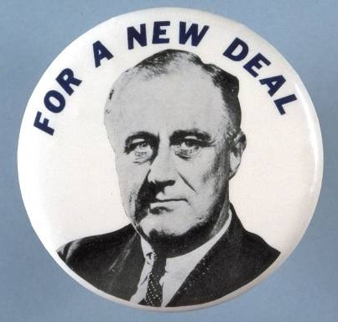
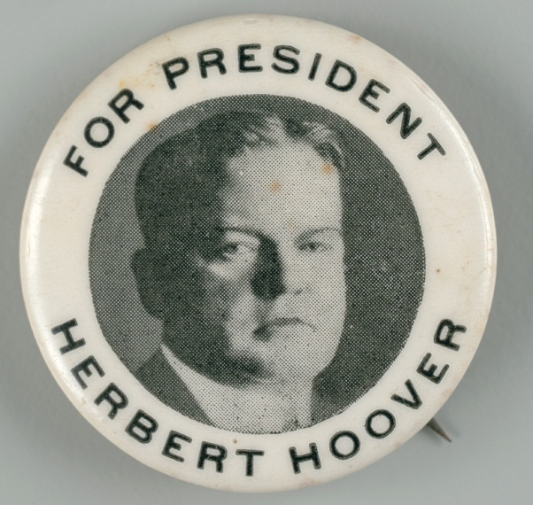
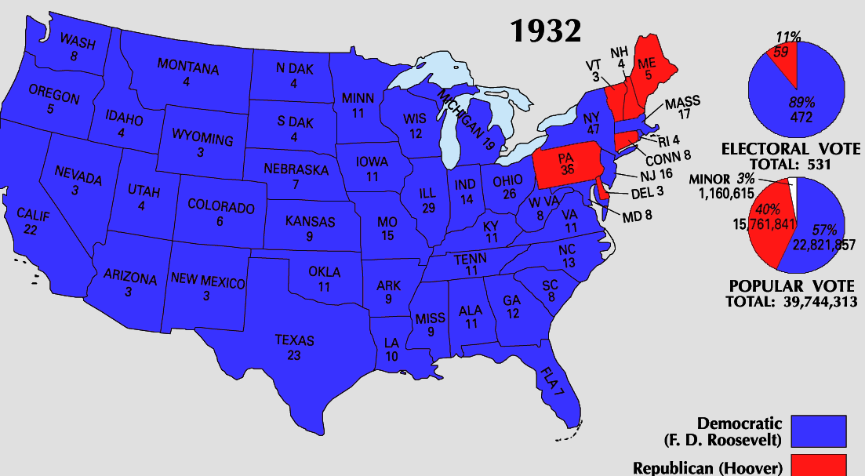
Democratic candidate Franklin Delano Roosevelt (FDR) defeated Hoover and won the presidency
By the election of 1932, Hoover ran for re-election but Americans wanted hope and strong leadership

Slide 4
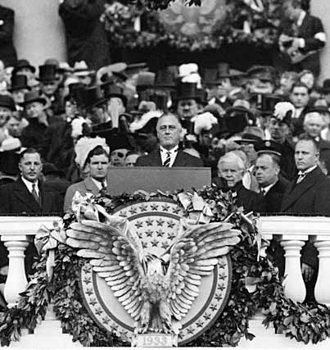
When Roosevelt was inaugurated as president, unemployment was at an all-time high
In his inaugural address, FDR inspired hope, declaring “the only thing we have to fear is fear itself”

Slide 5
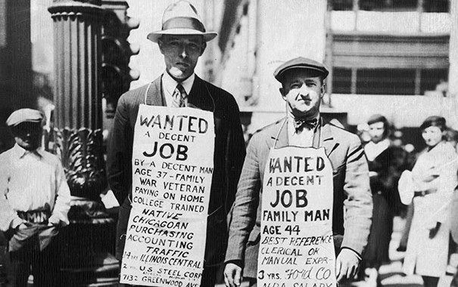
When FDR became president, he promised decisive gov’t action to fight the depression
FDR believed the gov’t should use deficit spending to stimulate the economy

Slide 6
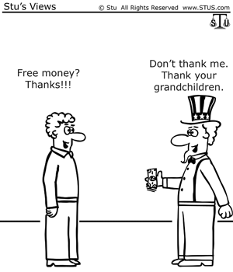
Deficit Spending
Roosevelt’s plans would require the government to spend more than it took in in taxes, creating a national deficit
Roosevelt assured Congress that the deficit was an emergency measure which would be temporary (it wasn’t)

Slide 7
First 100 Days
Roosevelt took office on March 4, 1933, immediately addressed the effects of the Depression.
Would pass 15 separate bills that formed the basis of his “New Deal”

Slide 8
The New Deal focused on the three “Rs”
New Deal Programs
Relief Relief checks and job programs to lower unemployment
Recovery Programs to stimulate agriculture, industry, and the economy to end the depression
Reform Programs to correct problems in the economy and prevent future depressions

Slide 9
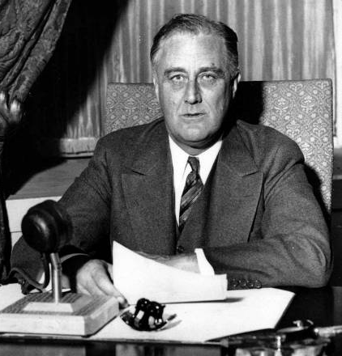
FDR used the power of the radio to communicate to the American people what the government was doing to address the Depression
FDR’s “fireside chats” used simple, clear language to explain New Deal programs
These weekly radio addresses gave people confidence that the government was actively fighting the Great Depression

Slide 10
Fireside Chat Classwork; Turn in with Warm up
Read the selected portions of FDR’s Fireside Chat from Weebly.
Respond to the following as you read:
In what way does FDR use the Fireside Chat as a conversation with the American people? Identify at least 1 example (Academic). Honors- Identify 2 examples.
Why might he use this technique?
Do you think it is effective?
What does FDR state that the American people have learned from the depression?
How does FDR describe the 3 parts of our government? Which part of government does he believe is not…”behaving”?
FDR says that some of his critics accuse him of trying to “drive that team.” Who does he suggest is really at the head of the government?
Why does FDR point to the Constitution as support for his New Deal programs?
What action had the Supreme Court taken regard to the AAA? What response does FDR suggest this calls for?
What is FDR’s final pitch to the American people? Do you think it is effective?
Honors: How did his critics describe FDR’s proposal?

