Slide 1
Warm up
True false: Review these questions on previous terms/events and record your answers in your journal.
“Consumerism” is a term linked to American life in the 1950s.
Stalin was able to permanently cut the Western allies off from Berlin.
During the Chinese Civil War, there were two political parties who wanted control of the government: the Nationalists and the Communists.
The USSR followed the terms set at the Yalta conference
In 1946, Truman gave the "Iron Curtain" speech, symbolizing growing East-West hostilities
The Marshall Plan was open to helped the Eastern Europe nations and even the USSR
General MacArthur wanted to use the atomic bomb against China during the Korean War.
Many white Americans began moving to suburbs in order to become closer to immigrants/African Americans

Slide 2
Warm up Answers
“Consumerism” is a term linked to American life in the 1950s. T
Stalin was able to permanently cut the Western allies off from Berlin. F
During the Chinese Civil War, there were two political parties who wanted control of the government: the Nationalists and the Communists. T
The USSR followed the terms set at the Yalta conference F
In 1946, Truman gave the "Iron Curtain" speech, symbolizing growing East-West hostilities F
The Marshall Plan was open to help the Eastern Europe nations and even the USSR T
General MacArthur wanted to use the atomic bomb against China during the Korean War. T
Many white Americans began moving to suburbs in order to become closer to immigrants/African Americans F

Slide 3
Review
Consumerism makes a return to American society
Notable changes: suburbs, automobiles, television, music, etc.
Family changes: men and women defined roles, teenagers’ new freedom.

Slide 4
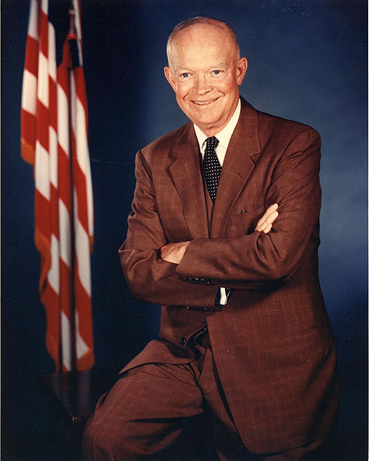
Dwight “Ike” Eisenhower
1953 – 1961 (President)
Military leader during WWII
Anti-communist, but also dedicated to scaling back military spending
Chose to focus on a build up of nuclear weapons to deter communist aggression
Cheaper

Slide 5
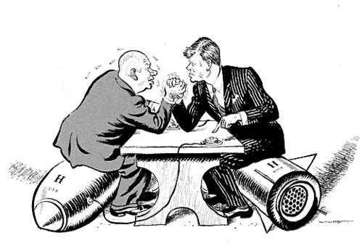
Brinksmanship
Term coined by Eisenhower’s Sec. of State John Foster Dulles
Escalating international tensions to the brink of war, with hope that the other side will back down at the last minute and thereby give you an advantage in future negotiations

Slide 6
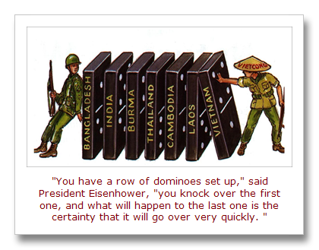
Domino Theory
Idea that if you let a single nation fall to communism, you would set off a chain reaction where its neighbors would also fall to communism
Justifies involvement

Slide 7
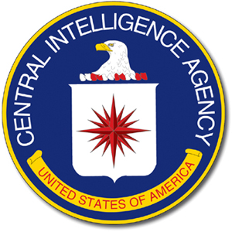
CIA Interventions
Ike used the CIA to interfere with communist aggression
Iran: Used covert CIA action to topple the Iranian govt; was unfavorable to U.S.
Guatemala: allowed CIA to train rebels to overthrow a pro-communist regime

Slide 8
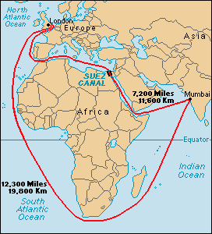
Suez Crisis
Egypt confiscated the Suez Canal from French and British investors
Britain and France invade Egypt to retake the canal, leading the Soviets to threaten war
Eisenhower forced Britain and France to withdraw
Many Arab states now saw the West as an aggressor, aligned with the Soviets
Notes:
The US withdrew financial support from an Egyptian dam project over Egyptian weapons purchases that threatened Israel

Slide 9
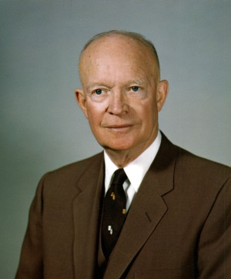
Eisenhower Doctrine
1957-Eisenhower pledged assistance to any nation in the Middle East which found itself threatened by communism

Slide 10
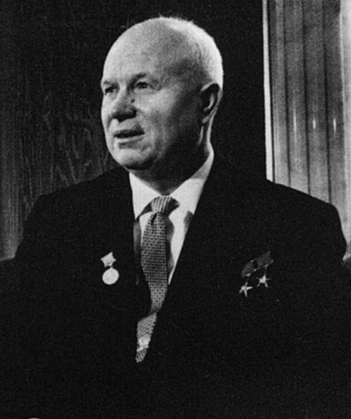
Nikita Khrushchev
Named head of the Soviet Union after the death of Stalin in 1953
More liberal than Stalin in Soviet domestic issues
Confrontational in foreign policy, pushing the Soviet Union to the brink of war with US on several occasions

Slide 11
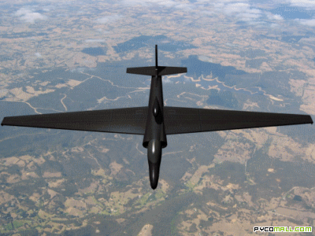
The U-2 Incident
1960
Soviets shot down an American U-2 spy plane over their airspace and captured the pilot, Francis Gary Powers
Marked a turning point in US-Soviet relations

Slide 12
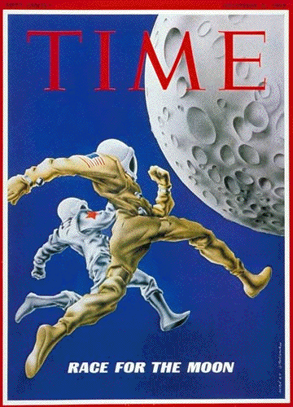
Space Race
Both the US and USSR were pursuing missile technologies
These technologies were used to compete against each other for control of outer space
A multi-billion dollar “space race” to see who could accomplish certain objectives or discoveries first

Slide 13
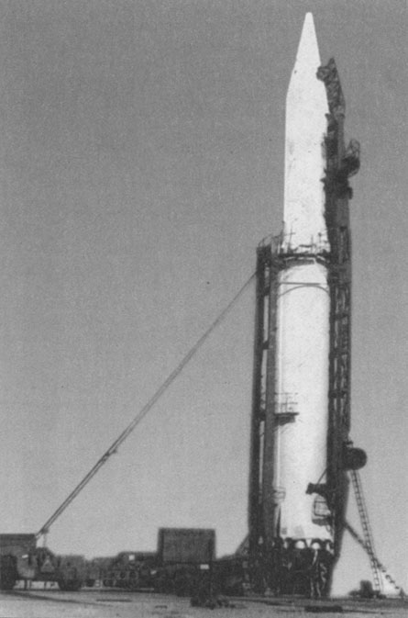
ICBMs
Intercontinental Ballistic Missiles
Allowed both sides to mount atomic warheads onto long-range rockets which could be launched against distant targets

Slide 14
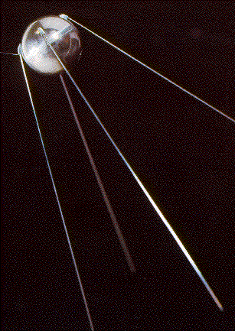
Sputnik
First man-made object to attain orbit around the earth (satellite)
Launched by Soviets in Oct. 1957
Triggered panic in the US
Why?

Slide 15
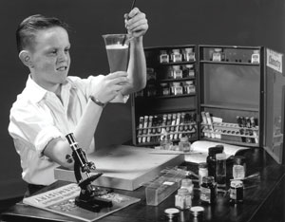
National Defense Education Act of 1958
Increased spending on education
Science, math, and foreign languages
Response to the belief that the US was falling behind the Soviets in scientific/ technological fields
1950: number of high-school graduates who went on to college was less than 15%
1970- over 40%

Slide 16
NASA
National Aeronautics and Space Administration
Civilian agency created to take over space exploration programs from the various military branches
Would increase coordination and efficiency

Slide 17
Summary
Eisenhower becomes President in 1953.
U.S. foreign policy of brinksmanship; foreign tensions remain high with new Soviet leader Nikita Khrushchev
Cold War extends to other nations, arms race continues
Examples of foreign engagement?
Space tech and education are now battlefields

Slide 18
In-Class
What is Eisenhower’s overall opinion of the US in 1961?
What are some issues Ike identifies and which does he apparently consider the most dangerous?
How can the military be “a vital element” and yet capable of “unwarranted influence”?
Ike frequently puts forth a sense of keeping key issues in “balance.” How is that perception manifested in this speech?
What price would the American people pay if they were to "live only for today"?

