Slide 1
2/2 Kahoot Review Warm Up
Go ahead and pull up Kahoot on your smartphones. Also please have your homework from yesterday out and ready to be collected.

Slide 2
Problems of Farmers
Please begin working on the Problems of Farmers handout available on your desk when seated. Be prepared to discuss key points from each of the paragraphs on the front.

Slide 3
Economics and the Populist Party

Slide 4
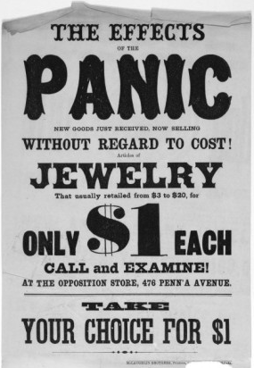
Background: Economic Turmoil of the 1870s
The Panic of 1873
Depression
Banks, Railroads, Companies closed; 3 million unemployed workers
Currency Dispute
Farmers wanted more greenbacks in circulation to help them pay off debts; Inflation

Slide 5
Farmers Unite to Address Common Problems
Why were farmers angry?
Economic Distress | Problems with the Railroads
Crop prices fell Farmers had to borrow money Paper money was being replaced with gold and silver and money was worth Banks foreclosed on their mortgages | Little competition among railroads; unfair rates for farmers

Slide 6
Farmers Unite to Address Problems
The Grange
Oliver Hudson Kelley-1867
Formed in order to fight for government regulation of big business- Railroads
Advance methods of agriculture, voice farmers’ needs
The Farmers’ Alliances- Inspired by the Grange Movement
An Organized agrarian economic movement among American farmers.

Slide 7
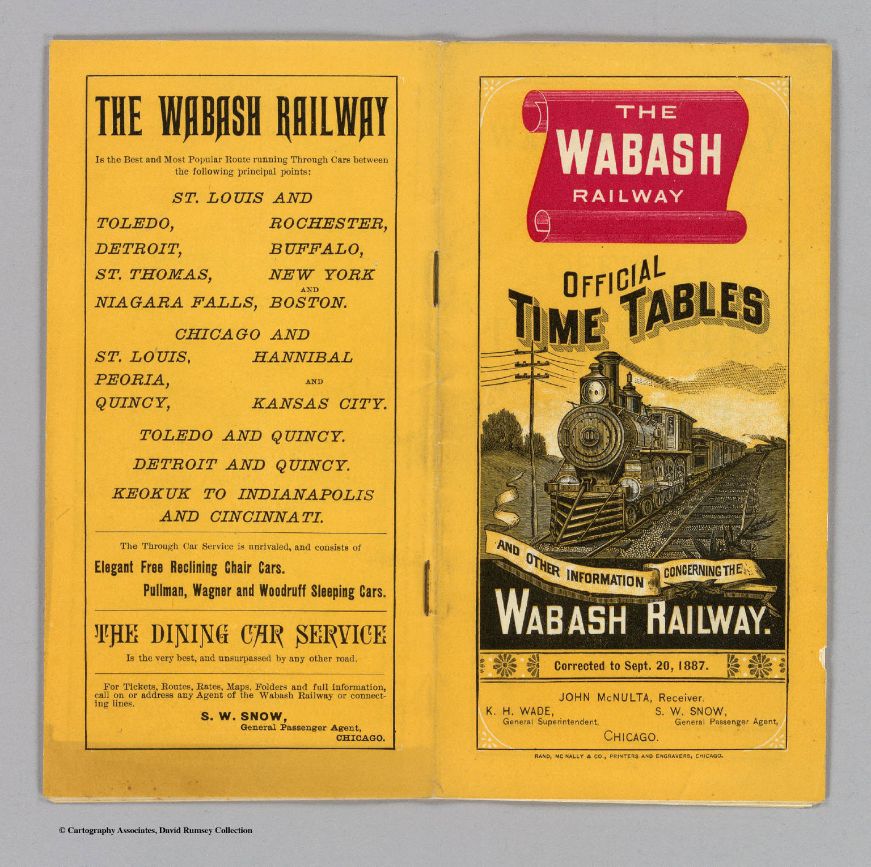
Grangers Begin to Make Progress
Munn v. Illinois (1876)
Ruled that states can regulate railroads and certain other businesses within their own borders
Wabash v. Illinois (1886)
Supreme Court rules states could not regulate rail lines between different states (interstate)
Leads to development of the Interstate Commerce Commission (federal regulation)
Interstate Commerce Act of 1887- regulate railroad industry

Slide 8
The Omaha Platform
To take their fight to the national level, farmers needed more than just a fraternity
They needed a political party
Use the provided handout to examine the Omaha Platform, written by the Populist Party
Read the Omaha Platform Handout, underling/highlighting key ideas on the front
With a partner, complete tasks 1 and 2 on the back of the handout.
Be prepared to discuss answers and reasoning

Slide 9
2/3 Warm Up: Match the following the terms with their definitions from the past couple weeks. Some of these will be on the test on Tuesday
The Grange
Closed Shop
Samuel Gompers
Captain of Industry
Indian Removal Act
Homestead Act
Social Darwinism
Manifest Destiny
Dawes Act
Collective Bargaining
Andrew Carnegie
Haymarket Square Riot
a place of work where membership in a union is a condition for being hired and for continued employment.
A notable steel industrialist who was well known for his Gospel of Wealth article/philosphy
Belief that the fate of the settlers was to grow and become powerful regardless of who/what was in their way
Goal was to ”convert” Native Americans into settlers by placing them on reservations, taking away their customs, etc.
A type of business leader who makes positive contributions to society
Founder of the American Labor Union (AFL)
An organization of farmers who banded together to fight for their well-being and the regulation of railroads
Policy of removing Native Americans from their homes and forcing them to immigrate west
The negotiation of wages/conditions of employment by an organized body of employees.
The theory of “natural selection” and “survival of the fittest” in a society
Event that caused anti-union feelings due to its violence
For a small fee, gave 160 acres of land out west to an individual

Slide 10
Answers
a place of work where membership in a union is a condition for being hired and for continued employment.
A notable steel industrialist who was well known for his Gospel of Wealth article/philosphy
Belief that the fate of the settlers was to grow and become powerful regardless of who/what was in their way
Goal was to ”convert” Native Americans into settlers by placing them on reservations, taking away their customs, etc.
A type of business leader who makes positive contributions to society
Founder of the American Labor Union (AFL)
An organization of farmers who banded together to fight for their well-being and the regulation of railroads
Policy of taking Native Americans from their homes and forcing them to immigrate west
The negotiation of wages/conditions of employment by an organized body of employees.
The theory of “natural selection” and “survival of the fittest” in a society
Event that caused anti-union feelings due to its violence
For a small fee, gave 160 acres of land out west to an individual
The Grange
Closed Shop
Samuel Gompers
Captain of Industry
Indian Removal Act
Homestead Act
Social Darwinism
Manifest Destiny
Dawes Act
Collective Bargaining
Andrew Carnegie
Haymarket Square Riot

Slide 11
What is Populism?
Political movement of farmers and laborers in the late 19th century (People’s Party)
Goals Included: 1. Regulate the railroads 2. Make more cash available (inflation) 3. Direct election of senators and 1-term presidents 4. Graduated income tax 5. Restrictions on immigration and 8-hour workday

Slide 12
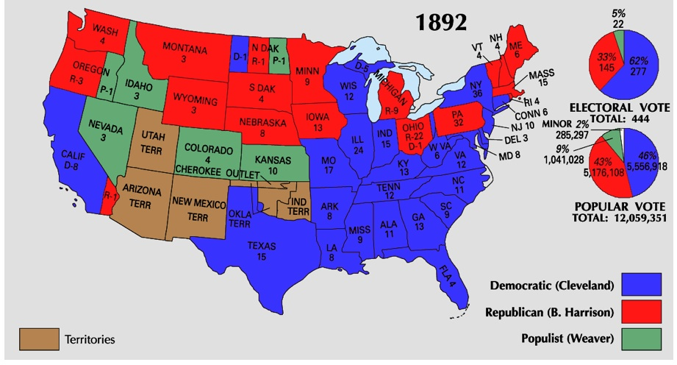
1892 Presidential Election

Slide 13
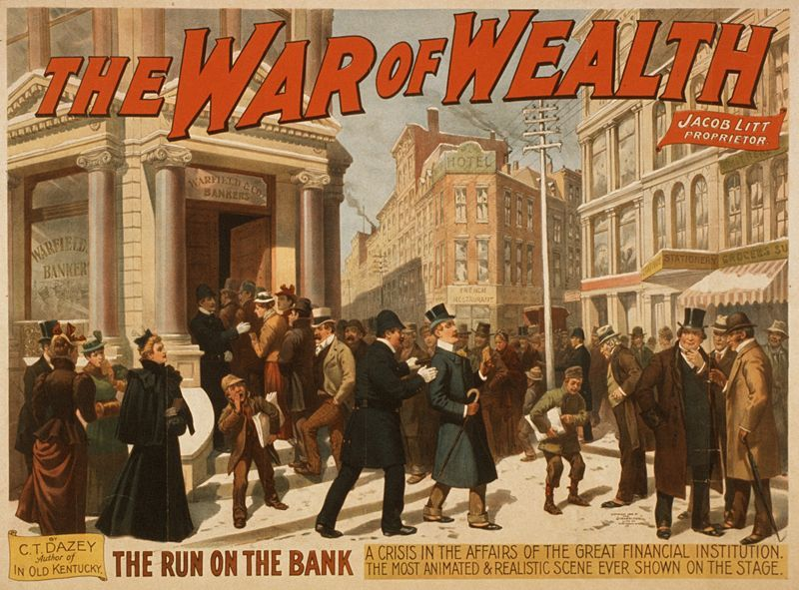
The Panic of 1893
Causes | Results
Railroads expanded faster than market Stock market collapsed Banks stopped loaning $ Farmers borrowed too much $ | Businesses collapsed Railroads went bankrupt Banks closed Gold value dropped severely

Slide 14
Gold vs Bimetallism
PROBLEM: Govt. threatened with running out of $
DEBATE: What should be the basis of the nation’s monetary system?
The East (factory workers and owners= Republicans) wanted a gold standard- value of currency linked to price of gold
VS
The West (Farmers & Miners= Populists) wanted a bimetal standard- gold AND silver linked to currency at a fixed ratio to each other.

Slide 15
The Election of 1896
Political Parties of the 1890s
Democratic Party | Populist Party | Republican Party
Southerners Wealthy farmers Supported low tariffs (wanted other countries to buy their crops) | Political movement of farmers and laborers in the late 19th century Goals: 1. Regulate trailroads 2. Make more cash available (back the dollar with silver) 3. Direct election of senators and 1-term presidents 4. Graduated income tax 5. Restrictions on immigration and 8-hour workday | Northerners Wealthy businessmen (connected to the railroad) Southern African Americans (poor farmers) → party of Lincoln Supported high tariffs (didn’t want to compete with other countries’ products)
 | “Fusion Coalition”

Slide 16
Gold Bugs v. Silverites
Gold Bugs and Silverites
 | Gold Bugs | Silverites (Bimetallists)
Who | Bankers and businessmen (Northerners/Republicans) | Farmers and laborers (Southerners, Westerners/Democrats & Populists)
What They Wanted | Gold standard | Bimetallism (both gold AND silver)
Why | Loans would be repaid in stable money. | Products would be sold at higher prices.
Effects | DEFLATION Prices fall Value of money increases Fewer people have money | INFLATION Prices rise Value of money decreases More people have money
William McKinley (Republican)
William Jennings Bryan
(Democrat/Populist)

Slide 17
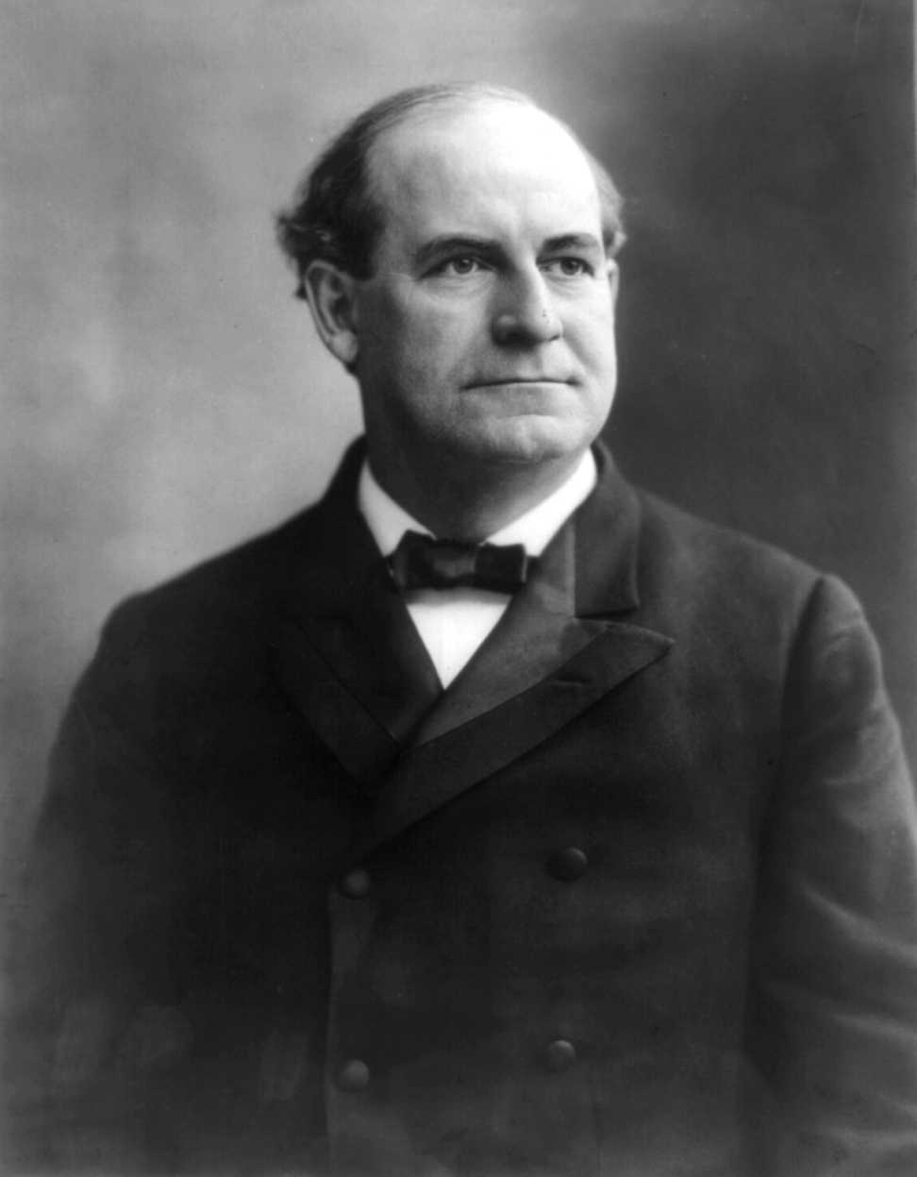
The Election of 1896
Populists decide to improve their chances by supporting the Democratic candidate, William Jennings Bryan.
Supported the silver standard
Criticized the unfair economic system

Slide 18
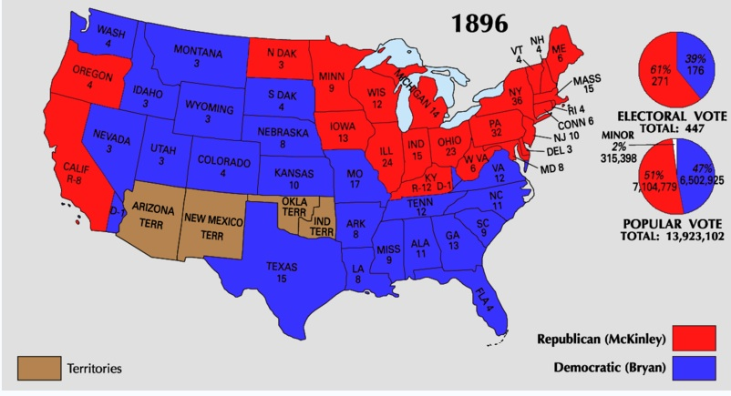
The Election of 1896
Effects:
Populists ideas were absorbed into the Progressive Party

Slide 19
Using Primary Sources
Read Document A and B. On a separate sheet of paper, respond to the following:
Document A
1. Who wrote this?
2. What was going on for farmers at the time?
3. Read the first paragraph: Why might she use religious references?
4. Honors: What does this say about women’s involvement in politics in the 1890s?
Document B
1. Where is Bryan speaking?
2. Based on the speech, how do you think farmers and workers were feeling about business and industry?
3. What is the main point of his speech?
4. Honors: Why were speakers like Lease and Bryan popular with farmers in the 1890s?

