Slide 1
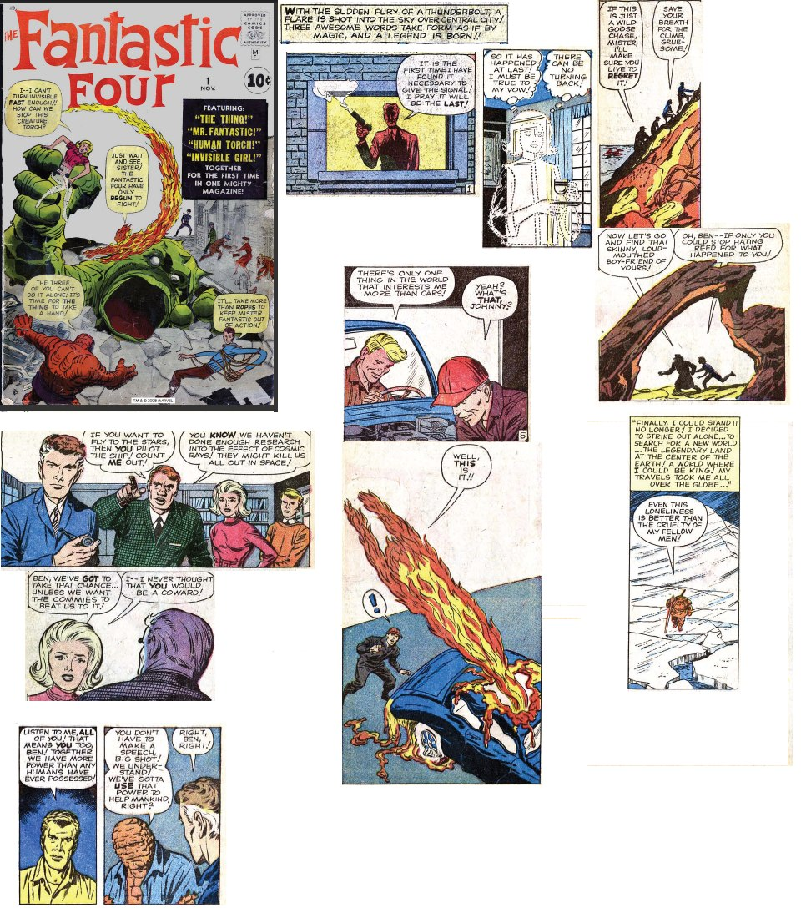
Warm up
Objective: To identify the effects of the Cold War on the “homefront”.
Journal: Examine this page from Fantastic Four #1 (1962). How has the Cold War affected pop culture?

Slide 2
Review
China is “lost” to the communists; American public stunned
With Korea in danger, Truman believes he can’t afford to lose another Asian nation
Truman and MacArthur clash; MacArthur removed in 1951
Stalemate in Korea; Armistice signed

Slide 3
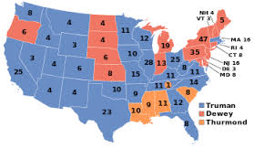
Truman Wins Second Term
Nearly everyone expected Dewey to win easily, but Truman pulled off a narrow victory

Slide 4
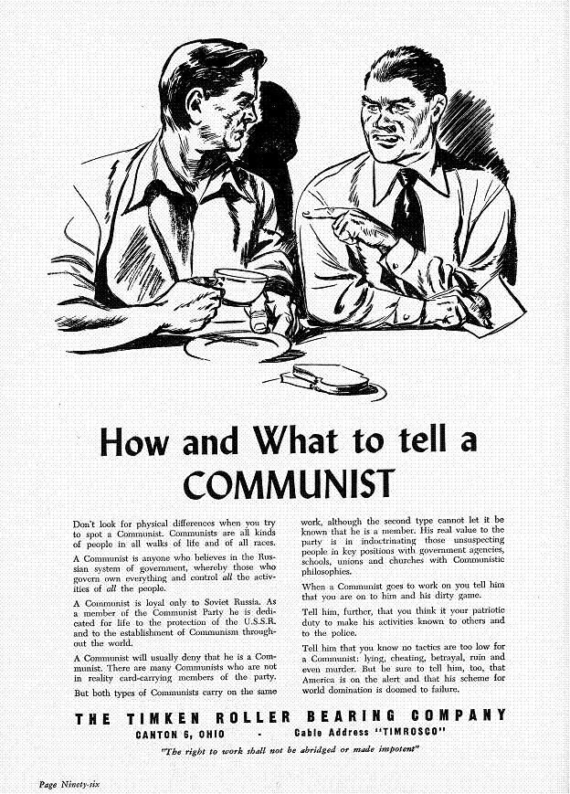
Fear of Communist espionage grew, was prevelant in everyday life

Slide 5
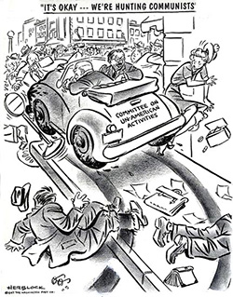
HUAC
House Un-American Activities Committee
Investigate “any suspected threats of subversion or propaganda that attack the form of government guaranteed by our Constitution.”
Notes:
Became a permanent committee in 1945

Slide 6
Hollywood Ten
10 members of the Hollywood film industry publicly shame HUAC
Jailed, banned from working for major Hollywood studios
People who speak out against HUAC/anti-communist forces are silenced through intimidation

Slide 7
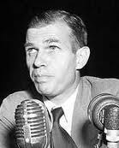
Alger Hiss
High-ranking State Department official who was accused of being a Soviet spy
Could not be convicted of espionage, but was convicted of perjury (lying under oath)

Slide 8
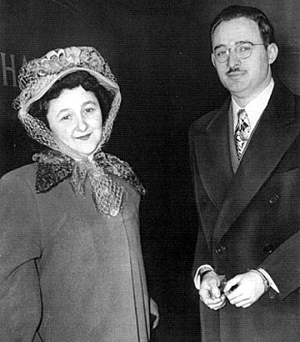
Julius & Ethel Rosenberg
American couple accused of helping the Soviets spy on the American atomic bomb program
Convicted of treason in a highly controversial trial
Both sentenced to death and executed

Slide 9
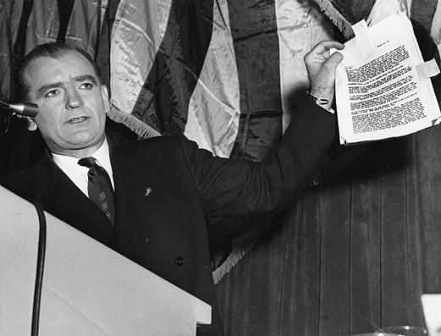
Joseph McCarthy
Senator from Wisconsin
Claimed to have a list of members of the state dept. who were Communists
Was never able to produce proof
Became a witch-hunt. Tactic became known as McCarthyism

Slide 10
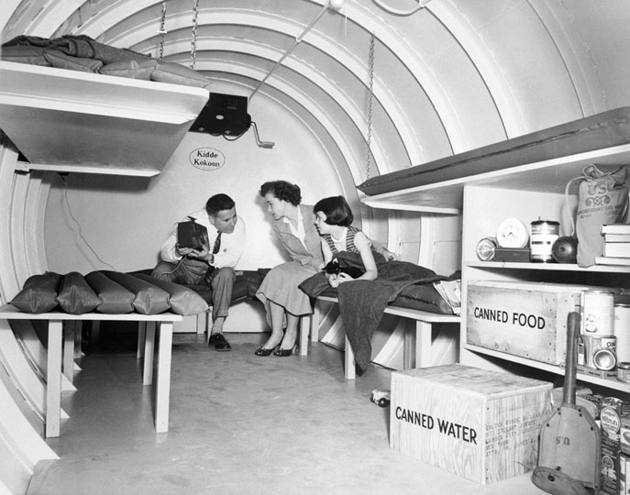

Life During the Early Cold War
Fear of Communism and nuclear war caused Americans to prepare to survive a nuclear attack
Duck and Cover Drill Video

Slide 11
Post War American Boom and the New American Dream in the 1950s

Slide 12
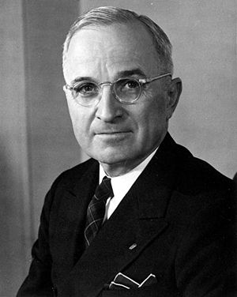
Truman’s “Fair Deal”
Truman begins a series of social reform programs
Included expansion of Social Security, increasing minimum wage, funding low-income housing

Slide 13
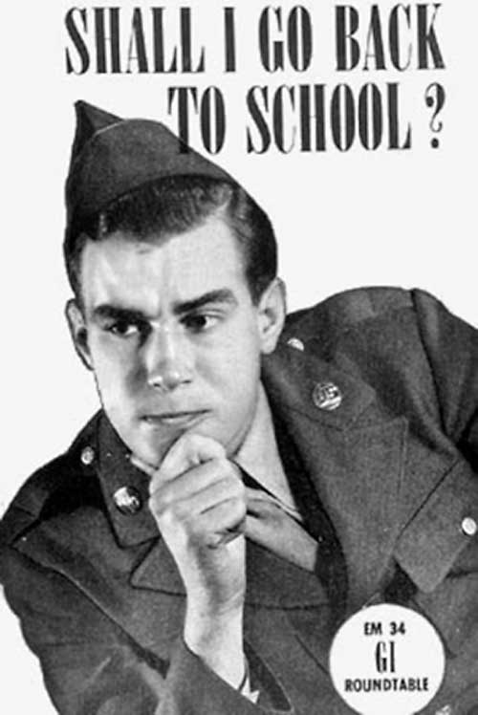
The GI Bill
Passed in 1944
Help GIs transition back to civilian life
Helped veterans by:
  Paying for college tuition
  Providing one year’s unemployment pay,
  Providing loans for housing or businesses

Slide 14
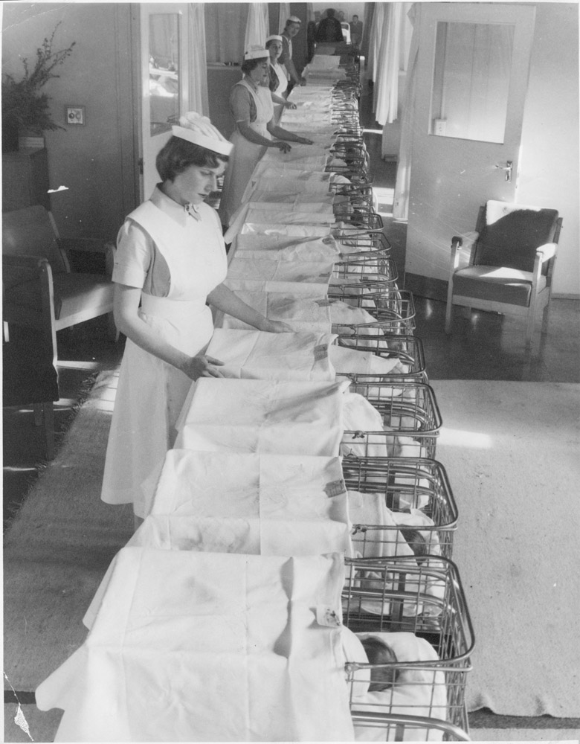
“Baby Boom”
Returning GIs were also anxious to marry and start families
Dramatic surge in the birth rate from 1946 to 1964
This generation, the largest in US history, came to be known as the “baby boomers”

Slide 15
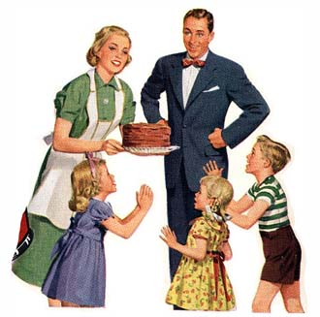
Growth of Middle Class
Middle-class grew significantly during the 1950s
This expanded middle-class increased the demand for consumer goods and single-family housing
  Suburbs

Slide 16
Summary
McCarthyism, Second Red Scare overtake the American public
  Americans fear and prepare for the worst
American economy booms following WWII
Attempts to better society through GI bill, increased consumer spending.

Slide 17
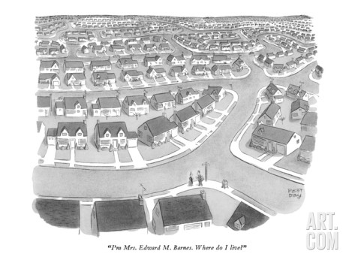
Warm up
Objective: To identify cultural trends in the United States in the post-war era.
Journal: Examine the cartoon on the right and listen to the song.
  What words or phrases would you use to describe the housing development depicted in the cartoon?
  How do you think Mrs. Edward M. Barnes feel about living in a suburban development?
  Why do you think Americans in the 1950s wanted to live in a housing development like these?

Slide 18
Review
McCarthyism, Second Red Scare overtake the American public
  HUAC, McCarthy seek to root out communists
  Americans fear and prepare for the worst
American economy booms following WWII
Attempts to better society through GI bill, increased consumer spending.

Slide 19
The 1950s: Consumerism
Consumerism returned in 1950s
  New goods like TVs & record players
  The 1st credit card was created in 1950
  Advertisers used newspaper ads, radio, TV commercials to market goods
  Franchises offered people across the country the same products
Notes:
Expansion of business in the 1950s:
Corporations, Franchises (848)
Consumerism (854-855)

Slide 20
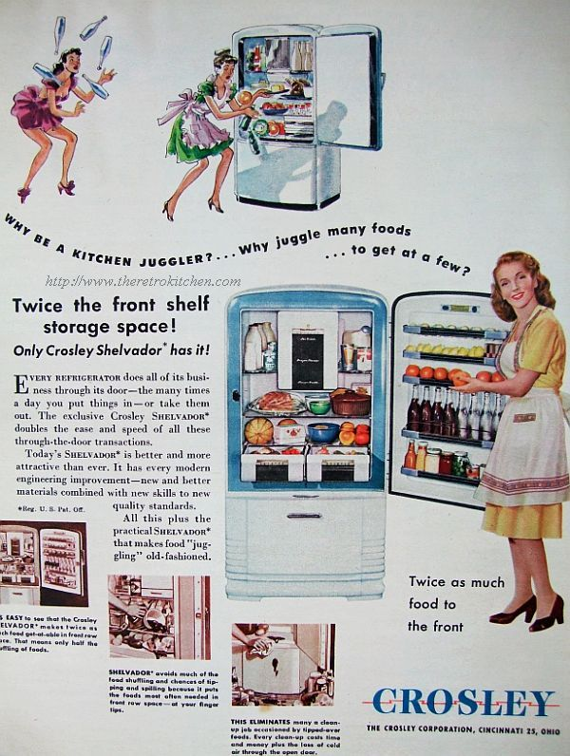
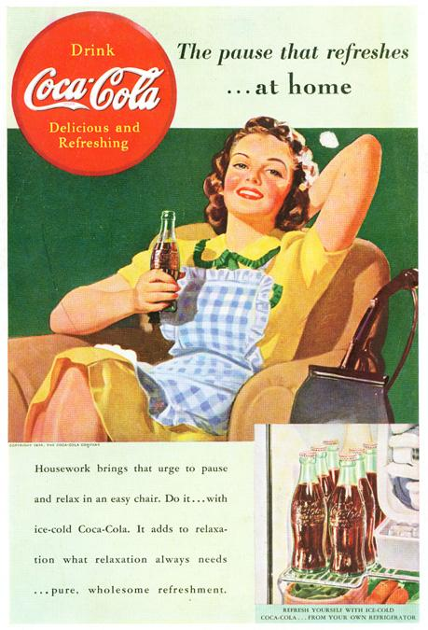
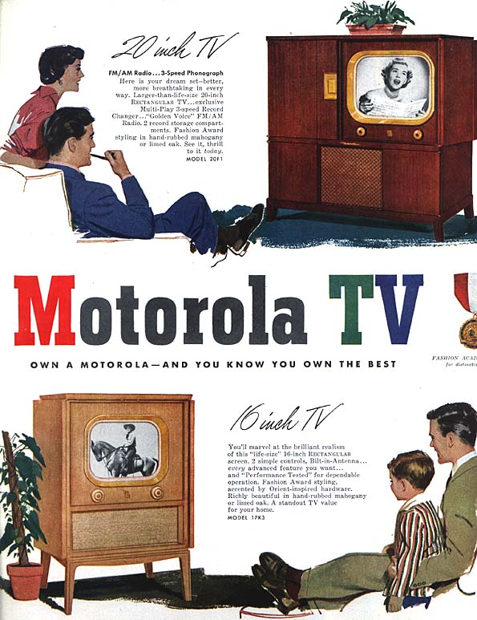
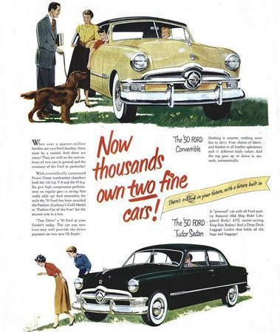
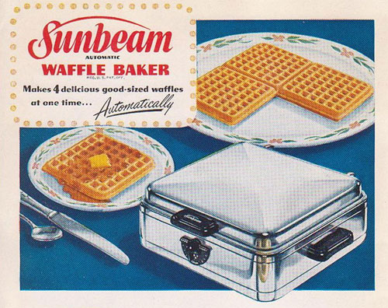
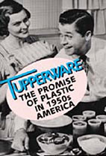
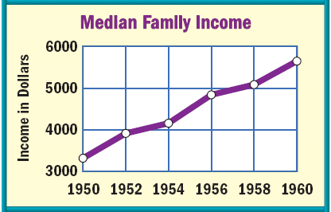
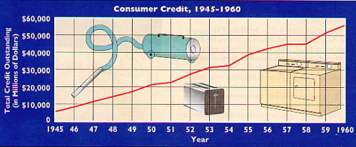
The “Affluent Society”

Slide 21
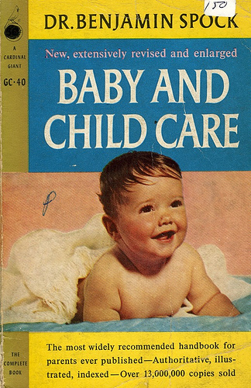
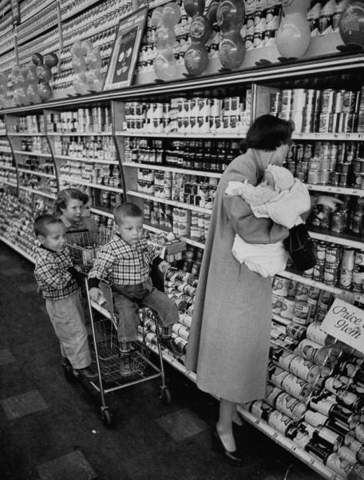
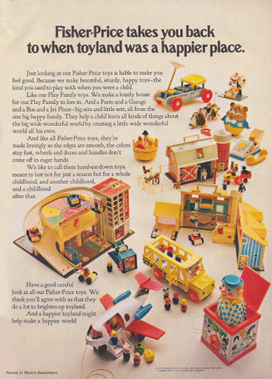
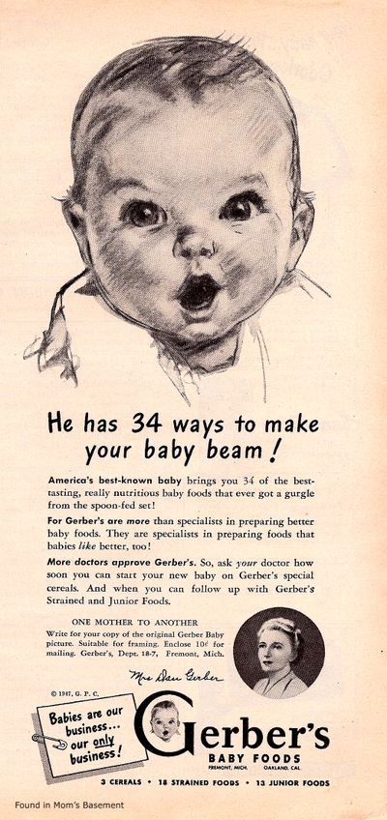
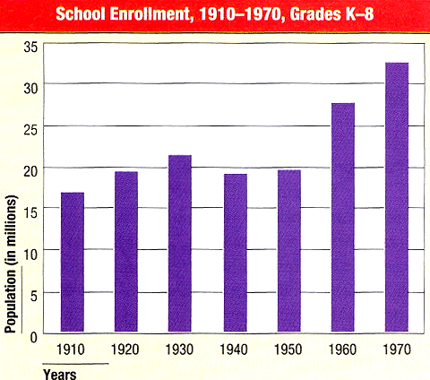
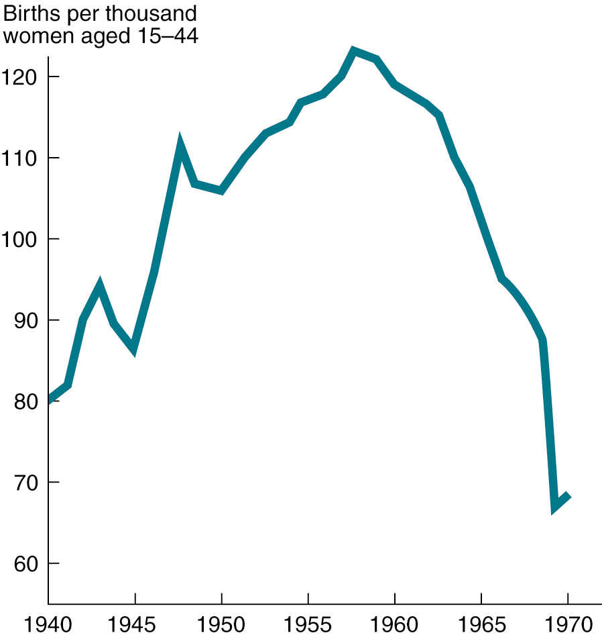
U.S. Birthrate, 1940-1970
The late 1940s & 1950s experienced the “baby boom”
In 1957, a baby was born every 7 seconds

Slide 22
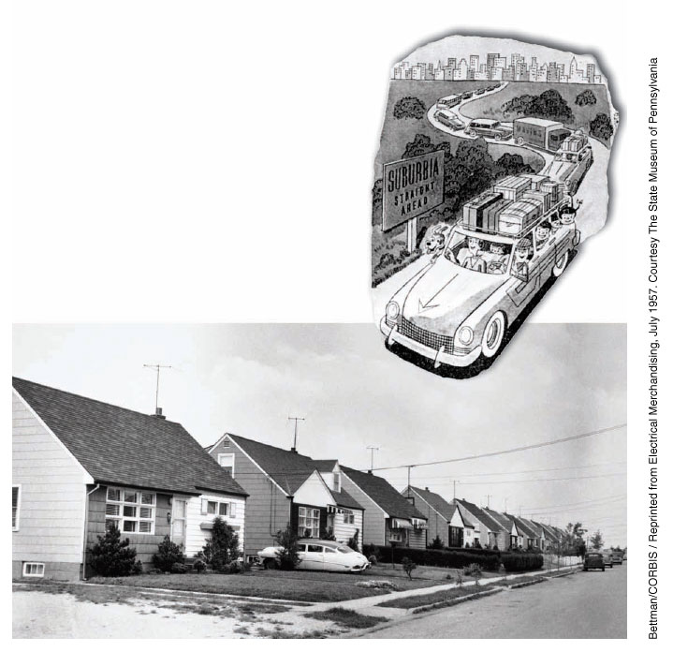
Growth of Suburbs
Growth of middle-class families led to a dramatic spike in demand for housing
Americans looked to the areas just outside of the cities to live and raise their families

Slide 23
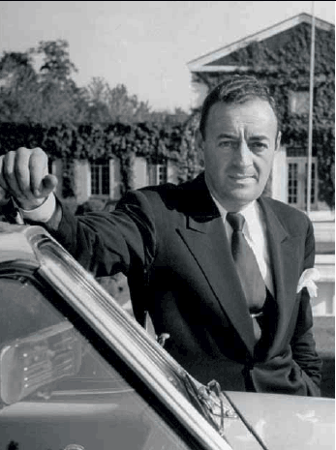
William J. Levitt
Real estate developer who popularized building large developments of cheap style housing within commuting distance of major cities

Slide 24
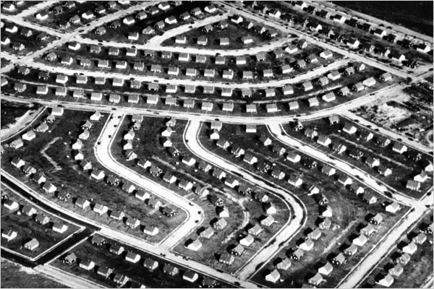
Levittown

Slide 25
The 1950s: Suburbs
Suburbs changed American life
  Suburbs increased need for cars & highways
  Churches, schools, grocery stores, shopping centers were built to service the suburbs
  Migration to suburbs was mostly by white families; “White flight” to the suburbs left African Americans in urban areas
Notes:
Returning soldiers, housing shortage, baby boom
Levittville
Suburban shopping centers
GI Bill of Rights (?)

Slide 26
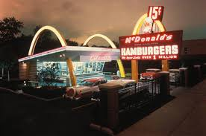
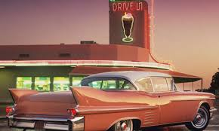
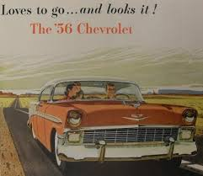
Automobile Culture
Automania
  Interstate Highway System Act- 1956- authorized the building of a nationwide highway network
  What are some effects of the increased use of cars?

Slide 27
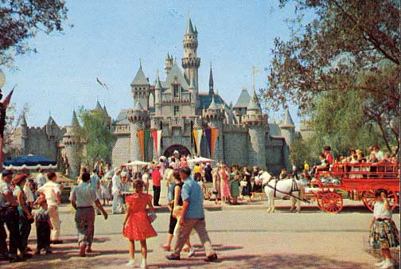
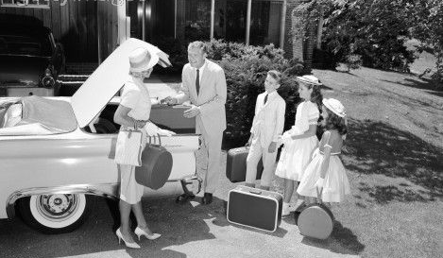
“Automania” transformed America
Americans were more mobile, took long-distance vacations, lived further from their jobs

Slide 28
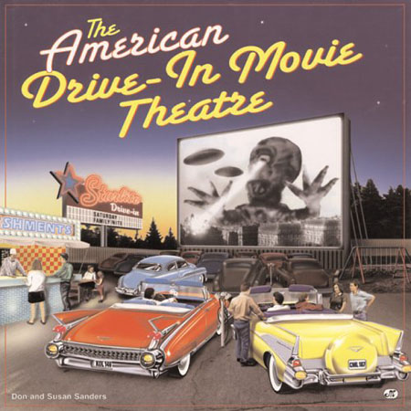
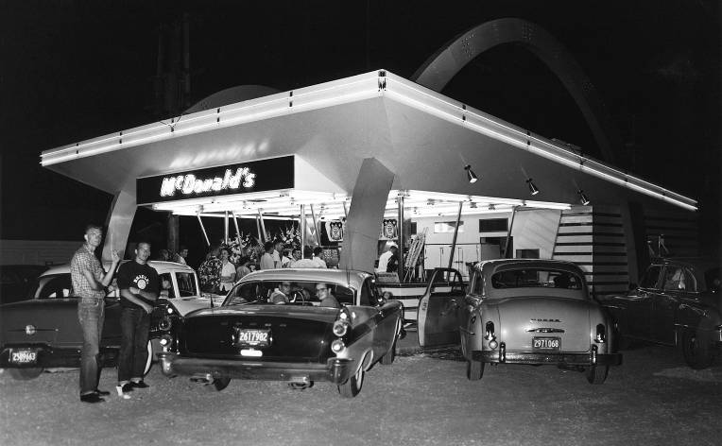
“Automania” transformed America
Drive-thru restaurants &
drive-in movies

Slide 29
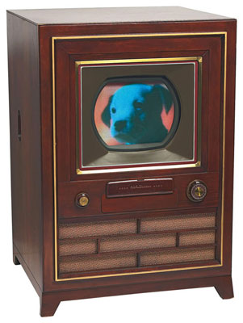
Television
1957- 40 million+ televisions were in use in the US
TV quickly became Americans’ primary means of receiving information

Slide 30
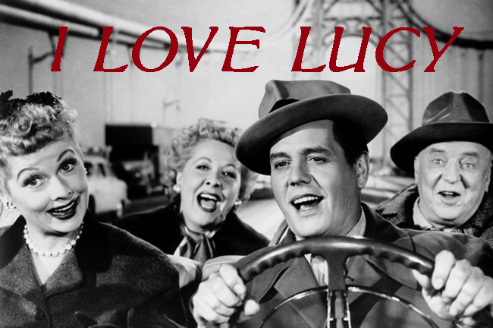
“I Love Lucy”

Slide 31
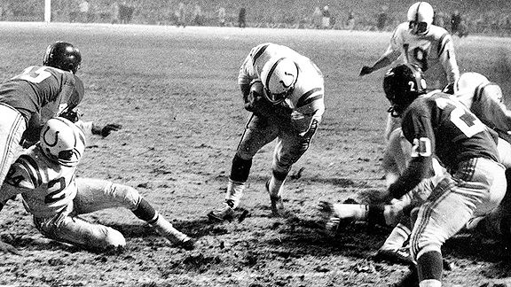
Live Sporting Events

Slide 32
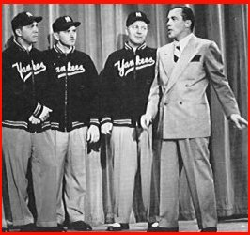
Variety Shows

Slide 33
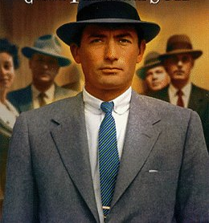
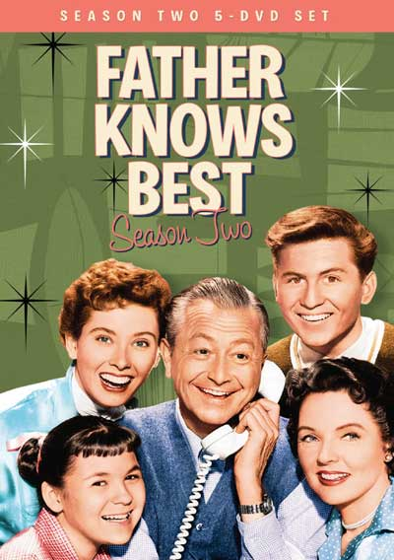
Conformity
TV, movies, & advertising in the 1950s promoted conformity & stereotypes
The “ideal man” was provider & boss of the house
Notes:
Ideal man? Ideal woman? Family expectations? Social expectations? Keeping up with the Joneses? White America?

Slide 34
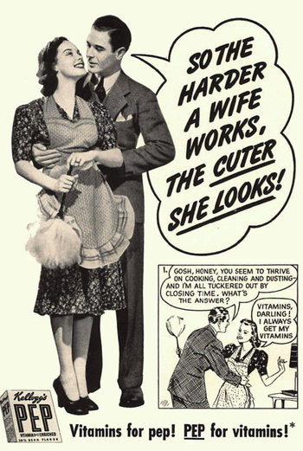
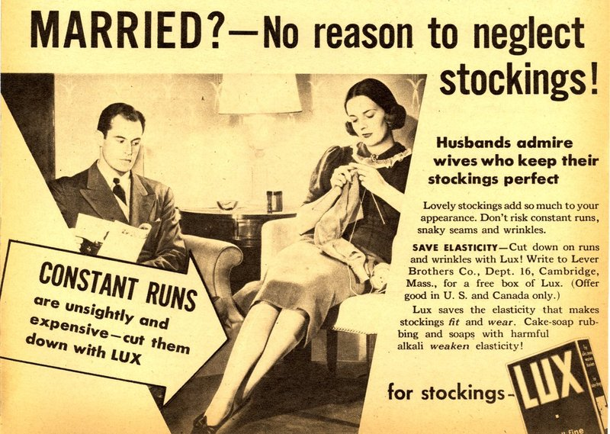
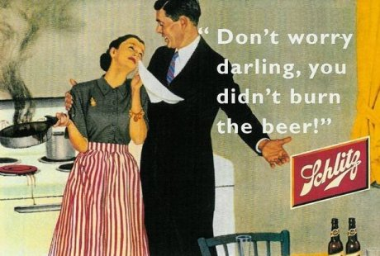
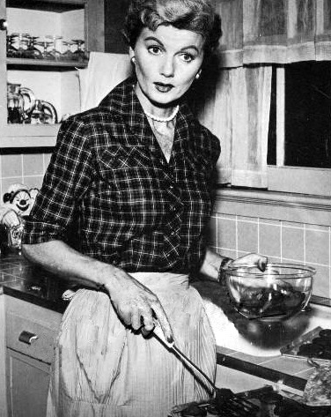
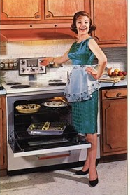
The 1950s: Conformity
TV, movies, & advertising in the 1950s promoted conformity & stereotypes
The “ideal woman” was a housewife & mother
Notes:
Ideal man? Ideal woman? Family expectations? Social expectations? Keeping up with the Joneses? White America?

Slide 35
The 1950s: Popular Culture
Music changed in the 1950s:
  “Doo-wop” music dominated the early 1950s, but was challenged in popularity by rock n’ roll
  Rock ‘n’ roll music was inspired by black artists, but Elvis Presley made it popular among the youth
  Rock scared parents who thought the fast beats were immoral

Slide 36
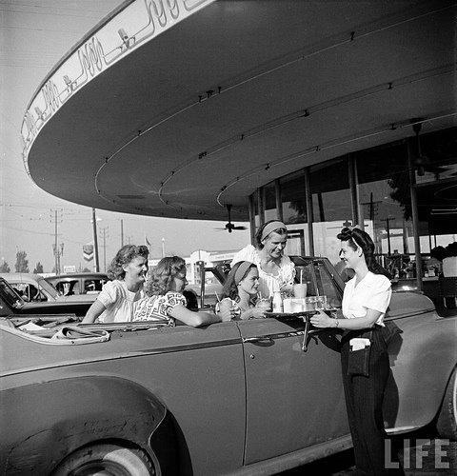
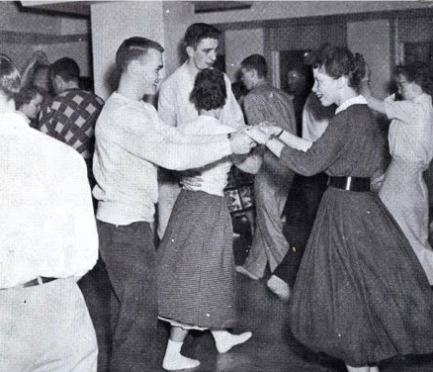

Teenagers were an important force in the 1950s
Suburban teens had leisure time &
money to spend
Notes:
Businesses targeted teenagers, selling billions of dollars of “cool” consumer goods
Music & movies were made specifically for teens

Slide 37
Summary
Consumerism makes a return to American society
Notable changes: suburbs, automobiles, television, music, popular culture
Family changes: men and women defined roles, teenagers.

Slide 38
In-Class
Use the following links to answer the questions. Please include these in your notes; we will go over at the end of class.
http://www.pbs.org/fmc/segments/progseg9.htm
  What did returning veterans want for their families?
  What social values facilitated suburban development after WWII?
https://edsitement.neh.gov/sites/edsitement.neh.gov/files/worksheets/suburbia-worksheet.pdf
  How does the central city population change from 1950- 1970?
  How does the suburban population change?
http://www.autolife.umd.umich.edu/Gender/Walsh/G_Overview3.htm
  How did family life change?
  What was liberating about the new suburban region?

