Slide 1
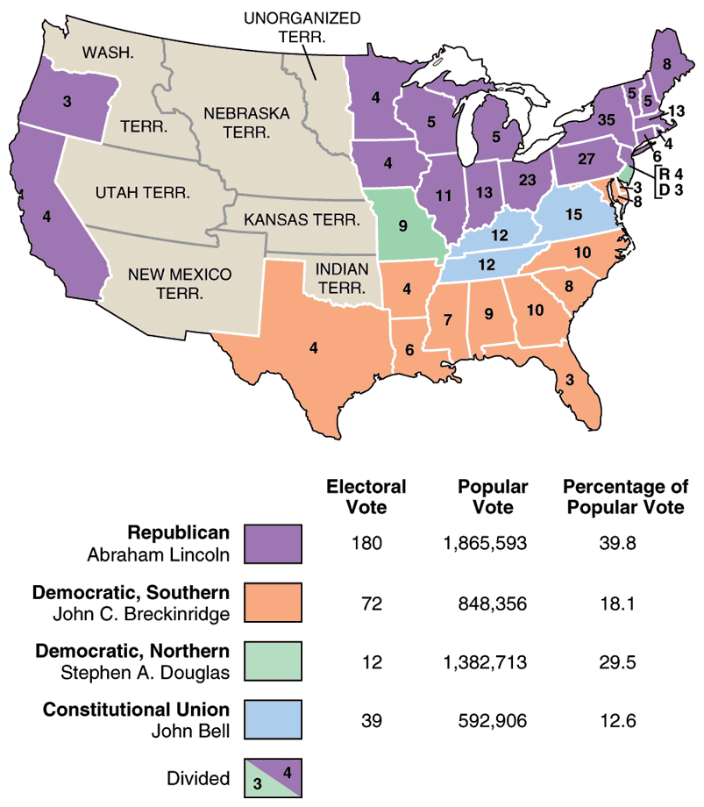
1860
Election
Results

Slide 2
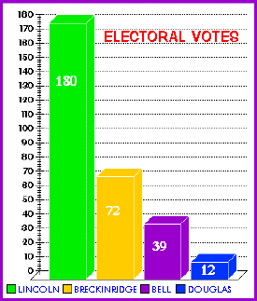

Slide 3
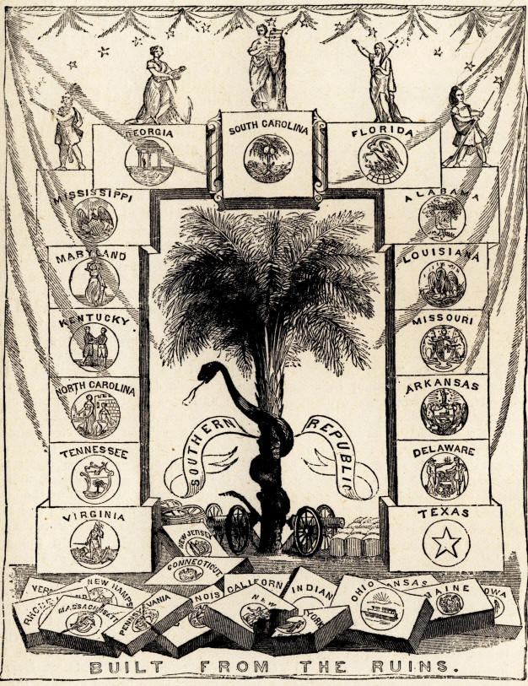

Slide 4
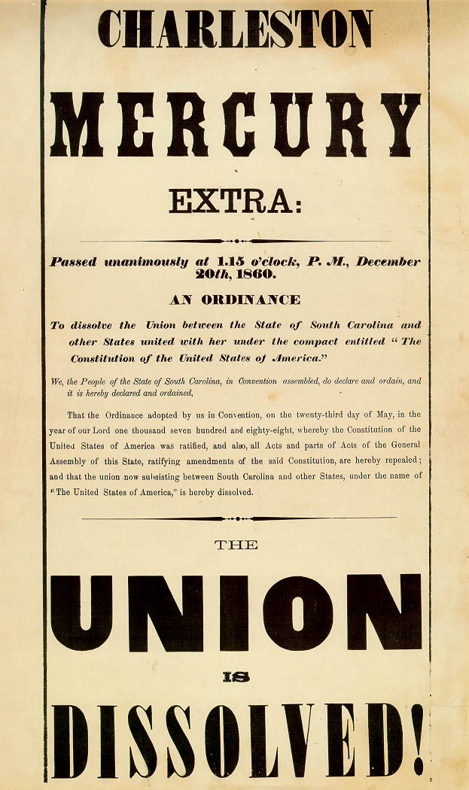
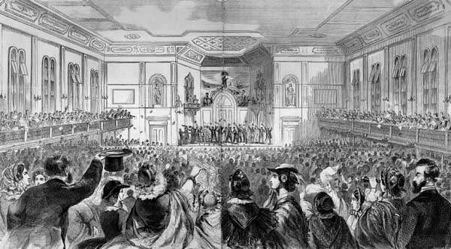

Slide 5
Discussion of secession preceded the election in SC
“slavery… is doomed to a war of extermination.”
“without firing a gun, without drawing a sword, should [anyone] draw a sword on us we could bring the whole world to our feet… What should happen if no cotton was furnished for three years? .. England would topple headlong and carry the whole civilized world with her, save the south. No, you dare not make war on cotton. … Cotton is king. - Sen Hammond (SC)
SC, Miss., Fl, Al, GA, LA, and TX seceded in December – February)
8 border states did not secede!
Unionists ignored!
“I am one of those dull creatures that cannot see the good of secession” – Lee (1860)
“South Carolina is too small for a republic and too large for an insane asylum” – SC secession debate

Slide 6
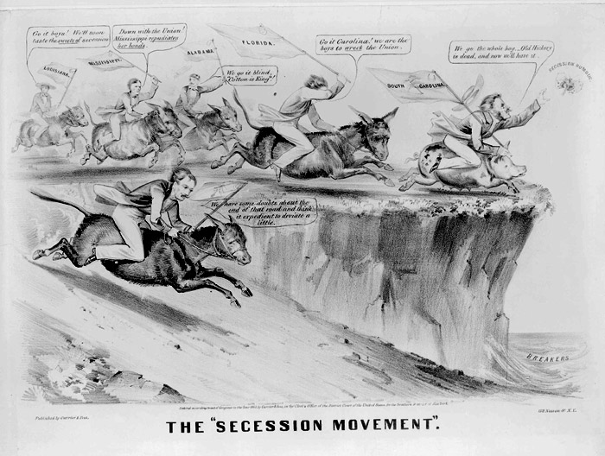

Slide 8
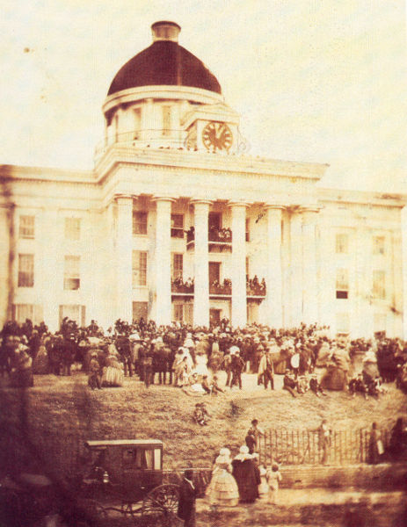
CSA – February
Constitution
Similar to US constitution but strong support of states’ rights and made abolition practically impossible.
Commitment to individual rights
J. Davis, president – ‘secession “illustrates the American idea that government rest on the consent of the governed.

Slide 9
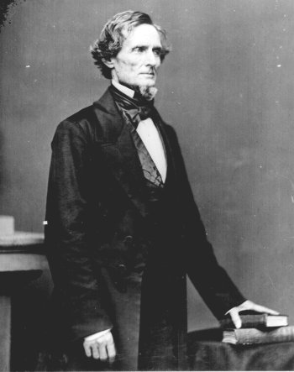

Slide 10
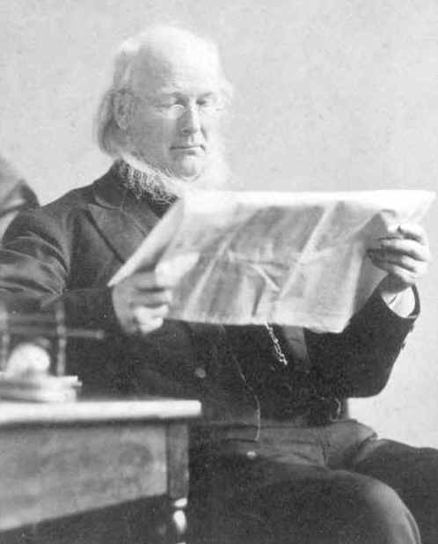
In the North…
Horace Greeley” erring sisters go in peace”

Slide 11
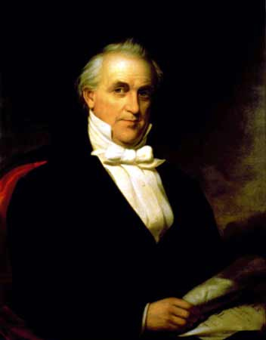
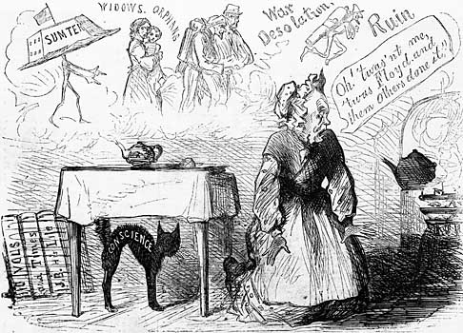
Buchanan: claimed he had no power to act and did nothing

Slide 12
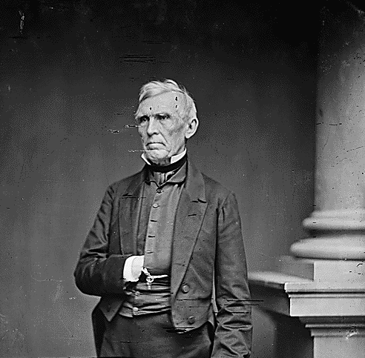
Crittenden Compromise:
Constitutional amendment to prohibit central government from interfering with slavery , established MO compromise line, repeal of personal liberty laws, expansion in Caribbean

Slide 13
Lincoln Waited… hoping for unionist support in the south
“…the necessity of proving that popular government is not an absurdity. We must settle this question now, whether in a free government the minority have the right to break up the government whenever they choose.” - Lincoln
“Now we are told.. The government shall be broken up, unless we surrender to those we have beaten… If we surrender, it is the end of us… They will repeat the experiment upon us ad libitum. A year will not pass, till we shall have to take Cuba as a condition upon which they will stay in the Union.” - Lincoln

Slide 14
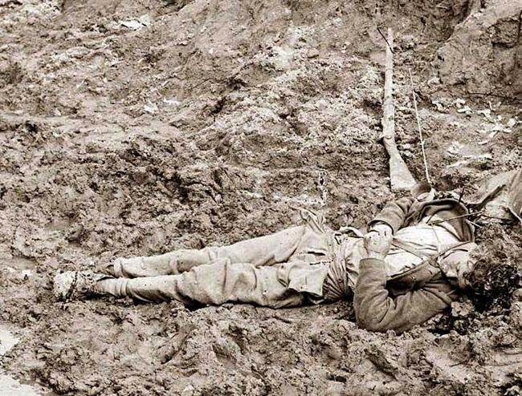
And the war came.
Casualties – no American war more deadly
Over 600K lost (WWII = 400K, Vietnam = 58K)
Equivalent total today would be 6 million!
1/11 men of fighting age lost; in the south ¼
At Antietam 24K casualties in one day – bloodiest day in US history ( a number = to entire casualty list of Am. Rev.

Slide 15
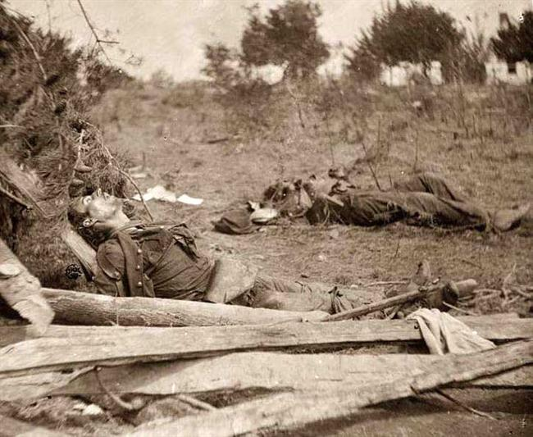

Slide 16
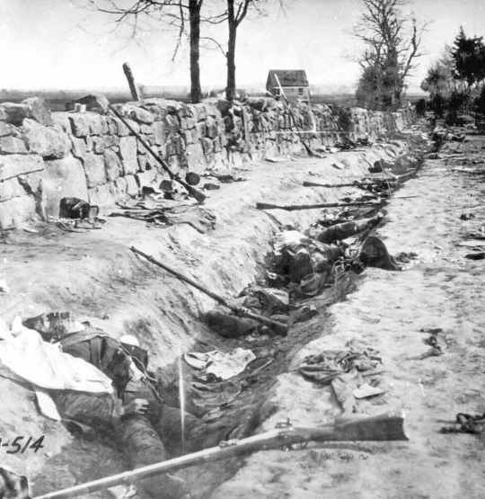

Slide 17
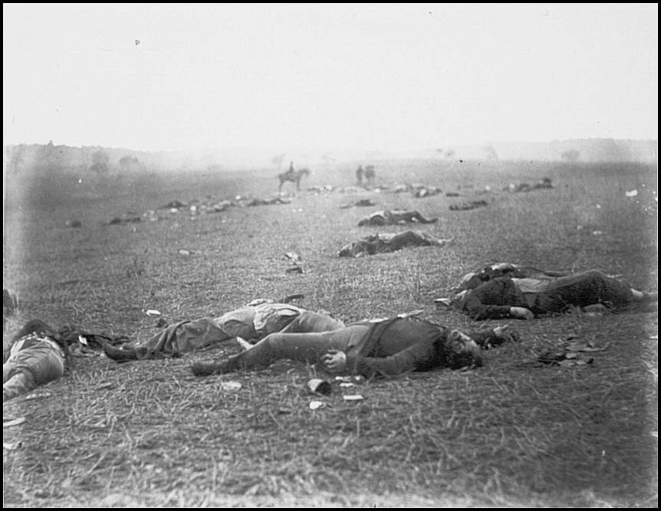

Slide 18
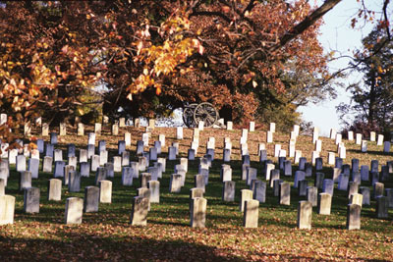
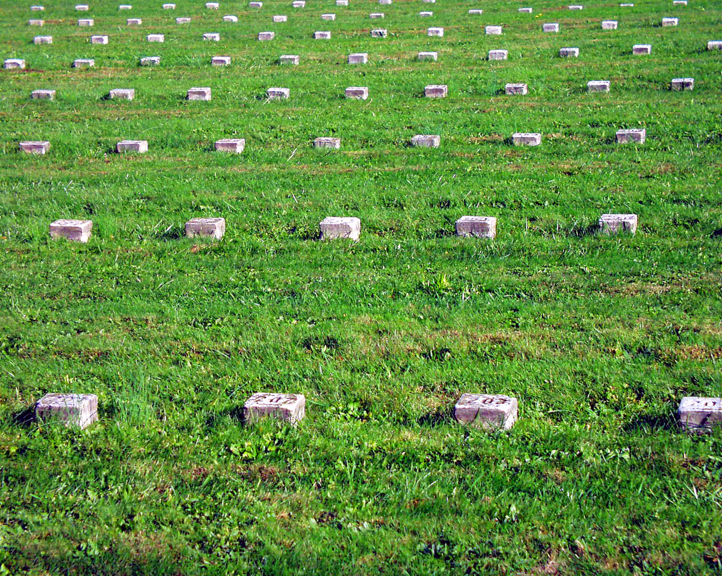

Slide 19
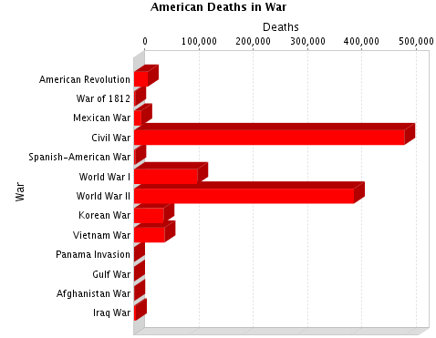

Slide 20
Why so bloody?
Rifled barrels not smooth bores
Belief in massed infantry offensives ( Picket’s Charge and Fredericksburg)
Medical ignorance
gangrene
Disease and exposure
Smallpox, dysentery, typhus, pneumonia

Slide 21
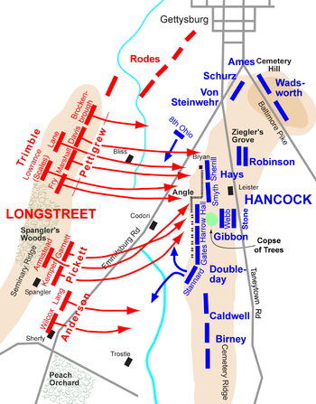
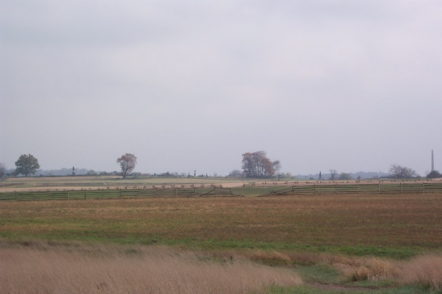

Slide 22
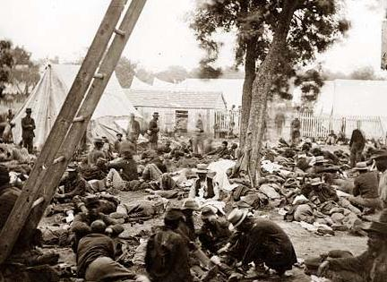
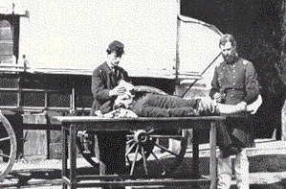
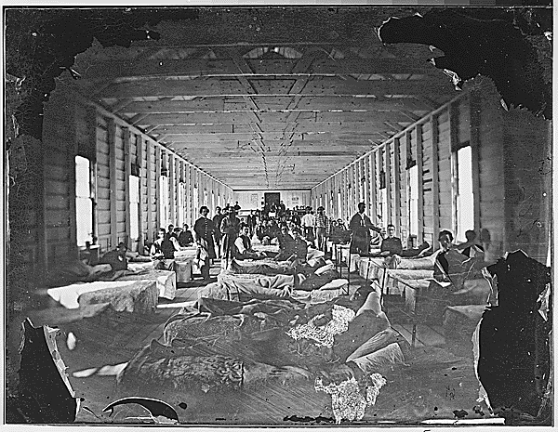

Slide 23
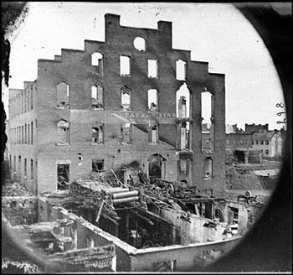
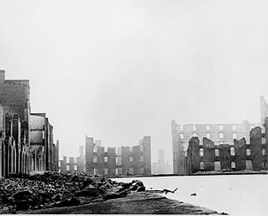
A southern gotterdamerung or holocaust
Property values fell from 4 to 2 billion
Cotton production fell from 4M to 300,000 bales a year,
Southern wealth as a percentage of nation’s wealth fell from 30% to 12%
Transportation network destroyed
Basis of economy destroyed
Only in memory did the old south remain

Slide 24
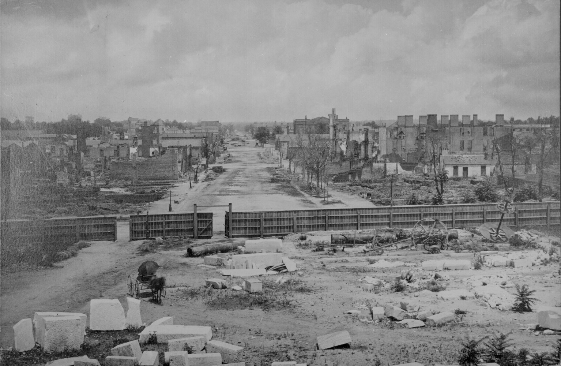

Slide 25
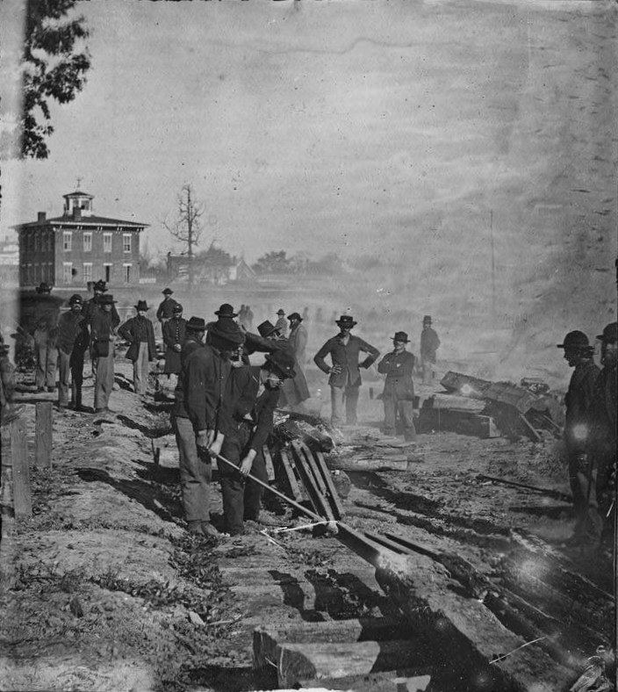
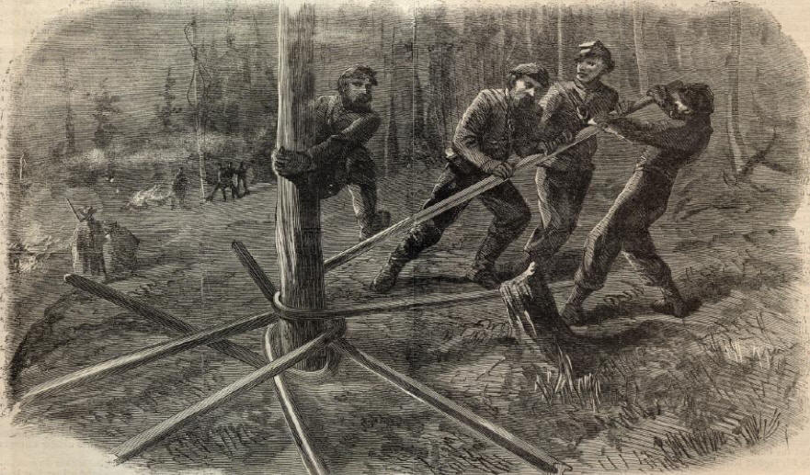

Slide 26
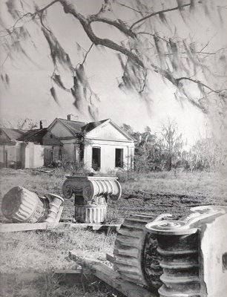

Slide 27
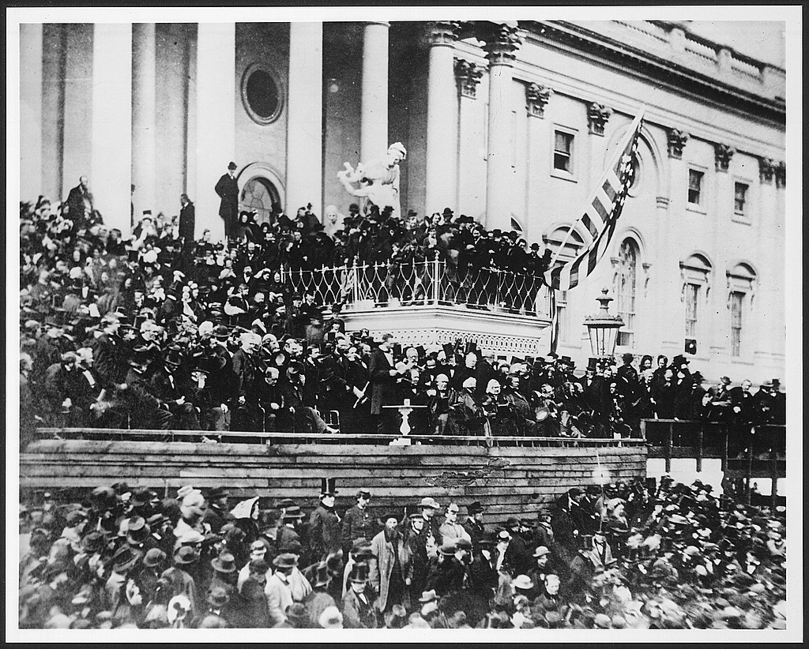
New Nationalism
US a singular noun
Lincoln first inaugural used Union 21 times, nation not at all; Gettysburg Address nation 5 times union not at all; 2nd Inaugural -one side seeking to dissolve the Union and the other preserving the nation.
Idea of secession was rejected
Survival of republicanism
No more talk of nullification until the 1950s

Slide 28
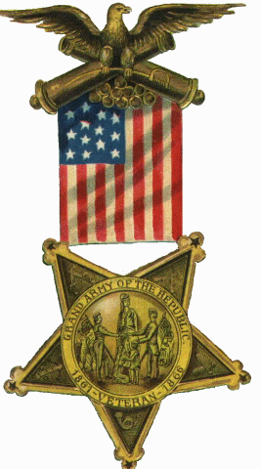
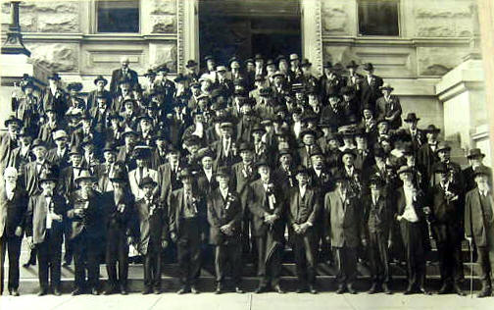
Spirit of nationalism in the north
3M men served in Grand Army of Republic became nationalists
“twenty years since I came to this country and you are the first man to call me a yankee”
Not so much in the south – rallied to the lost cause until the north accepted the southern approach to race issues and SA war

Slide 29
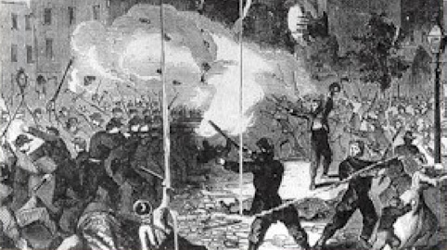
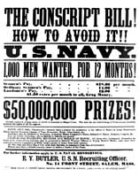
Power of the federal government
First draft in 1863 → not especially successful, many hired substitutes, draft riots in NYC in 1863
Use of greenbacks (gov’t paper money)
Brief experiment with income tax (3% on y of $800
Constitutional amendments
11 of first 12 limited federal government – 6 of next 7 increased power
Denied right to property (13th)
Obligated states to guarantee rights
First social welfare agency – the freedmen’s bureau

Slide 30
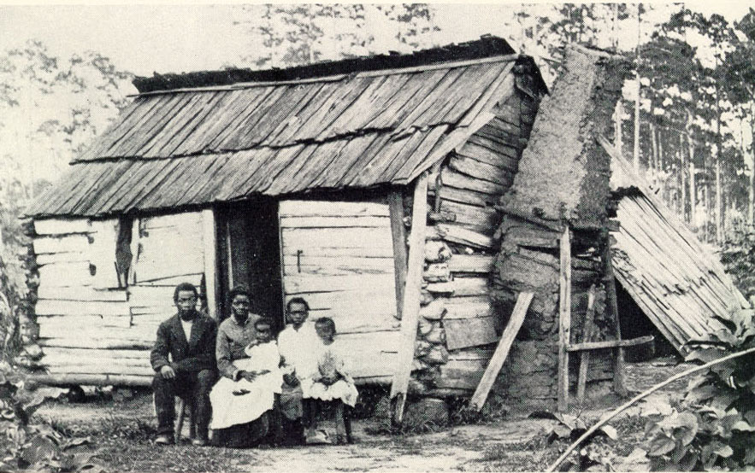

Slide 31
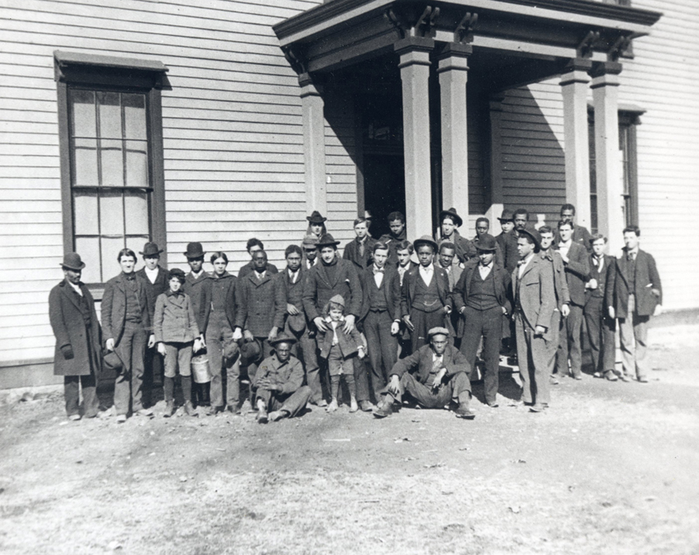

Slide 32
Power of the Presidency Increased
Raised an army (violation of 1-8), borrowed money and established a blockade without congressional support
Emancipated slaves without congressional consent
Suspended habeas corpus (csa sympathizers imprisoned without trial – Taney ignored
Ohio peace democrat running for governor was banished by a court martial even though courts open)

Slide 33
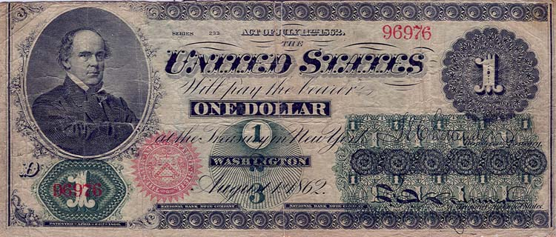
Expansion of American Industry (republican ideal)
Morrill tariff
Transcontinental railroad proposed on northern route
National Banking system – banks that issued paper money backed by US bonds was okay other would be taxed.
New scale of industry – beginnings of industries not factories – railroads similar in scale to armies.

Slide 34
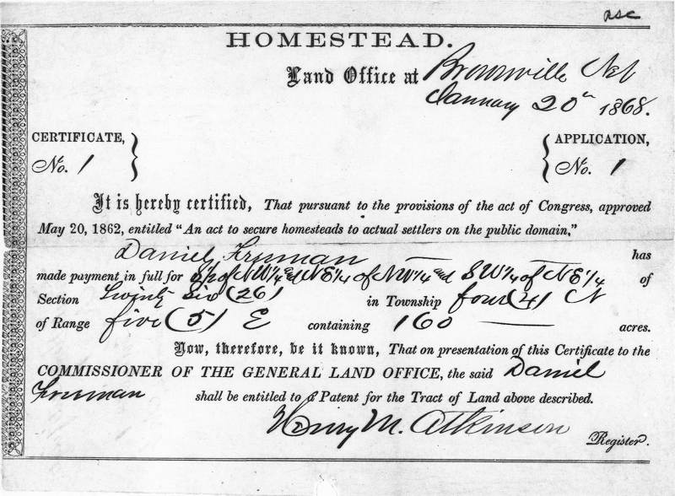
Westward movement supported
Homestead Act 1862 – 160 acres of free land
Support of railroad

Slide 35
Party Politics
Democrats associated with south and appeasement
No southern support for republicans
Blacks solid republicans; Douglass “Lincoln… was not our man… he was a white man in his interests and prejudices… yet one whom I could love, honor and trust”
Between 18 and 1860 only 2 whig presidents; between 1860 and 1912 only 2 democrats ( Cleveland and Johnson - and one was from the union party)

Slide 36
A new birth of freedom
no longer was freedom a negative freedom from restraint. Lincoln believed in positive steps to enable greater opportunities for all
Douglas = pop. Sov. Lincoln = emancipation
Lincoln looked to Declaration of Independence as founding document not constitution. A higher law.
“a practical and triumphant refutation of the lying sophists who maintain that without kings and aristocrats civilized communities cannot exist.”
Slavery abolished in Cuba and Brazil
US = “bright luminary of the western hemisphere whose radiance will light the hole world to freedom.” - Tocqueville

Slide 37
Homework: Test Friday! Chapters 17 - 21
Warm-Up: Frederick Douglass claimed that Lincoln tailored his positions on race and slavery for political effect. Consider this while answering the following questions.
What was Lincoln’s position on emancipation in 1861? Why did he take this position? What specific steps did he take regarding slaves before 1862?
Why did Lincoln call for limited emancipation in 1862?

Slide 38
Impact on slavery
“my goal is to save the Union and is not either to save or destroy slavery” – Lincoln
Need to hang on to border states and support of more conservative people in the north
Lincoln’s ambivalence about race
Original plan to fight a limited war – blockade, limited battles and wait
If war had ended early no emancipation

Slide 39
But
Summer 1861 confiscation act – slaves used to aid rebel war effort would be freed but generals who freed all who were owned by those helping rebels was condemned.
1862 slavery in DC and the territories abolished.

Slide 40
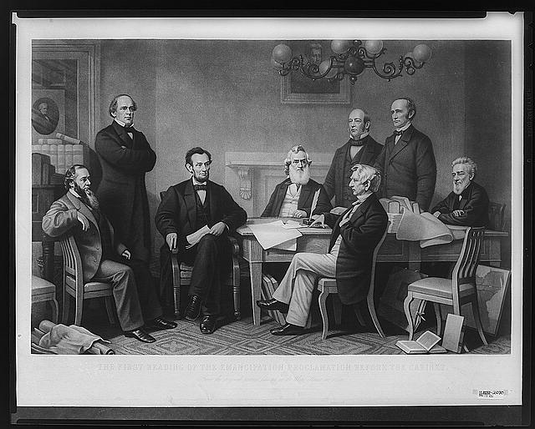
9 -23 – 63 preliminary emancipation act after battle of Antietam to go in effect 1 – 1 – 63
Only slaves in areas actively resisting - no slaves freed

Slide 41
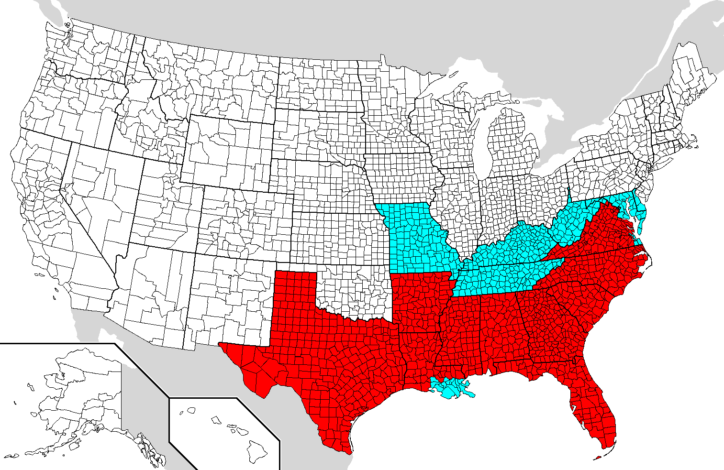

Slide 42
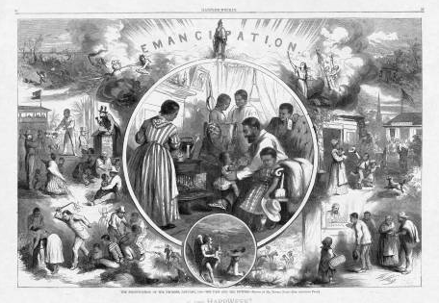

Slide 44
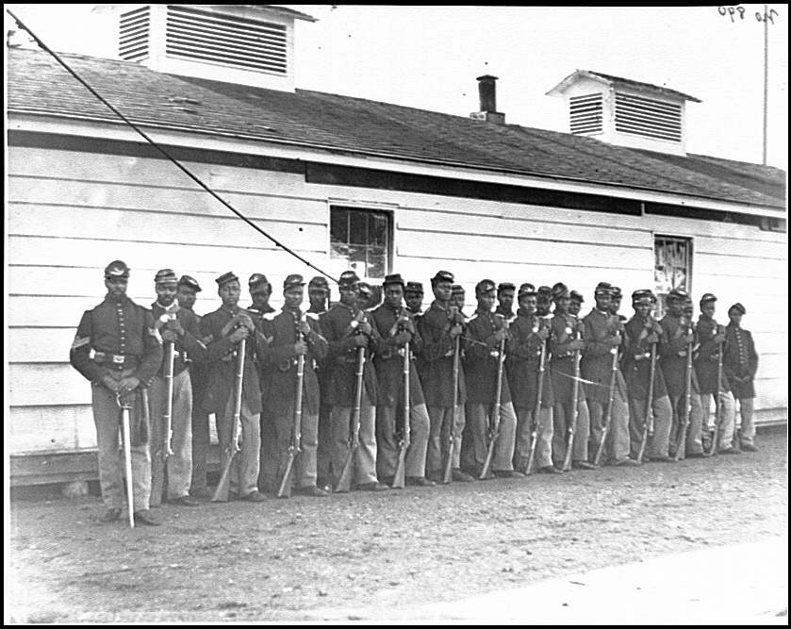
Sold as a total war measure – gain support of radicals, gain support of blacks to serve in the military (10%)
in spite of tremendous discrimination
Nathaniel Bedford Forrest and “fugitives”
Note change in thinking also influenced military strategy

Slide 46
1864 – emancipation became a precondition for surrender.
13th Amendment December 1865

Slide 47
In the beauty of the lilies Christ was born across the sea, With a glory in His bosom that transfigures you and me: As He died to make men holy, let us die to make men free, While God is marching on.
That the war to preserve the Union had become a godly crusade to end slavery, -- one in which soldiers would “die to make men free” -- seemed logical and even providential by 1865. Yet it was an outcome that few in either the North or South would have predicted at the onset of hostilities. Before the war, the vast majority of white Christians in both sections opposed emancipation. A few years into hostilities, the improbable had become the inevitable: Abolition, a once-despised cause now justified the costliest of American wars.
A growing sense that the redemption of the US required freedom.

