Slide 1
Warm Up 2/27
Answer the following questions the best you can:
What is nationalism? (If you don’t know, take a guess!)
How can imperialism lead to this nationalism?
What can lead to nations forming “alliances” with each other?

Slide 2
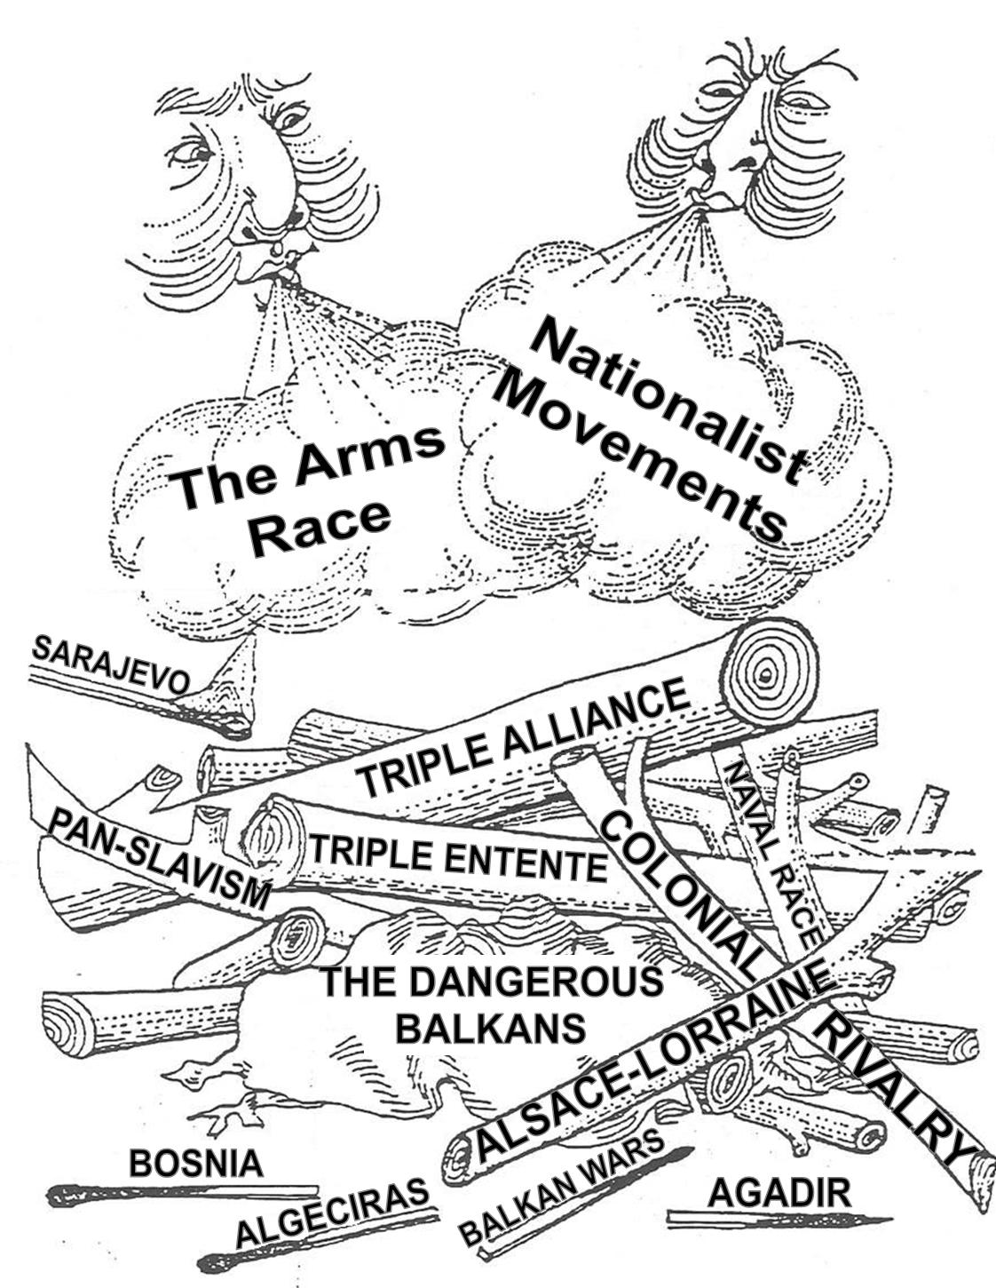
Causes of WWI
MAIN

Slide 3
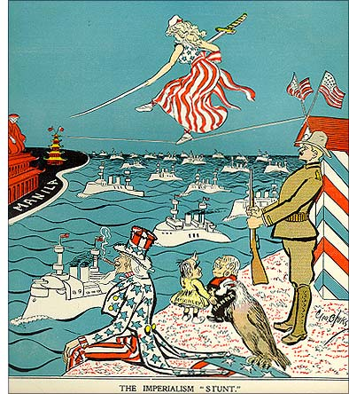
Imperialism
When a country takes over new lands or countries and makes them subject to their rule.

Slide 4
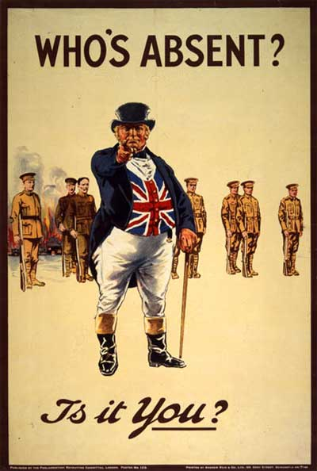
Militarism
means that the army and other military forces are given high priority by the government.
Building up the military and gathering arms/weapons

Slide 5
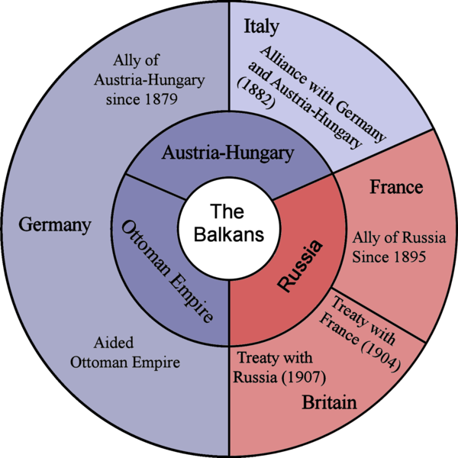
Alliance
- agreement made between two or more countries to give each other help if needed.

Slide 6
Nationalism
A feeling of intense loyalty to one’s own country/group
Encouraged new nations to unify and establish power
Encouraged certain groups of people to break away from existing nations and create their own country (ethnic groups)

Slide 7
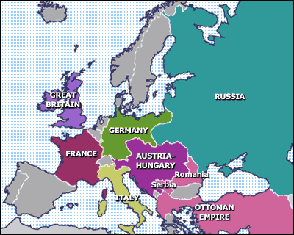
Tensions in the Balkans
Russia & Austria-Hungary wanted to control the Balkans
Austria-Hungary wanted to stamp out growing Slav nationalism
Russia saw themselves as protector of the Slavs
1908: Austria-Hungary annexed Bosnia

Slide 8
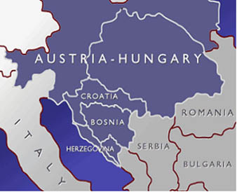
Reactions to the annexation
Bosnians angry: wanted freedom from Austria-Hungary to form a strong Slav state with Serbia
Serbians concerned about Austria-Hungary’s aggression

Slide 9
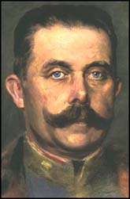
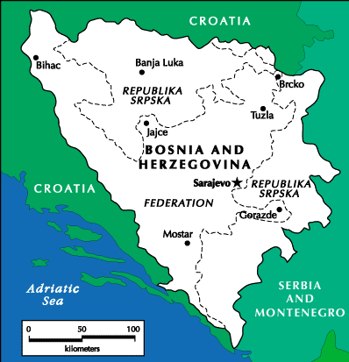
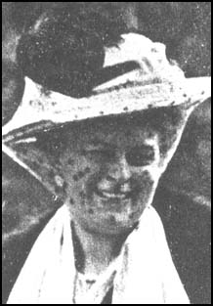
Archduke Franz Ferdinand fact file
Heir to the Austro-Hungarian throne
Unpopular due to his marriage to Sophie
Visited Sarajevo in 1914 in an attempt to improve relations between the monarchy and the Bosnian people

Slide 10
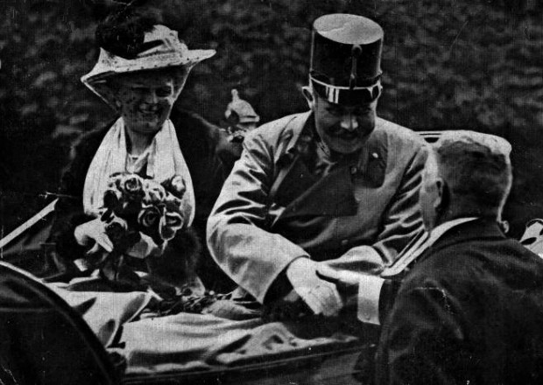
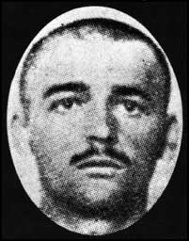
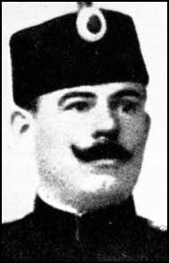
28th June 1914
Ferdinand, future Emperor of Austria-Hungary, and his wife are assassinated

Slide 11
The Point of No Return: The Assassination of Archduke Franz Ferdinand
Austria blamed Serbia for Ferdinand’s death and declared war on Serbia.
Germany pledged their support for Austria -Hungary.
Russia pledged their support for Serbia.

Slide 12
The Point of No Return: The Assassination of Archduke Franz Ferdinand
Germany declares war on Russia.
France pledges their support for Russia.
Germany declares war on France.
Germany invades Belgium on the way to France.
Great Britain supports Belgium and declares war on Germany.

Slide 13
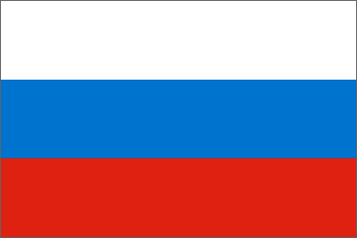
Allied Powers:
Central Powers:
Germany
Great Britain
World War I
France
Austria-Hungary
Russia
Ottoman Empire
Italy

Slide 14
American Isolationism
Motives for Isolationism
Tradition of Neutrality in European Affairs
War = Expensive
War was Uncivilized & Un-democratic
Ethnic Diversity
Large Irish & German Populations
Pacifist Movement
Women
Socialists

Slide 15
U.S. Entry into World War I
Cause #1: Heavy Trade w/ Allies

Slide 16
Cause #2: Freedom of the Seas
Un-restricted Submarine Warfare
Sinking of the Lusitania

Slide 17
Cause #3: The Zimmerman Note
January 1917: Telegram from Germany to Mexico intercepted by British
Revealed Germany would support Mexican claims to re-gain American Southwest if Mexico allied w/ Germany

Slide 18
Activity/Homework (Due by Wednesday 3/1)
Given the differing views/events surrounding the U.S. and WW1, write a brief, ½-1 page editorial that expresses the view on whether or not the U.S. should/should not join the war. Use the notes/events sheet to back up your claims
Academic: Why the U.S. SHOULD join.
Honors: Why the U.S. should NOT join/stay neutral.

