Slide 1
Warm -Up Answers
1. True
2. True
3. False: 1799 in Cabarrus County, NC was the first Gold “Strike” in North America.
4. False: Cholera
5. False: Railroad
6. True
7. True
8. False: 8-10 days

Slide 2
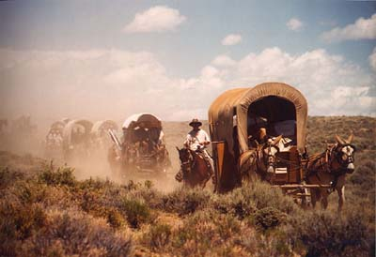
Westward Expansion: Moving West

Slide 3
Why did people move west after the Civil War?
In the East, farmland was expensive
Poor people could not buy their own land
Sharecropping was how many poor whites and ex-slaves had to farm
Chance to begin anew was enticing
The west was “wide open” – Overcrowding occurring in the East
Gold and silver was discovered – many left seeking fortune.

Slide 4
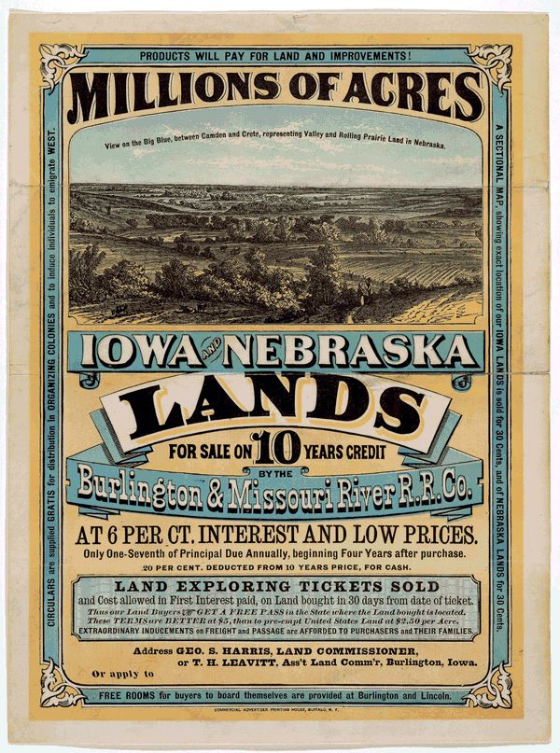
Homestead Act
Law signed by Lincoln in 1862
For a small fee, a person could obtain 160 acres of land out west
Some rules applied:
At least 21 years old or head of a family
American citizen or immigrant filing for citizenship
Build house a minimum size (12 feet by 14 feet)
Live in house 6 months out of year
Farm land 5 yrs in a row before ownership set

Slide 5
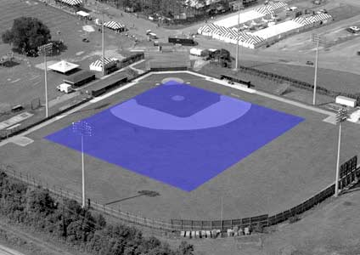
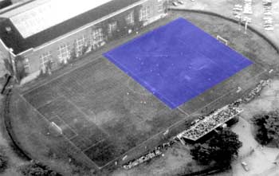
In the photos above, the blue square represents one acre.

Slide 6
Manifest Destiny
Belief that the fate of the settlers was to grow and become powerful regardless of who or what was in their way
Americans, stirred by their hunger for land and the ideology of “Manifest Destiny,” flocked to the new frontiers, seeking to build in the image of the U.S.A.
Belief in cultural and racial superiority led to conflicts with Native Americans, Hispanics.

Slide 7
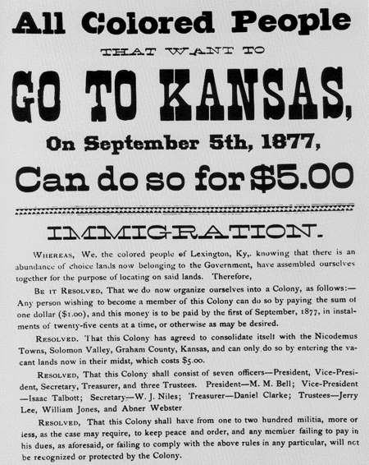
Thousands of African-Americans moved west in 1879 in an effort to find land/work, escape racism, etc.
This was known as the “Exodus of 1879”, and the participants were called “Exodusters”.

Slide 8
Transcontinental Railroad
Before the 1850's, most people traveled westward by wagon and/or horseback.
The Pacific Railroad Act of 1862 authorized a transcontinental rail line
The Union Pacific Railroad built their railroad westward from Omaha, Nebraska, and the Central Pacific Railroad built it eastward from Sacramento, California.
These two lines met at Promontory, Utah, in 1869. On May 10, to mark the achievement, officials of the two railroads drove silver and gold spikes to join the rails.
This feat made possible coast-to-coast travel in 8 to 10 days.

Slide 9
Immigrant Workers
· Labor was scarce due to the hard, dangerous work and low pay.
Central Pacific – workforce was primarily Chinese immigrants
· Therefore, immigrant labor was used.
http://unctv.pbslearningmedia.org/resource/akh10.socst.ush.now.westexpans/westward-expansion-18601890/
Union Pacific – workforce consisted of Civil War veterans and Irish immigrants

Slide 10
Transcontinental Railroad Impact
Before the railroad, it took almost 6 months and cost $1000 to travel from New York to California.
After the transcontinental railroad was completed, it cost $150 and took about one week!
Within 10 years of the transcontinental railroad’s competition, it was already shipping $50 million worth of freight from coast to coast every year.

Slide 11
Communication
During the early days of the frontier, a letter took months to travel from the Midwest to California. But several developments soon made communication much faster:
In April 1860, a mail service called the pony express began carrying mail between St. Joseph, Missouri, and Sacramento. The service's horseback riders usually made their long journey in about 10 days.

Slide 12
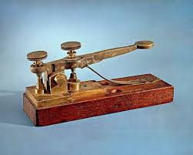
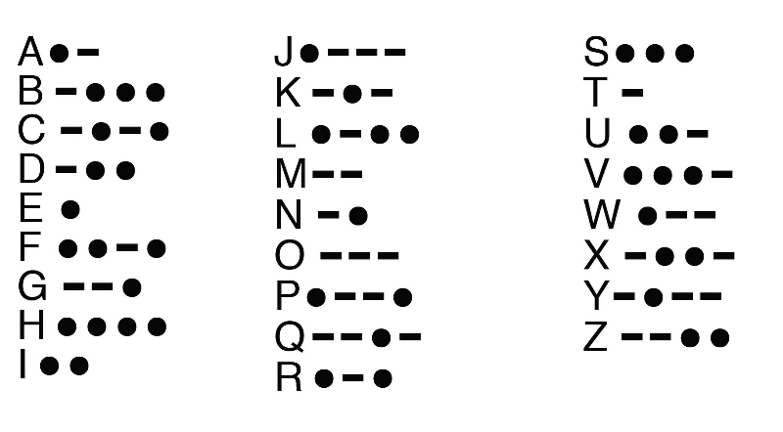
Telegraph
This instrument, the first used to send messages by means of wires and electric current, could transmit messages in minutes.
A transcontinental telegraph service was established in 1861.
The telegraph would be a primary source of communication until it was replaced by the telephone later in the 19th century.
https://en.wikipedia.org/wiki/File:A_through_Z_in_Morse_code.ogg

Slide 13
Do you know Morse Code?
What does this message say?
.. ..-. -.-- --- ..- ·----· .-. . .-. . .- -.. .. -. --. - .... .. ... --··-- ... - .- - . -... . .- - -.. ..- -.- . --- -. -- --- -. -.. .- -.--

Slide 14
Warm-Up: Day 2
Quietly begin working on the warm-up on your desk when you are seated.
Use pages 122 and 219-296 in your textbook to find answers to the questions on the front; the map is on the back.
You may use colored pencils or regular pen/pencil.

Slide 16
Impact on the American Indians
As more settlers moved father west:
They took more Native American land and created conflict with the Native American tribes.
The United States government exercised its power to make treaties and forced tribes to move from their ancestral lands.

Slide 17
Indian Removal Act (1830)
Policy of removing Native Americans from the states
“Voluntarily” signed removal treaties
Exchanged land in the East for land in the West
Signed under President Andrew Jackson
Led to the emigration of tens of thousands of Native Americans into the West

Slide 18
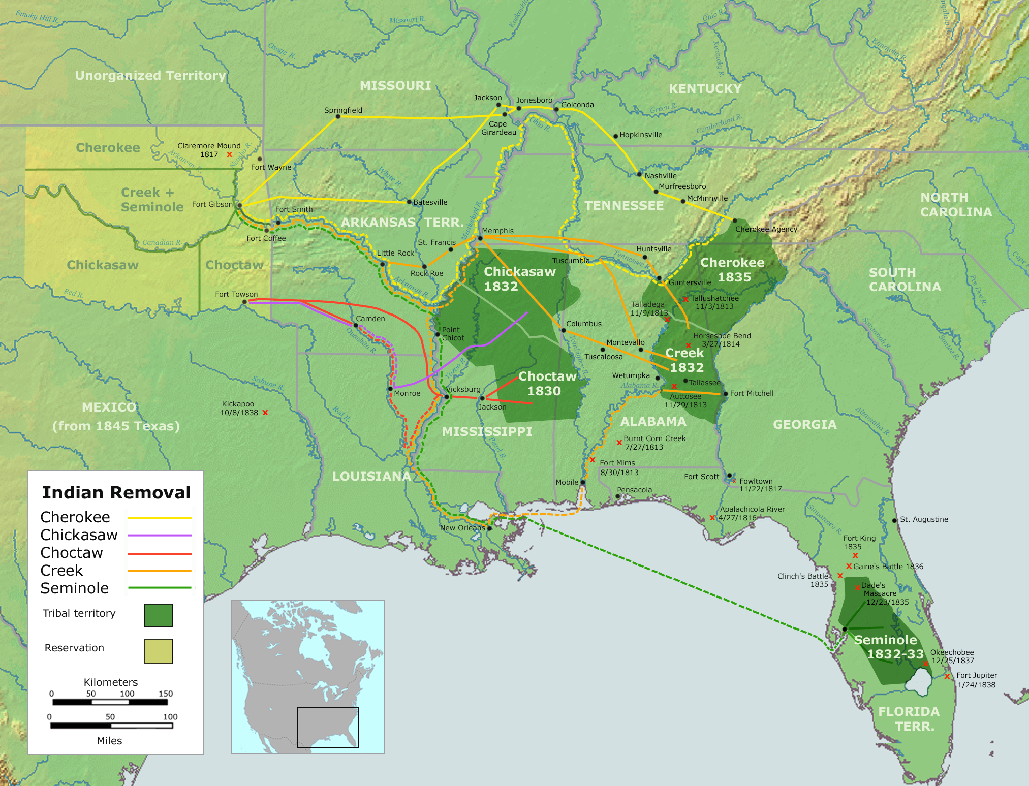
Trail of Tears
Forced relocation of the Cherokee tribe from its lands in the southeastern U.S. to Oklahoma
Georgia Gold Rush (1829) on Cherokee lands led to pressure for removal
Led to (estimated) 4,000 Indian deaths
Many died from diseases, starvation, exhaustion

Slide 19
Reservations
Indian tribes forced to reservations – land supposed to be set aside for Indians and not managed by the U.S. Government
Generally poor land, no hunting, not good for crops.
The collective geographical area of all reservations is 56,200,000 acres, approximately the size of Idaho.

Slide 20
The Buffalo
Buffalo driven to near extinction due to expansion out West
Primary food/clothing/shelter source for Native Americans on the plains.
Est. 40,000,000 Buffalo in 1830 - Down to 541 in 1889.
Aside from necessity use, sport hunting and commercial killings were main cause of deaths

Slide 21
Notable Conflicts
Sand Creek Massacre (1864) – killing of 450 Cheyenne by U.S. Soldiers
Battle of Little Big Horn (1876)- U.S. 7th Cavalry led by George Armstrong Custer wiped out by and a mixture of Sioux and Cheyenne forces
Battle of Wounded Knee (1890) – last major confrontation – death of (estimated) 150 Native Americans

Slide 22
Dawes Act (1887)
Goal: to “assimilate” Native Americans
Reservations were broken up into "allotments" that were given out to individual families.
Families were supposed to farm and build homes on their allotment to support themselves
It failed:
Much of the land was unsuitable for farming & ranching
Some refused to adopt a different way of life
Some sold their land to white settlers, but others were upset that their land was given away

Slide 23
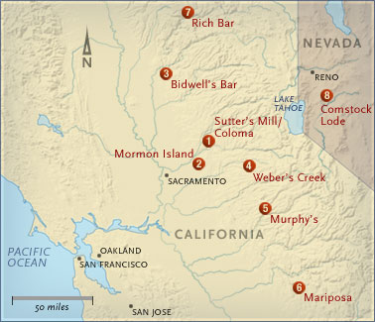
California Gold Rush
Sutter's Mill/Coloma- Jan. 24, 1848 James Marshall kicked off the California gold rush when he spotted some bits of gold in a mill raceway. Within two years, 100,000 people had flocked to California to make their fortune.
Sacramento population:
1846- 200
1852- 36,000

Slide 24
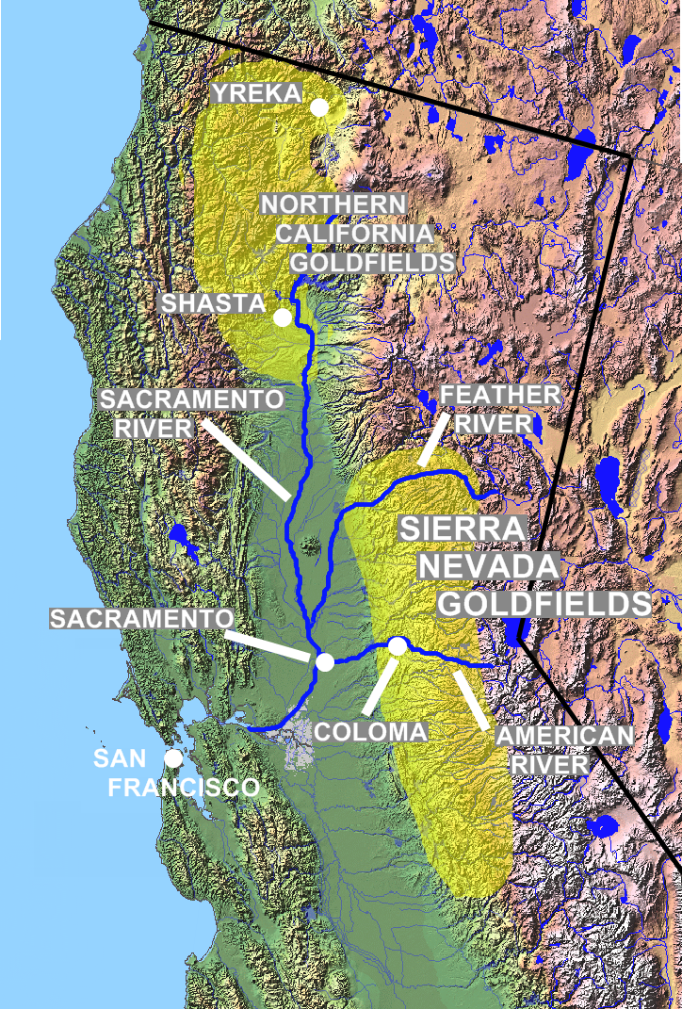
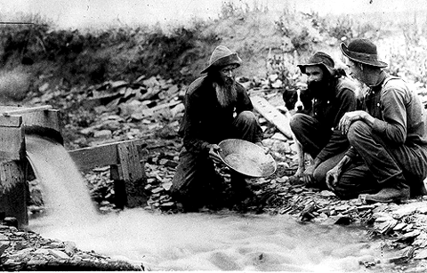
Gold and Silver Strikes
The CA Gold Rush began in 1849, attracting thousands of gold hunters known as forty-niners.

Slide 25
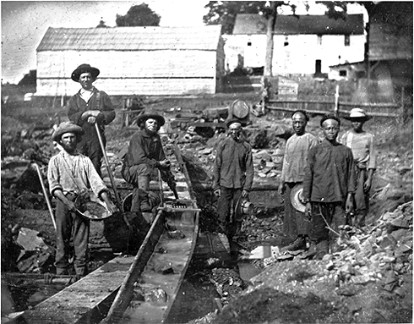
Gold and silver mines were discovered throughout the West, including Colorado, Nevada and Oregon.
Thousands of miners from the U.S., Europe, Mexico, and China flocked to the West.
White and Chinese miners hoping to strike it rich during the California Gold Rush at Auburn Ravine in 1852.

Slide 26
Frontier Thesis
Read the excerpts from Frederick Jackson Turner’s Frontier Thesis and answer the following questions. Do your best, you will be turning your answers in:
Academic
Where is the Frontier?
How does the wilderness “change” Europeans into Americans?
Where all the Frontier settlers English? Who all settled in the West?
Honors
Same questions as above, plus:
Why is the Frontier significant to the American identity?

Slide 27
Twitter Homework Assignment
In 140 characters* (or less), compose a Tweet that summarizes Turner’s image or important of the American frontier
Honors: Summarize a criticism or flaw with Turner’s explanation
*Characters include letters, spaces and punctuation

